Slide 1
Notes:
We will have a go!

Slide 2
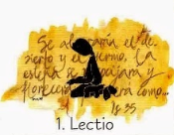
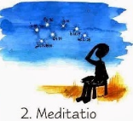
Read
Reflect
Respond
Rest

Slide 3
A reading from the Gospel according to John
Lord be on my mind, Lord be on my lips, Lord be in my heart
Jesus went up a hill and sat down with his disciples. The time for the Passover Festival was near. Jesus looked around and saw that a large crowd was coming to him, so he asked Philip, “Where can we buy enough food to feed all these people?” (He said this to test Philip; actually he already knew what he would do.) Philip answered, “For everyone to have even a little, it would take more than two hundred silver coins[a] to buy enough bread.” Another one of his disciples, Andrew, who was Simon Peter's brother, said, “There is a boy here who has five loaves of barley bread and two fish. But they will certainly not be enough for all these people.” “Make the people sit down,” Jesus told them. (There was a lot of grass there.) So all the people sat down; there were about five thousand men. Jesus took the bread, gave thanks to God, and distributed it to the people who were sitting there. He did the same with the fish, and they all had as much as they wanted.
(6:1-14)

Slide 4
Notes:
We will have a go!

Slide 5
`
Thank you God for allowing us to hear your Word and to become closer to you; may we take it and use it in our lives.

