Slide 1
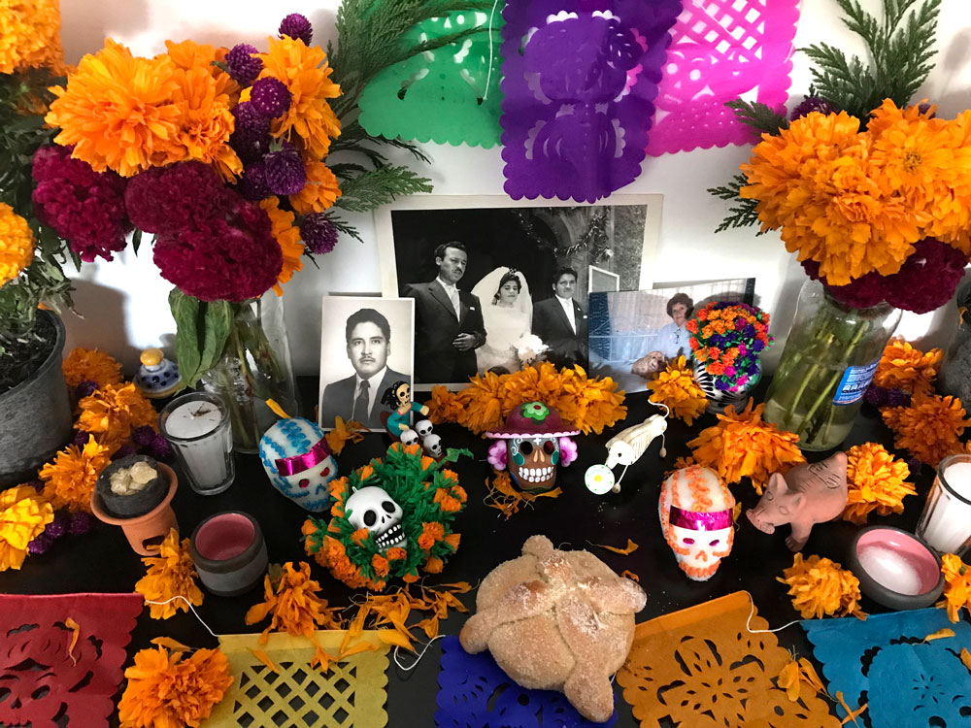
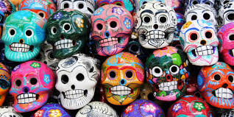
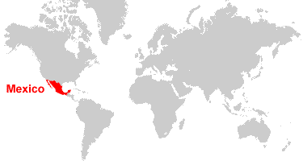
Hola Mexico!
Mexico is located in the south of the continent of North America. Mexico City is the capital of Mexico. It is home to nearly 9 million people, with a vibrant, diverse population and a rich cultural heritage. It has a diverse landscape that includes mountains, rainforests and deserts. This means that its climate is also very varied and there are a wide range of plants and animals.
Festivals and celebrations
Dia de los Muertos (Day of the Dead)
This festival takes place during the first two days of November. The 1st November is the Little Day of the Dead to remember children and babies who have died. The 2nd November is to remember and respect adults who have died. It is a positive celebration to remember loved ones who have died. Families set up bright decorated altars (ofrendas) with photographs of the deceased. Relatives place their loved ones’ favourite foods on the altars and skeleton costumes and skull decorations are popular.
Chihuahuan Desert
The Chihuahuan desert is one of the largest in North America. It covers part of Texas, New Mexico, Arizona and Mexico. Winters are cool and summers are extremely hot. There is very little rainfall but the Rio Grande River runs through the desert and provides water for the animals, plants and people who live there. The Chihuahuan desert is said to have more species of cacti than any other desert. Shrubs and Cacti, such as Morman tea, and prickly pear, are found in the desert. There are many different animals such as the pronghorn antelope and kit fox that thrive in the desert.
Music
Music and dance are essential to the culture of Mexico. One type of well known type of mariachi, which is performed by a group of musicians playing violins, trumpets, and guitars.

Slide 2
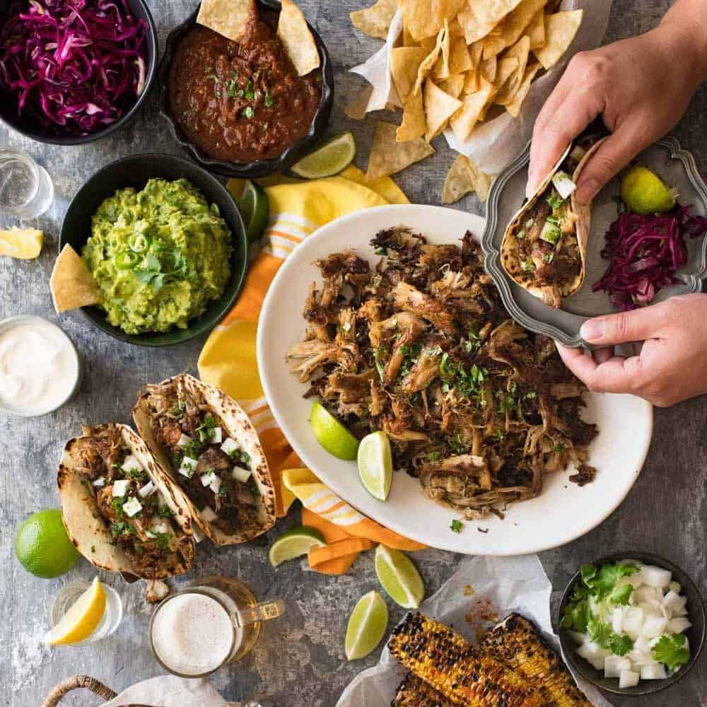
Maya-
The Maya were a group of indigenous people who lived in Mexico and other parts of Central America over 3000 years ago. The Maya were experts in farming, pottery, writing and Maths. Around 900 AD, the Maya civilisation began to decline, and the people moved into small villages, rather than staying in the great cities they had built.
Maya Calendar
The Maya created a calendar that was based on their understanding of Maths and astronomy. It was highly complex and used three different calendars to record the days, months and years.
Maya ball game
The Maya played a ball game called ulama on a large, rubber ball through a stone ring using their knees, elbows and hips. The leaders of the losing team was killed after the game.
El Castillo
El Castillo is a Maya temple in Chichen Itza. During the spring and autumn equinox, the Sun casts a shadow that slithers down the steps of the temple like a snake.
Food
Food plays an important part in Mexican culture. Many Mexican foods can be traced back thousands of years to the Aztecs of Maya and some contain flavours from other countries, including Spain. Traditional Mexican foods include chocolate, corn tortillas, avocados and beans. Popular Mexican dishes may contain a mixture of these ingredients, such as enchiladas, guacamole, or churros with chocolate.
Glossary-
Civilisation- a well organised and developed society.
Climate- the weather in a particular place over a period of time.
Culture- The lifestyle of a group of people or a society.
Diverse- Very varied or different.
Festival- a celebration or special event held to mark a particular occasion.
Heritage- Traditions, languages or buildings from the past that are important to a particular society.
Indigenous- People, plants or animals that originated in a place.
Region- a geographical area with its own unique features or characteristics.
Tradition- an activity, custom or belief that people have continued to follow for a long time.

Slide 5
Recipe
? minutes
? people
Ingredients
text | text
text | text
text | text
text | text
text | text
Method
1. text | 6. text
2. text | 7. text
3. text | 8. text
4. text | 9. text
5. text | 10. text
Notes:
To add a picture, select the box you wish to use, go to Format, Shape Fill, and select picture or texture fill, or go to the insert tab, select Pictures, and choose the picture you wish to add.

