Slide 1
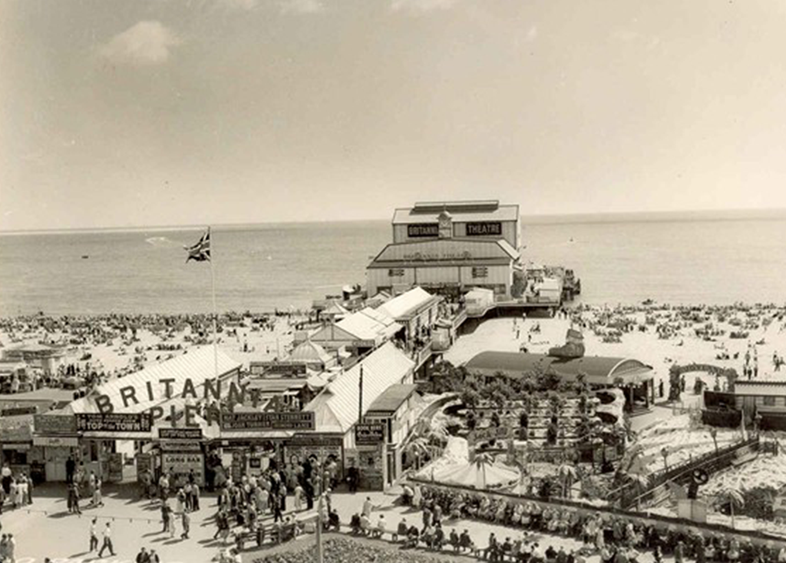
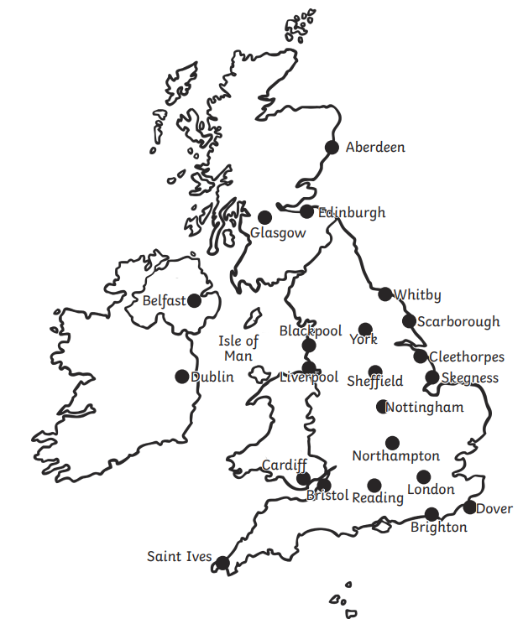
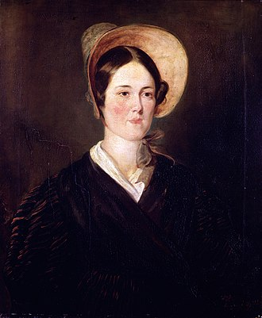
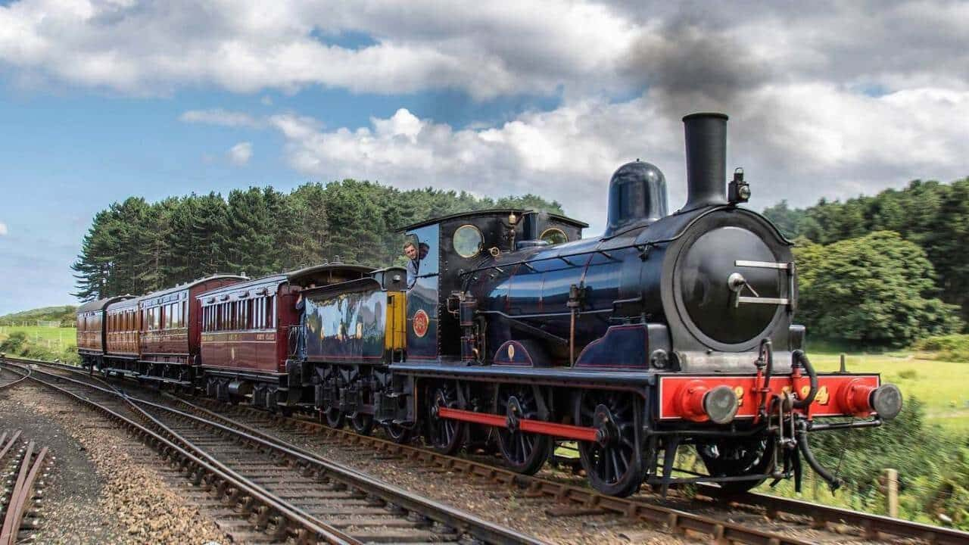
Beachcombers: History Knowledge Organiser
Coastal Resorts
People all over the world visit beaches for a holiday or a day out! Today we can go abroad on holiday.
Beaches in the past
Victorians were the first people to make going to the beach popular. They went to the beach for a holiday or day trip. They believed that going to the beach and bathing in the sea was good for your health.
N
W
E
Transport
To get to the beach people got on the train or used carriages.
Planes and boats were far too expensive.
S
Grace Darling
She lived from 1815-1842 and was the daughter of a light house keeper. She famously rescued shipwrecked sailors.

Slide 2
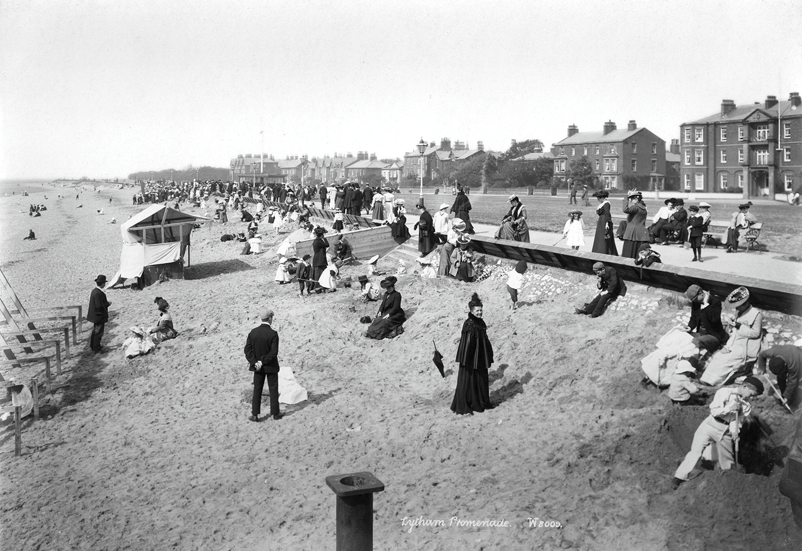
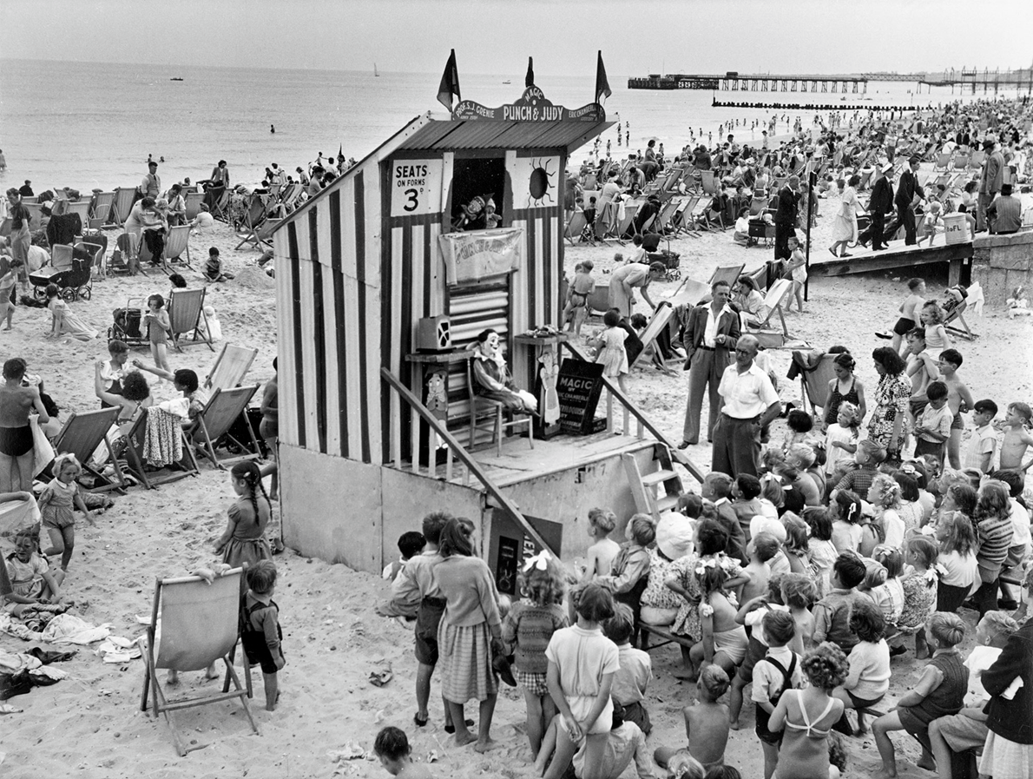
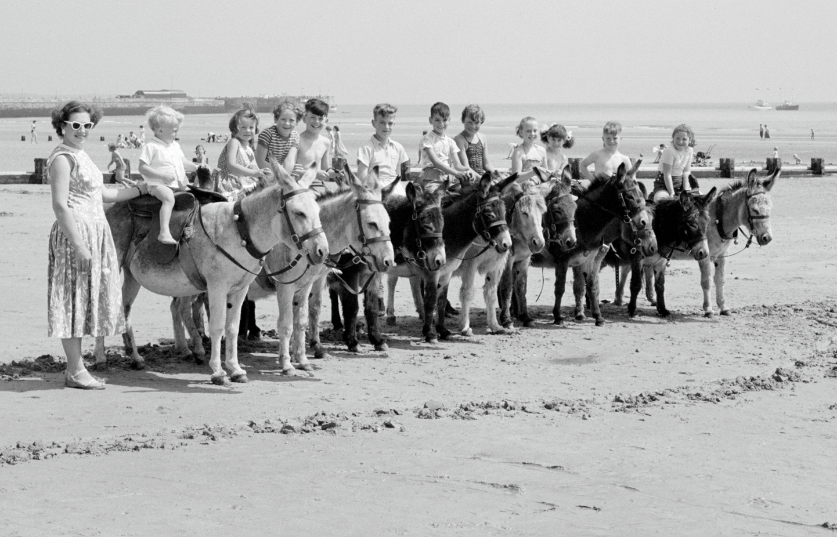
Activities at the beach in the past
Glossary
Victorians
People who lived in the Victorian period
1836-1901
People visited the beach to build sandcastles and relax for the day.
resort
A place where lots of people go on holiday.
railway
Where trains go on the tracks.
They also visited the beach for entertainment. Like the show Punch and Judy.
entertainment
An activity that is for enjoyment.
arcades
A place where there is lots of games and slot machines.
At the beach Victorians loved sea bathing.
bathing machine
Bathing machines were used a long time ago so people could change in private before getting into the sea.
There was also other activities to do like riding donkeys or visiting the arcades.
Victorians would also go on boat rides in the sea.
pier
A wooden structure going from land out over water.
rock pooling
An activity where you look for creatures in exposed rocks on the beach.

