Slide 1
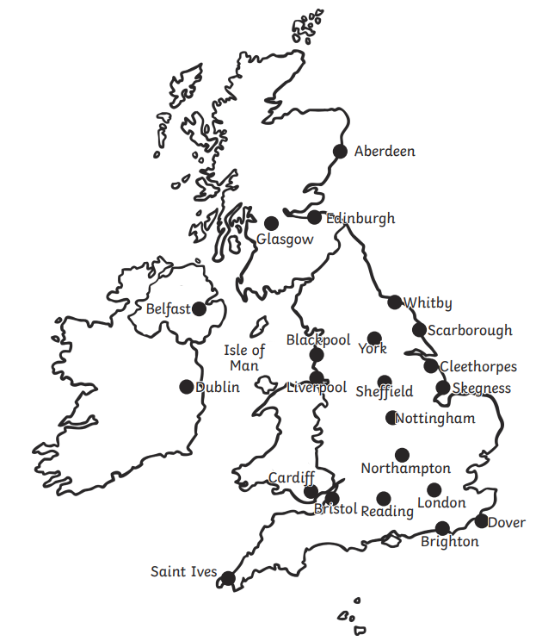
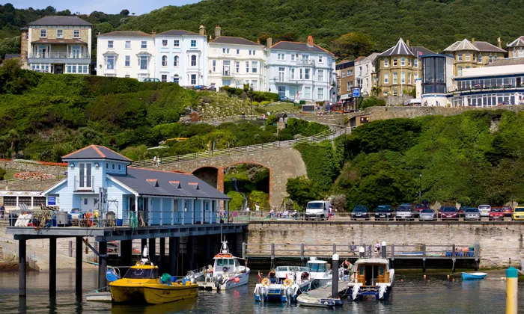
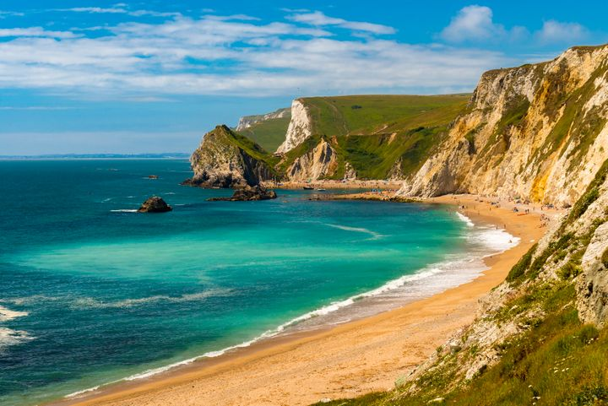
Beachcombers: Geography Knowledge Organiser
The United Kingdom
The United Kingdom is an island surrounded by sea and coastline.
UK Coastline
the coastline is made up of cliffs and sandy beaches. Animals and plants that live by the sea have adapted to their habitats to help them survive the tough conditions.
N
W
E
S
Land Use
The land along the UK coastline is used in various ways. The majority of the UK’s coastline is protected and therefore left in its natural form.
In coastal resorts the land is used for leisure, tourism, fishing, retail and housing.

Slide 2
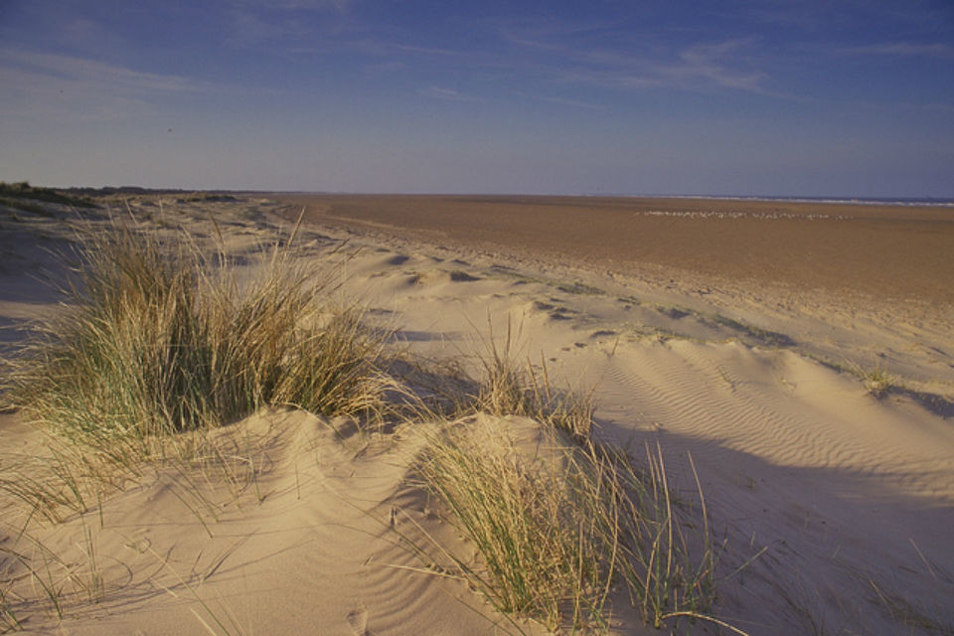
Physical features of a coastline
Glossary
coastline
Where the land meets the sea.
An arch forms when the rock of a headland is worn away by the sea.
feature
An interesting or important part of something.
resort
A place where lots of people go on holiday.
A stack is formed when an arch collapses. It is a column that stands on its own in the sea.
port
A town or city with a harbour
aquatic
Living in or near water.
A cave is a large hole in the side of a cliff that forms when waves wash away the rock.
beach
An area of sand or shingle between the sea or ocean and the land.
An island is formed when land breaks away from a continent or volcanoes form under the sea and rise out of the water.
cliff
A high area of rock with straight side.
coast
An area of cliff that extends into the sea or ocean.
island
A piece of land with water all around it.
A sand dune a hill of sand made by the wind on the coast or in a desert.
rock pool
A pool filled with seawater on a rocky seashore.
beach
A large area of saltwater.

