Slide 1
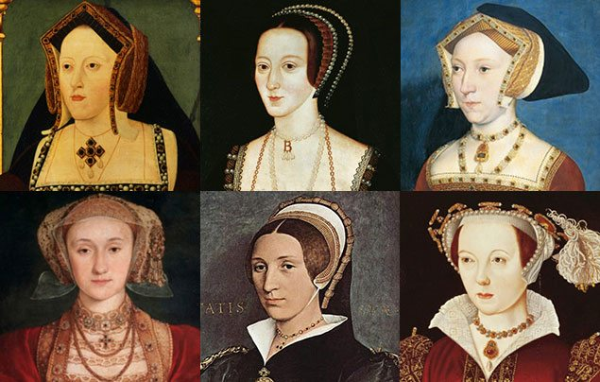
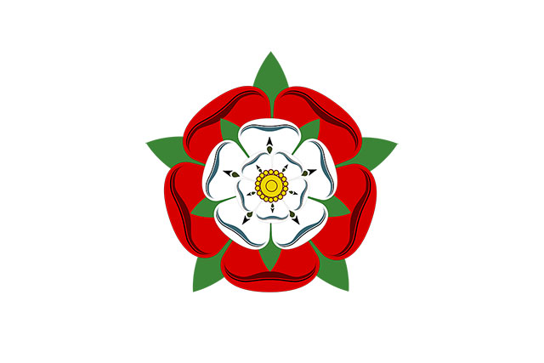
Off with Her Head!
What sort of man would order the beheading of his wife? Was she really that bad? Travel back in time to the 1500s and meet the terrifying Tudors, a domineering dynasty that changed our history. Discover an opulent court where dancing and singing goes hand in hand with swift falls from favour – and even swifter falling of heads. Delve into the history of the trials of the Tudors. Will you find out the facts or will the evidence from the past bemuse you? How will you find the accused… innocent or guilty?
The Tudors
The Tudor period began when Henry Tudor defeated King Richard III at the Battle of Bosworth in 1485. This ended the Wars of the Roses. Henry Tudor became King Henry VII after the battle and married Elizabeth of York in 1486. Their youngest son, Henry, went on to become King Henry VIII. After King Henry VIII died his nine-year old son, Edward, became king for six years. Henry’s daughter, Queen Mary I, then took the throne and ruled until her death in 1558. Henry’s youngest daughter then became Queen Elizabeth I. The reign of the Tudors ended with the death of Queen Elizabeth I in 1603.
Henry VIII
Henry VIII was King of England from 1509 until he died in 1547. He is mostly remembered for having six wives and for breaking away from the Roman Catholic Church and the Pope. He was only 18 when he became king and was an attractive and educated man. He was also an excellent sportsman, author and composer. Later in his life, he became overweight and had various health problems. He was known as a cruel and selfish man. During his reign, Henry founded the Church of England and expanded the Royal Navy from five ships to sixty.
Henry VIII’s six wives
Catherine of Aragon (1485- 1536)
Henry and Catherine were married for 24 years and had one daughter, Mary. Their marriage was annulled in 1533 after Henry broke away from the Roman Catholic Church.
Anne Boleyn (1501-1536)
Henry married Anne in 1533 and their daughter, Elizabeth, was born later that year. Anne was accused of treason and beheaded at the Tower of London in 1536.
Jane Seymour (1508-1537)
Henry married Jane Seymour three weeks after Anne was beheaded. Jane died 12 days after giving birth to their son, Edward.
Anne of Cleves (1515-1557)
Henry was persuaded to marry Anne after seeing her portrait. They married in 1540 but divorced after six months.
Catherine Howard (1521-1542)
Catherine Howard was a teenager when she married the 49-year-old king. Within two years, she was beheaded for treason.
Catherine Parr (1512-1548)
Henry married his last wife, Catherine Parr, in 1543. She looked after Henry until he died.
Henry’s ‘Great Matter’
In 1527, Henry decided he needed a divorce from Catherine of Aragon so that he could marry her young lady-in-waiting, Anne Boleyn. The only way to divorce Catherine was to break away from the Roman Catholic Church. This became known as the ‘Great Matter’. Thomas Cromwell, the king’s chief advisor, helped Henry to break away from the Roman Catholic Church and persuaded parliament to make Henry the Head of the Church of England. This led to a period called the Reformation, where the Roman Catholic abbeys, monasteries and convents were closed, with all the money going to the king.
Anne Boleyn
Anne Boleyn was one of Catherine of Aragon’s ladies-in-waiting. Henry married Anne in January 1533 after his divorce. Anne gave birth to a daughter, Elizabeth, in September 1533. Henry was disappointed not to have a son and blamed Anne. He decided to marry Jane Seymour and looked for ways to end his marriage to Anne. She was accused of being unfaithful to him, convicted and imprisoned in the Tower of London. On 19th May 1536, Anne was executed. Even though Henry VIII had sentenced her to death, she used her final moments to praise him.
‘… a gentler nor a more merciful prince was there never: and to me he was ever a good, a gentle and sovereign lord.’

Slide 2
The Tudors timeline
1485 – The Battle of Bosworth. Henry VII becomes King of England.
1491 – Henry Tudor, later King Henry VIII, is born.
1502 – Henry’s older brother, Arthur, dies, leaving Henry as heir to the throne.
1509 – Henry VII dies and Henry VIII becomes King of England. Henry VIII marries Catherine of Aragon.
1516 – Princess Mary is born to Catherine of Aragon.
1533 – After seven years of trying, King Henry VIII breaks away from the Catholic Church and forms the Church of England. Henry VIII marries Anne Boleyn and Princess Elizabeth is born.
1536 – Anne Boleyn is executed for treason. Henry VIII marries Jane Seymour.
1537 – Prince Edward is born to Jane Seymour. Jane dies 12 days later.
1540 – Henry marries Anne of Cleves. The marriage lasts six months. Henry then marries Catherine Howard.
1542 – Catherine Howard is executed.
1543 – Henry marries Catherine Parr.
1547 – King Henry VIII dies and King Edward VI reigns over England.
1553 – King Edward VI dies and Mary becomes Queen of England.
1558 – Queen Mary I dies, meaning Queen Elizabeth I rules over England.
1603 – Queen Elizabeth I dies. The Tudor period ends.
Life at court
Henry VIII had over 60 homes and his favourite was Hampton Court Palace. Henry enjoyed showing off his wealth at court. It became a centre for his favourite things, including art, music, dance, poetry and tournaments. The richest and most important people in the country also lived at court. To show their wealth and impress the king, the courtiers wore expensive clothes made of silk, velvet and lace. They had to please the king, give him expensive gifts and flatter him. If they displeased him, they would be severely punished or even executed.
Tudor crime and punishment
Punishments for crimes during Tudor times were much more harsh than punishments today. Many of the punishments caused severe pain or even death. Others were used to embarrass somebody in the hope they would not commit the crime again. Punishments included: drunkard’s cloak, scold’s bridle, whipping, hanging, boiling, beheading, burning at the stake and hanging, drawing and quartering.
Homes, education and medicine
There were huge differences between the lives of rich people and poor people in the Tudor period.
Rich people lived comfortable lives whilst poor people suffered and had to endure terrible conditions. Poor people’s homes would be an uncomfortable hut with one or two rooms, cold, hard floors, no furniture and straw beds. Rich homes would be lavishly decorated with spacious rooms and comfortable furniture.
Only boys from wealthy families would be educated at school during Tudor times. The schools were extremely strict and children were often beaten. Girls would be kept at home to be educated there, made to do housework or sent out to work and earn money for the family. Poorer children would often be uneducated and forced to work at a young age.
Medicine in the Tudor period was very basic. Doctors were incredibly expensive but also incredibly ineffective as they did not know what caused disease and illness. Many people could not afford to visit a doctor so they visited Wise Women or Surgeon Barbers who were untrained and often caused more pain instead of helping the patient. The equipment used on patients was often unclean and caused further complications such as infections.
Glossary
Annulment – a legal procedure in which something is no longer legally binding.
Church of England – a protestant branch of Christianity created by Henry VIII.
Divorce – a legal or official process to end a marriage.
English Reformation – The breaking away of the Church of England from the authority of the Pope and the Roman Catholic Church during the 16th century.
Protestantism – The beliefs and activities of the Christian Church that separated from the Roman Catholic Church in the 16th century.
Reign – The period that a monarch rules.
Tower of London – a fortress in London used for many purposes, including a prison and execution ground.
Treason – The crime of betraying your country and going against the ruler or government.
Tudor – Relating to the Tudor line of rulers who held the throne from 1485 until 1603.
Wars of the Roses – A series of wars between the House of Lancaster and the House of York for control of the throne of England.
Links to other historical periods
In Year 1, it is taught that during the Crimean War, healthcare took place in very dirty places and often caused more harm than good. This links closely Tudor healthcare
Off with her head links with the Year 2 topic Towers, Tunnels and Turrets as it is taught that castles were often built to show off power and wealth. Henry VIII built many different castles and palaces to display how powerful he was.
In the Year 4 topic, Traders and Raiders, it is taught that William Duke of Normandy was a cruel and greedy king just like Henry VIII.

