Slide 1
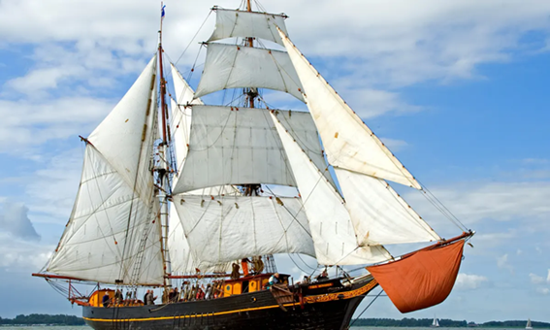
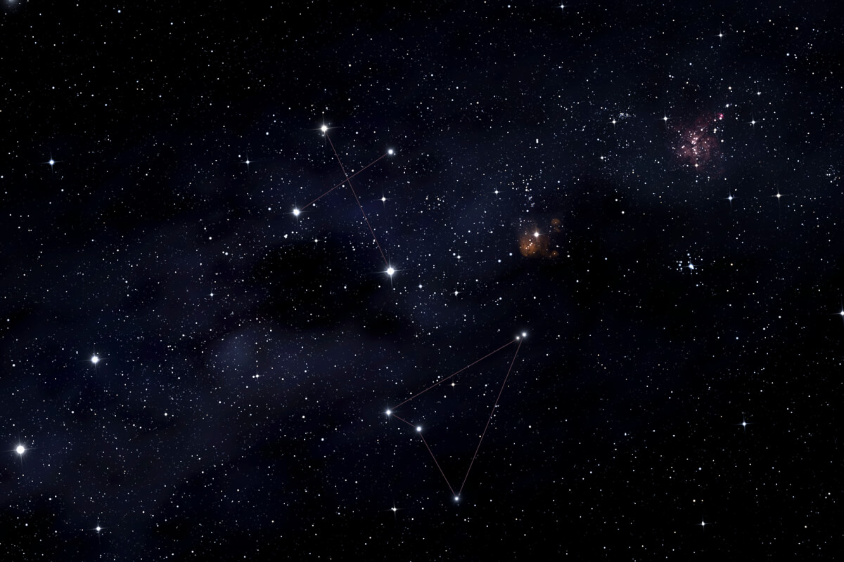
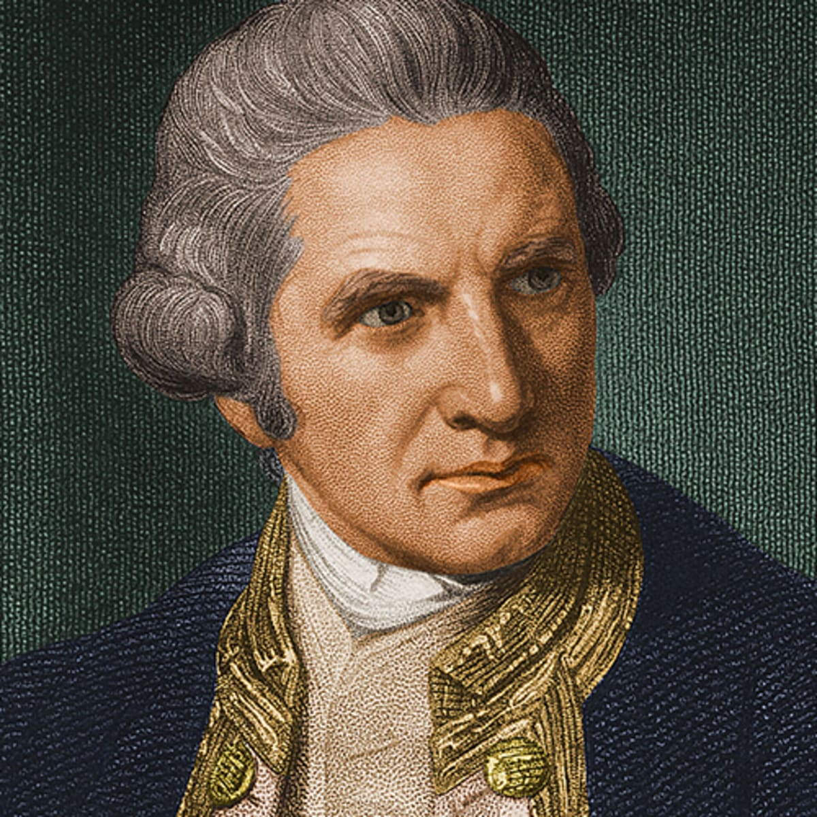
History - Land Ahoy
Sea Explorers
There have been lots of famous sea explorers who have discovered large parts of the world and made the world we live in today.
Timeline
1304: Idn Battuta
was born
1768: Captain
James Cook
made his
first voyages
1909: Matthew
Henson
discovered
the North Pole
2005: Ellen Captain
circumnavigated
the world
2023: Today
Life at Sea
Life was very difficult. Explorers were at sea for a long time with no clean water or fresh food. So it was very smelly on board and lots of people got ill due to poor diet and hygiene.
In the early years of discovery they had no maps and the only way of navigation was through reading the stars and badly drawn maps.
Captain James Cook
Cook was a famous English sea captain, navigator and explorer. He was born in 1728 and died in 1779. He joined the Royal Navy in 1755.
Cook went made three famous voyages and went to places no one had ever been before. Cook designed some of the first maps that we still use today.

Slide 2
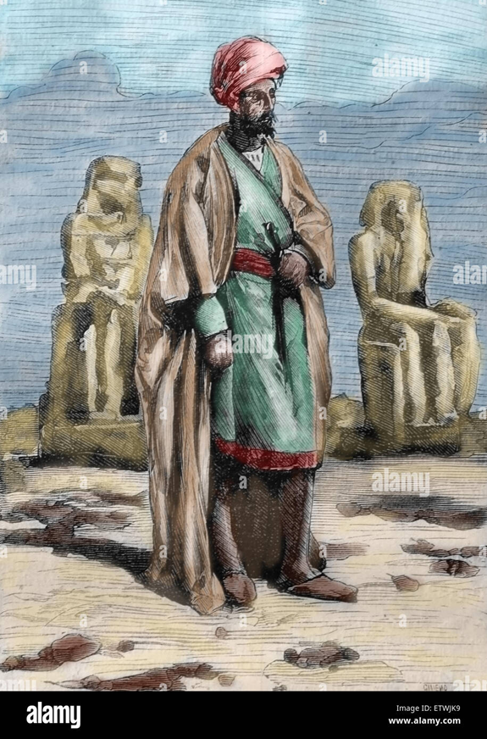
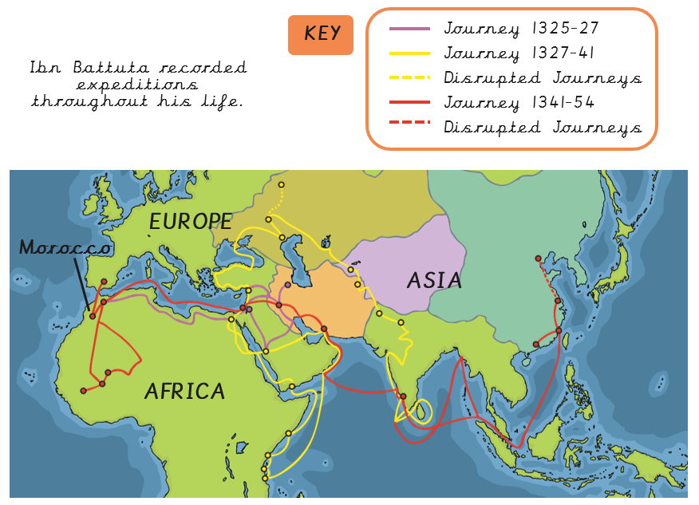
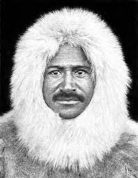
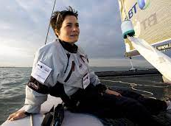
Idn Battuta
First known explorer
Travelled nearly 73000 miles and visited the equivalent of 44 modern countries on foot or by sea.
Glossary
explorer
A person who explores a new or unfamiliar area.
pirate
A person who attacks and robs ships at sea.
circumnavigate
Sail or travel around something like the world.
Matthew Henson
He was a Black American explorer, at the time when there was a lot of racism in the world. He explored the world by sea.
Matthew Henson was famous for exploring the Arctic with Robert Peary and being first people to discover the North Pole.
ocean
A very large expanse of sea.
artefacts
an object made by a human being, typically one of cultural or historical interest.
continents
Any of the world's main continuous expanses of land
Dame Ellen MacArthur (1976-present)
Today explorers like Ellen have technology to help them on their expeditions.
Ellen is famous for setting a new world record in 2005 by sailing solo around the world in 71 days.
voyage
A long journey involving travel on the sea or in space.
cargo
The goods that are carried by large types of transport such as ships and aircraft.

