Slide 1
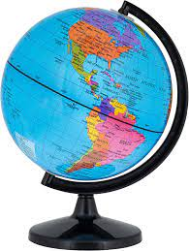
Geography – Land Ahoy!
Oceans
We have five oceans in the world.
Pacific Ocean
Atlantic Ocean
Indian Ocean
Southern Ocean
Arctic Ocean
An ocean is a large body of salty water.
Sea
The United Kingdom is an island surrounded by water. These are the Atlantic Ocean, English Channel, Irish Sea and North Sea.
Coastline
The line where the sea meets the land is called coastline.
Land
The world is covered in water and land. The land is split into 7 continents.
North America
South America
Europe
Asia
Africa
Antarctica
Australasia
Physical and Human Features
The world is full of physical and human features.
Physical features include:
Mountains, hills, river, waterfalls
Human features include:
Houses, roads, bridges, tunnels

Slide 2
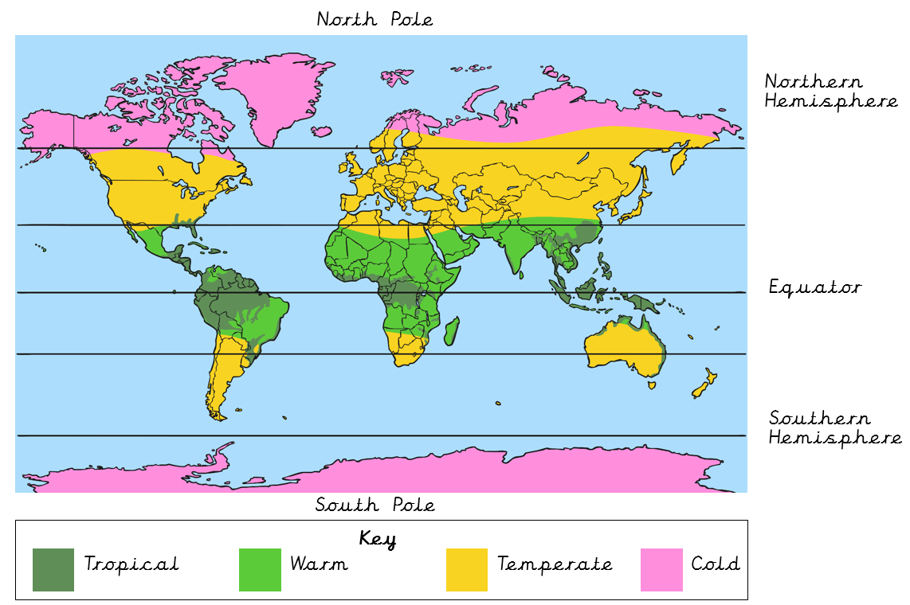
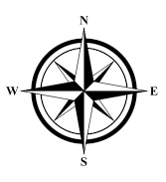
Climate Zones
We have different climates all over the world. The map below shows 4 types of climate zones.
Every climate changes the landscapes in each continent or country. This means that some climates are more suitable for animals.
Glossary
temperate
A type of climate that is changeable.
tropical
A type of climate that is hot and wet all year.
Non-European
A country outside of Europe.
climate
The typical weather of a place over the year
Geographical
Physical features of an area.
continent
Any of the world's main continuous expanses of land.
environment
The surroundings of where a person or something lives.
coastline
Where the water meets the land.

