Slide 1
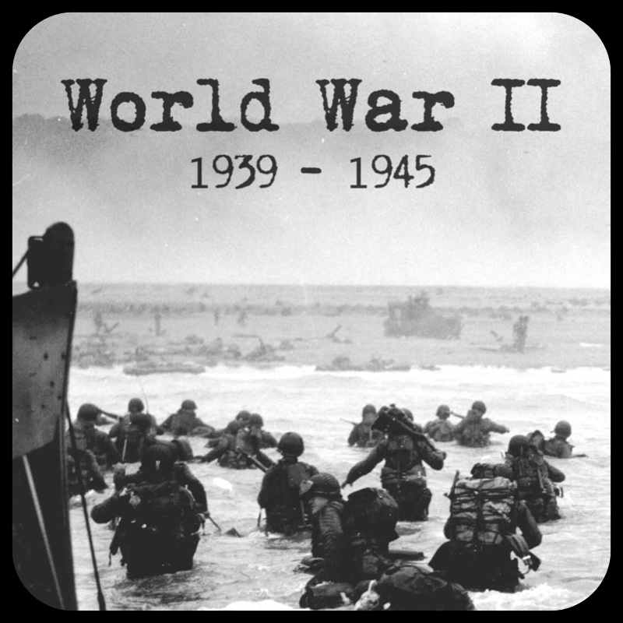
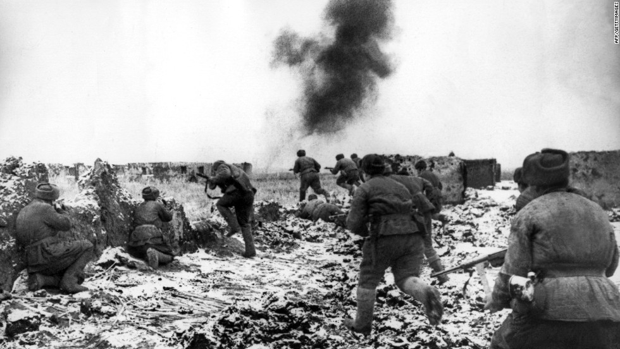
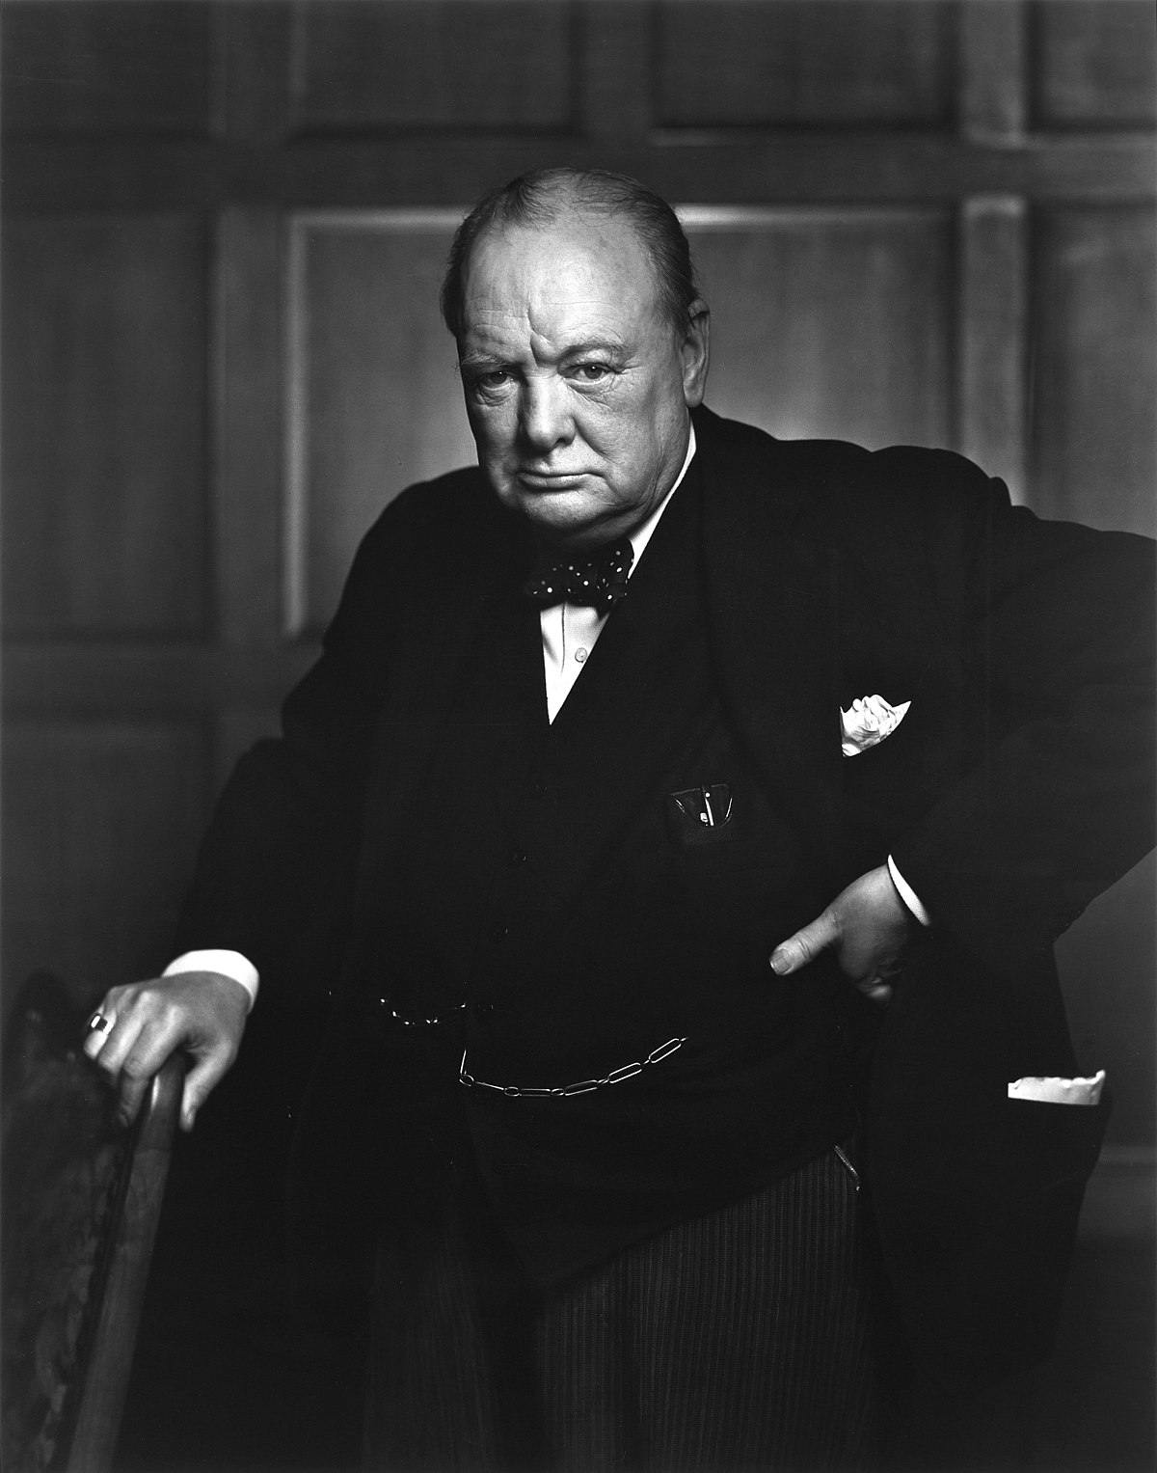
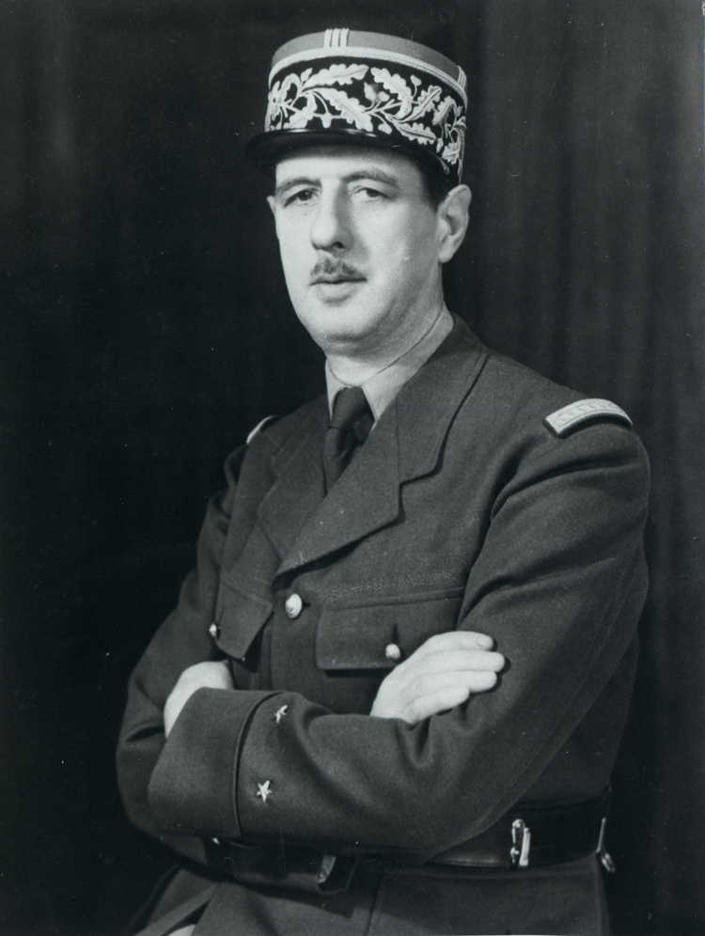
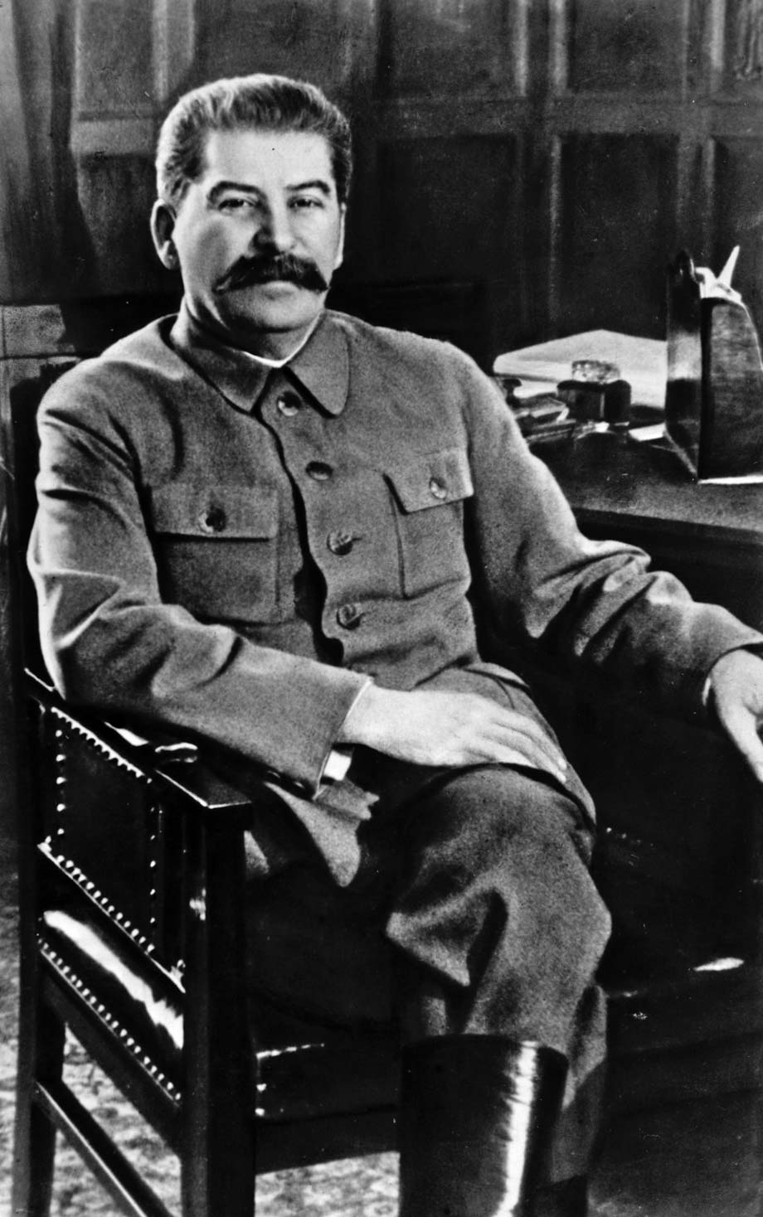
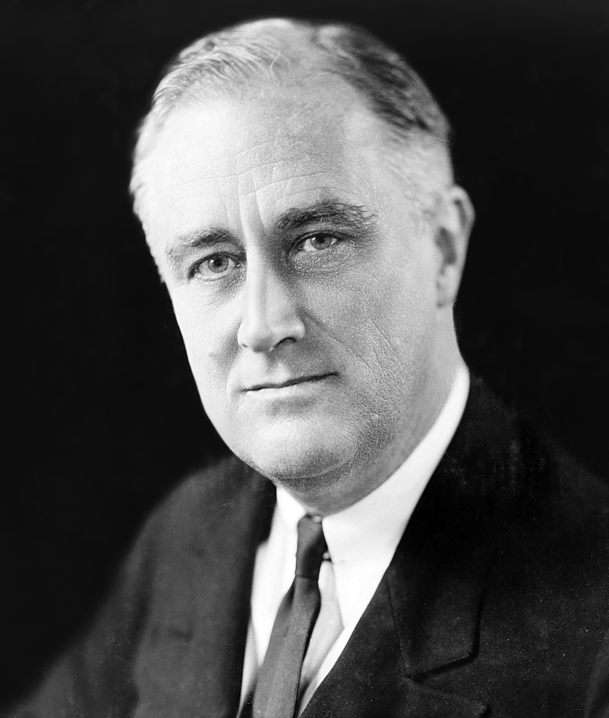
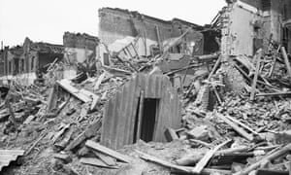
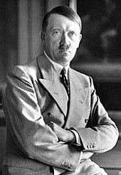
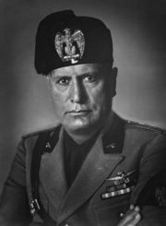
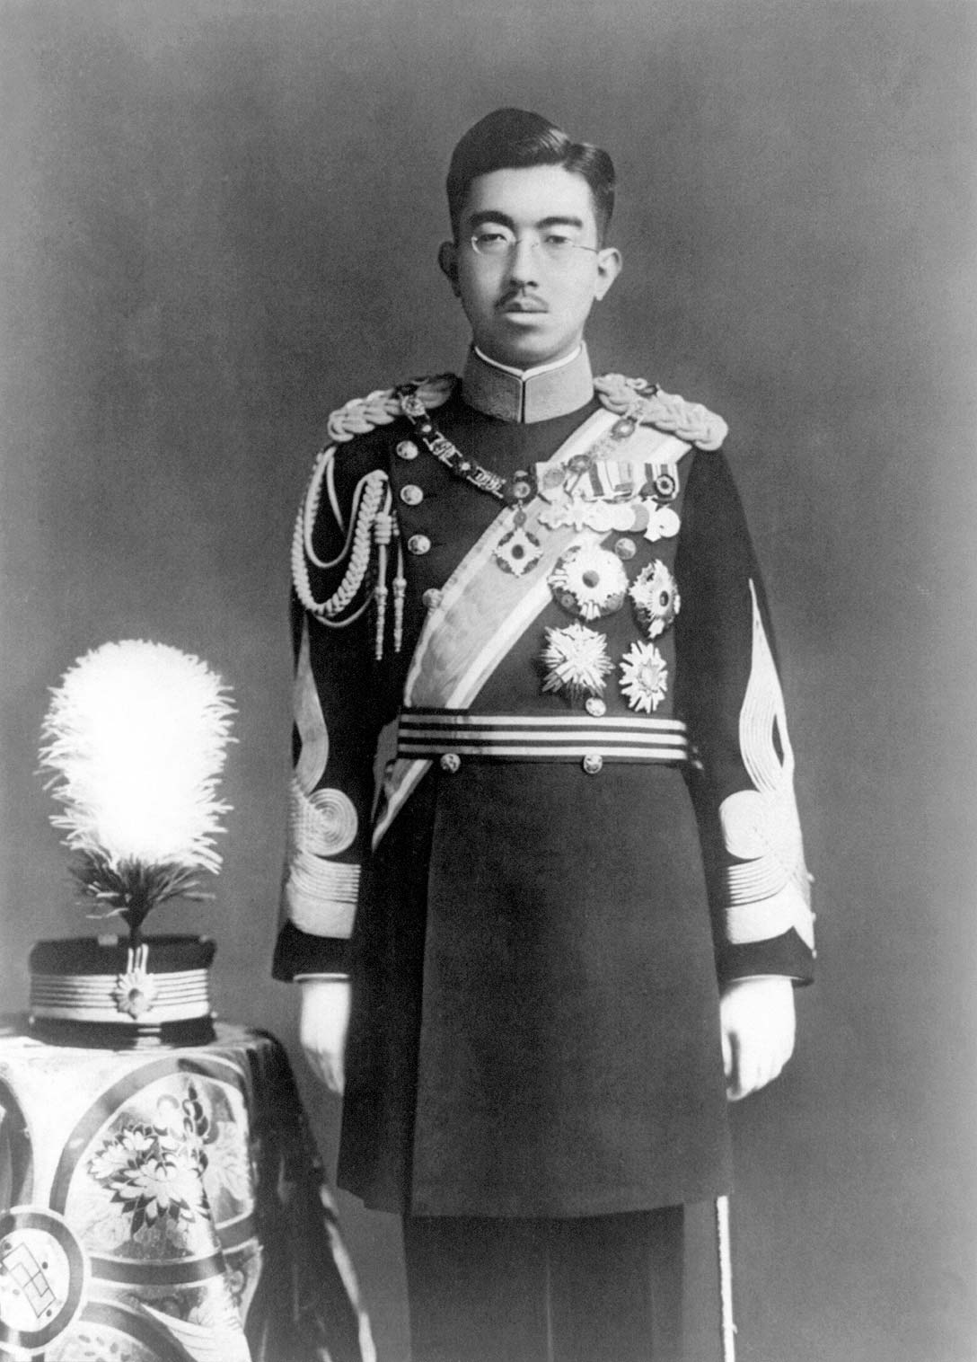
Food and rationing.
During the war, there was a shortage of some foods because ships bringing food into Britain were at risk of sinking by German submarines. Rationing was introduced in 1940, which meant that each person could only buy fixed amounts of certain foods each week. Every person was issued with a ration book, and they had to hand over coupons from their ration book, as well as money, when they went shopping. Many foods were rationed such as butter, bacon, sugar, meat, cheese and milk, but some were not, including potatoes and fish. People were encouraged to grow their own vegetables through the ‘Dig for Victory’ campaign
A Child’s War
WWII
The Second World War lasted from 1939-1945. On one side were the Axis Powers (including Germany, Italy and Japan) and on the other side were the Allied Powers (including Britain, France, the Soviet Union and USA). After 6 years of fighting, the Allied Powers won.
Blitz
The intense and sudden bombing of British cities was called the Blitz. Sirens were sounded in the streets to warn civilians that bombers were coming. To escape the bombs, people went into air raid shelters. Weeks of sustained bombing raids killed thousands of people and destroyed many homes and cities. Air Raid Precaution (ARP) wardens were people who helped people to the nearest shelter, they would then tour their sector and finally would carry out first aid and help with the emergency response.
Key Leaders
Allied Leaders
Evacuation
During the war, German planes dropped bombs on British cities in an attempt to destroy factories, dockyards and airfields but homes and schools were also hit. Some of the places worst hit include Liverpool, Hull and London. The government decided to evacuate children from the cities where they might be in danger to the countryside where they would safer. Children, who were evacuated, were called evacuees. They went to live with other families who looked after them until the war ended.
Winston Churchill
Prime Minister GB
Charles du Gaulle
President of France
Joseph Stalin
Leader of Soviet Union
Franklin D Roosevelt
President of USA.
Axis Leaders
Adolf Hitler
Leader of Germany
Benito Mussolini
Prime Minister of Italy
Michinomiya Hirohito
Emperor of Japan.

Slide 2
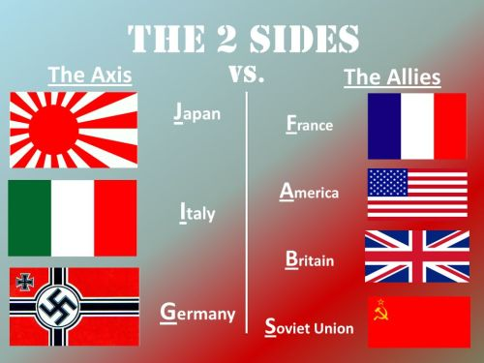
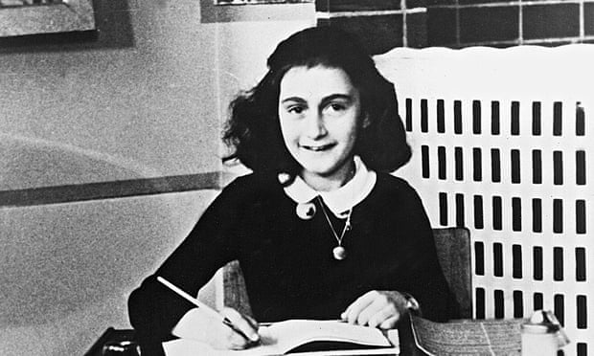
Timeline
19th August 1934- Adolf Hitler, leader of the Nazi Party, becomes the leader of Germany.
March 1936- German troops break the Treaty of Versailles when the occupy the Rhineland.
12th March 1938- Austria becomes part of the German Empire, which is known as the Third Reich.
1st September 1939- WWII begins as Germany invades Poland.
September 1939- In the first three days of evacuation, 1.5 million children and vulnerable adults leave British cities.
8th January 1940- Rationing starts.
10th July- 31st October 1940- The Battle of Britain takes place.
7th September 1940- The Blitz begins.
10th May 1941- The Blitz ends.
7th December 1941- Japanese planes bomb the American naval base at Pearl Harbour, leading the USA to enter the war.
6th June 1944- Allied troops land in Normandy, France to free western Europe from German control. (D Day)
January 1945- Allied forces begin to free prisoners of war from German concentration camps.
30th April 1945- Adolf Hitler commits suicide.
8th May 1945- Germany surrenders. WWII in Europe ends.
15th August 1945- Japan surrenders. WWII ends.
24th October 1945- The United Nations is created to make sure a world war doesn’t happen again.
4th July 1954- Rationing ends in Britain.
Holocaust
The word Holocaust was given to the killing of 6 million Jews because it was a war of extermination designed to wipe out an entire group of people. This included as many as 1 million Jewish children. Millions of others killed included handicapped people and trade unionists. Hitler hated Jewish people and blamed them for losing the WWI. He made laws that said Jews had no rights. He organised boycotts of Jewish businesses and attacks on Jewish businesses and homes. On 9th November, 1938 many Jewish homes and businesses were burnt down or vandalised. This night was called Kristallnacht or ‘Night of the Broken Glass’.
All Jewish people were eventually put in concentration camps. People had their heads shaved and they were tattooed with a number. They had to wear a striped uniform and do forced labour. 11 million people died in concentration camps.
Glossary
Allied powers- Countries (including Britain, France, the Soviet Union and the USA) that united to fight the Axis powers.
Axis powers- Countries (including Germany, Italy and Japan) that united to fight the Allied powers.
Civilian- A person who was not in the police or armed forces.
Concentration camp- A place where large numbers of people, especially Jews, were held and often killed.
Evacuee- A child or vulnerable adult who was sent away from a city to live in the countryside, which was considered safer.
Invade- To enter or occupy a country by force.
Nazi- A follower of Adolf Hitler, leader of the Nazi Party.
Persecute- To treat someone cruelly or unfairly.
Propaganda- Biased news, media and communication used to influence people’s opinions.
Rationing- The limited supply of food, clothes and other goods to prevent shortages.
.
Anne Frank
Anne was a German Jew who wrote a diary about her experiences during the war. When the Nazis gained control over Germany, Jews were persecuted and transported to concentration camps, so Anne moved with her family to Amsterdam in the Netherlands. When the Germans then invaded the Netherlands, Anne and her family went into hiding in a concealed room in her father’s work building. Her famous diary tells her story while in hiding.

Slide 5
Recipe
? minutes
? people
Ingredients
text | text
text | text
text | text
text | text
text | text
Method
1. text | 6. text
2. text | 7. text
3. text | 8. text
4. text | 9. text
5. text | 10. text
Notes:
To add a picture, select the box you wish to use, go to Format, Shape Fill, and select picture or texture fill, or go to the insert tab, select Pictures, and choose the picture you wish to add.

