Slide 1
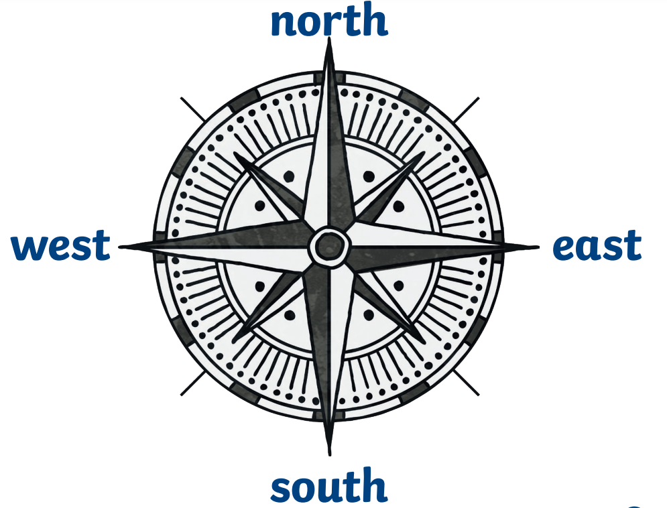
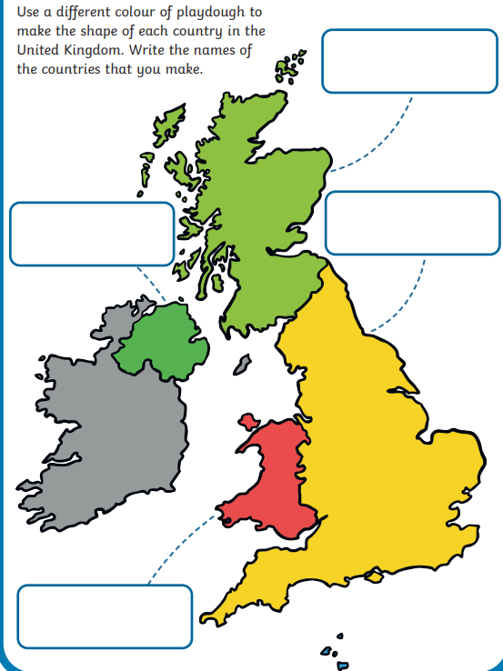
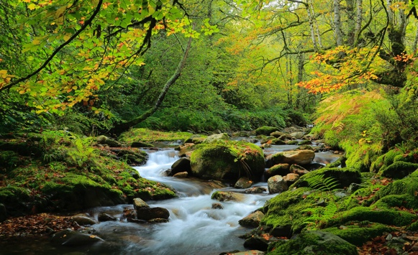
People Who Help Us: Geography Knowledge Organiser
United Kingdom
We live in a country in the United Kingdom called England.
Compass Points
A compass is a map tool for finding directions.
There are four main compass points.
Scotland
Northern Ireland
England
Human features are features made by people. For example a bridge, building or road.
A physical feature is a natural feature made by God. For example a river,
woodland or hill.
Wales

Slide 2
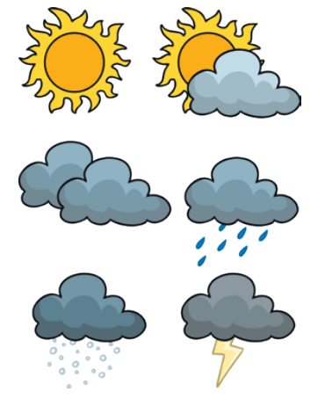
Glossary
A piece of land surrounded by seas.
A town in the country of England.
The four different times of the year when the weather changes.
A description of what the conditions are like in a particular place. For example if it is raining, hot, or windy.
UK Weather
There are changes in weather in each season.
We have snow, rain, sun, cloud, sleet, storms and wind.
Island
Shirebrook
Seasons
Weather
Seasonal Changes
There are four seasons in the year.
As the weather changes, plants change too and animals change their behaviour to suit the weather.
Spring Summer
Autumn Winter

