Slide 1
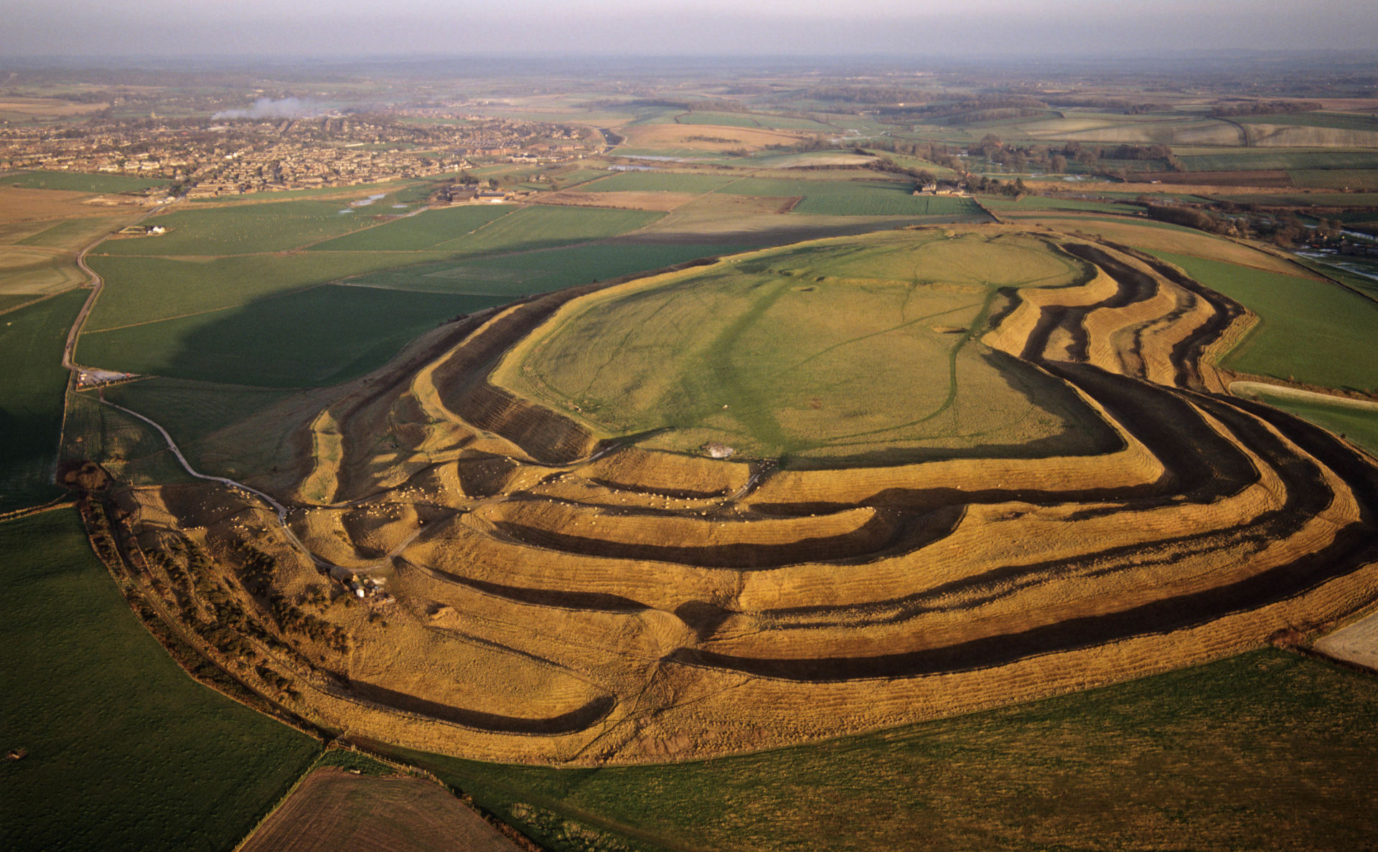
Tribal Tales
Take a moment to step outside and stand quietly and still. Turn off all your technology and try to forget the modern world. Imagine this place 5,000 years ago. What would you have seen? Head back to prehistoric times to gather berries and hunt down dinner. Unearth ancient objects and visit astonishing mystical monuments that reveal the secrets of an ancient time. Learn how the people of Britain developed over thousands of years, from the Stone Age to the Iron Age.
Stone Age (450,000 – 2,300BC)
The Stone Age was separated into three periods: Palaeolithic, Mesolithic and Neolithic.
Tools and Weapons
Sharpened stick – used to defend themselves from wild animals and for hunting.
Harpoon – spear- like tool used to kill aquatic animals.
Spear – made of wood and steel. Used as weapon in wars and hunting.
Food
For early humans, their survival depended on finding food. We call them hunter-gatherers because they had to hunt animals and fish and gather wild food. It wasn’t until the Neolithic period that they grew and raised their own food. They would hunt whatever animals they could find. In Britain during the Stone Age this could have been horses, deer, mammoth, hares, rhino and hyena.
Bronze Age (2,300 – 700 BC)
People started to make tools and weapons from bronze. Bronze was a harder and more durable metal than had been created before. It was used to make daggers, swords and spearheads, as well as chariots and armour. Bronze Age villagers lived in roundhouses with a central fireplace and a roof of animal skins or thatch. Bronze Age people buried the dead in small, round mounds of earth called round barrows. Sometimes, treasures such as beads, weapons or jewellery were buried with the dead, showing their position in society. Later in the Bronze Age, people stopped burying their dead and cremated bodies instead.
Iron Age (700BC – 43 AD)
People began using iron to make weapons and tools. Iron was cheaper, stronger and lighter than bronze. During this time, many Celtic people from Europe settled in Britain. People now lived in tribes and fought against each other for land and goods. Hill forts were built for defence. People lived inside the forts and warriors defended them against enemy attack.

Slide 2
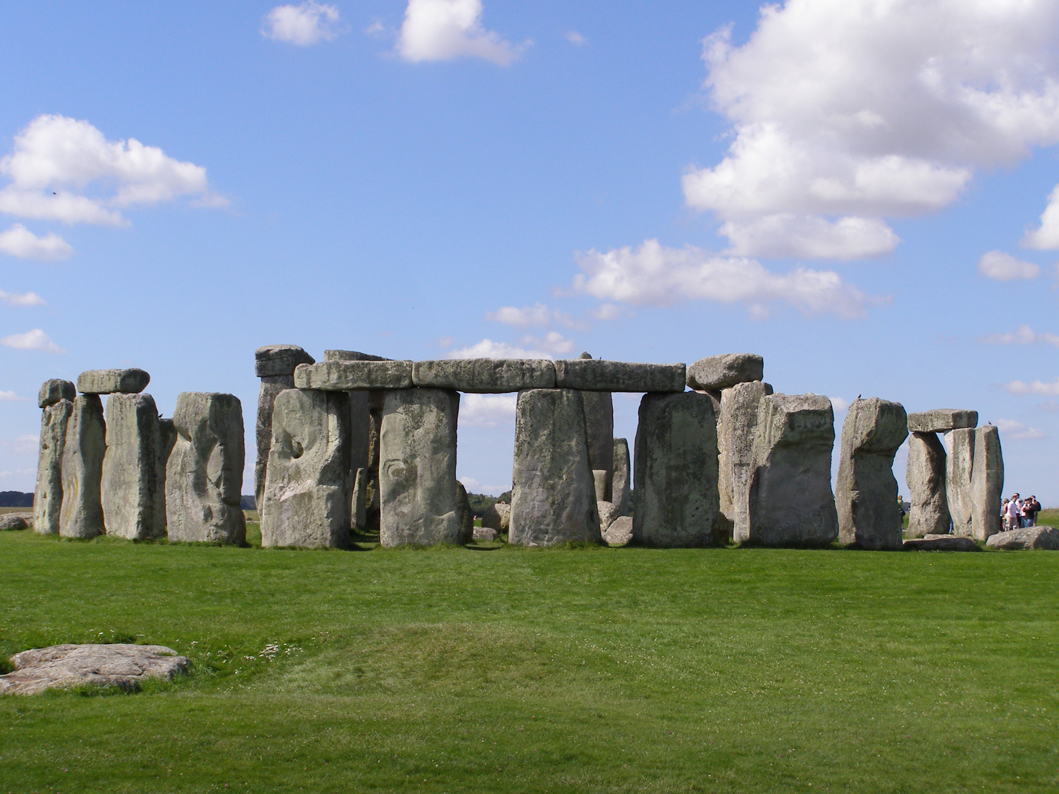
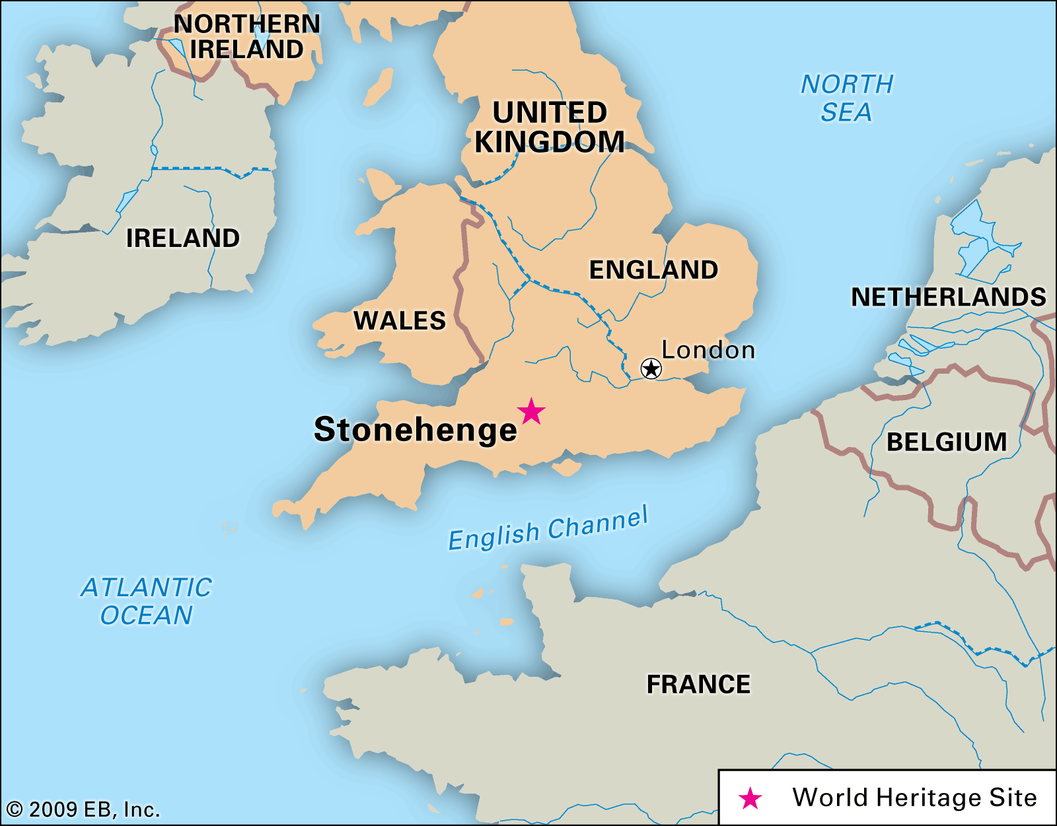
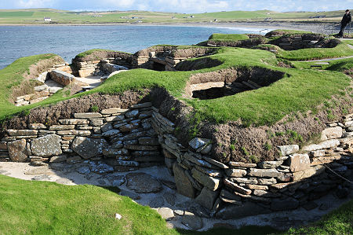
Stonehenge
Stonehenge is a prehistoric monument in Wiltshire, England which was built about 3,500 years ago. It is made up of standing stones and huge, stone arches. Nobody knows how or why Stonehenge was built. The stones came from different locations and would have been very difficult to move. Some historians think it was an ancient burial ground or memorial to remember to dead. Many historians now believe it was a prehistoric temple that might have been used to track how the Sun appeared to move across the sky.
Glossary
archaeologist – a person who studies human history and pre history through the excavation of sites and analysis of artefacts.
artefact – an object, such as a tool or decoration which is of historical interest.
barrow – an ancient burial mound.
flint – a hard, grey rock that was used in prehistoric times to make tools or weapons.
monument – a statue, building or other structure that is built to help people remember a special person or event.
prehistory – the time before written records.
Skara Brae
Skara Brae is a remarkably well preserved Stone Age village built in the Neolithic period, around 3,000 BC. It was discovered in 1850 after a heavy storm stripped away the earth that had previously been covering what we can see today. The remains of 8 houses stand on the site. Apart from one building, the layout of the houses is very similar.
Timeline
15,000 – 10,000 BC. Animal hide is used to make tents.
4,500 – 3,500 BC. People begin to make simple pottery and farming starts to spread.
3,750 BC. Woolly mammoths start to die out.
3,000 BC. Construction starts on Stonehenge.
1,800 BC. First large copper mines are dug.
800 BC. First hill forts are constructed.
700 – 500 BC. Iron working technology becomes widespread through England.
Links to other historical topics
In the period of the Normans, they built their Motte and Baileys on the sites which were previously Iron Age hill forts.

Slide 5
Recipe
? minutes
? people
Ingredients
text | text
text | text
text | text
text | text
text | text
Method
1. text | 6. text
2. text | 7. text
3. text | 8. text
4. text | 9. text
5. text | 10. text
Notes:
To add a picture, select the box you wish to use, go to Format, Shape Fill, and select picture or texture fill, or go to the insert tab, select Pictures, and choose the picture you wish to add.

