Slide 1
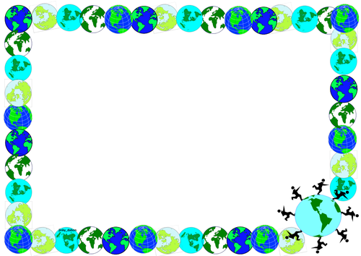
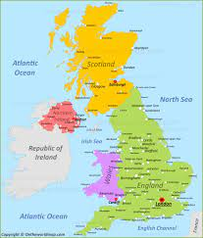
Geography knowledge organiser – Tribal Tales
Key knowledge:
There are four countries in the United
Kingdom (UK): England, Scotland, Wales,
and Northern Ireland. Great Britain (GB) is made up of Scotland,
England, and Wales.
The UK seas are the Irish Sea, North Sea,
Atlantic Ocean, and the English Channel.
There are 9 regions in England.
Land use:
Agricultural
Industrial
Residential
Recreational
Mining
Topographical features:
Topographical features are hills, rivers, coasts, mountains.
Physical features:
Physical Features are the natural features on the Earth's surface​.
Human Features:
Human features are things like houses, roads and bridges. They have been built by people.
Geographical regions of the UK
Yorkshire and Humber
East midlands
West Midlands
London,
North East
North West,
South East,
East of England
South West

Slide 2
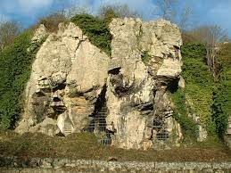
Creswell Crags:
From Creswell Crags
"Creswell Crags is one of the most important prehistoric archaeological sites in the UK. A limestone gorge, honeycombed with caves, it is also a well-loved beauty spot, and Site of Special Scientific Interest, with beautiful flora and varied wildlife. Church Hole cave contains engravings 13,000 years old, from the last Ice Age; Robin Hood Cave is the largest cave in the crags.
Settlements:
In the United Kingdom a settlement can be: a single isolated dwelling (far away from all other houses and buildings), a hamlet, a village, a town or a city. You can find each type of settlement in each of the four countries of the United Kingdom. Land is used to source food: rivers, fishing, farming livelihood: trade
Continent - a very large area of land that
consists of many countries. Europe is a
continent.
Country - an area of land that is controlled
by its own government.
population - all the people who live in a
country or area.
Settlement – a place where people live.
Human features - features of land that
have been impacted by human activity.
above the surrounding land in a limited
area.
Topographical features - natural features of
land
Region – an area of land that has common
features
Key Vocabulary
Atlas - book of maps
Capital city - the city where the
government sits. London is the capital city
of England and the UK.
City - a large town. London is a city.
Coasts - an area of land that is next to the
sea.
Compass points - any of the main points of
a compass: north, south, east, west, north-east,
north-west, south-east, south-west.

