Slide 1
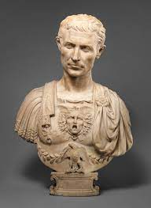
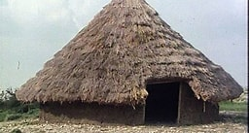
The Roman Empire and its impact on Britain
Julius Caesar
Julius Caesar was a renowned general, politician and scholar in ancient Rome who conquered the vast region of Gaul and helped initiate the end of the Roman Republic when he became dictator of the Roman Empire. Julius Caesar tried to invade Britain in 55-54 in BC. However he was defeated by the Britons.
Life as a Celt
The Celts were tribespeople who lived in England and across most of Europe over 2000 years ago. In Britain there were many tribes of Celts, each with its own King. Celts lived by farming, hunting and gathering. They built roundhouses made from wattle and daub with thatched roofs. Most Celt farmed the land and kept animals, but there were also skilled craftsmen and blacksmiths. They made jewellery using glass beads and pots from clay.
Life as a Roman
The Romans invaded Britain in AD 43 under the order of Emperor Claudius. Their way of life was different to the Celts. Romans built towns protected by walls. Inside, they had houses, shops, meeting rooms, workshops and bath houses. Romans also enjoyed entertainment and built amphitheatres for theatre performances and gladiator battles. To join towns together, Romans built roads. These made it easier for troops to move around and for goods to be traded. Some rich romans lived in grand country houses called villas. These were large farms with a big house for the owners, with servants and farm workers.
Queen Boudicca
Boudicca refused to allow her tribes land to be taken over by the Romans after the death of her husband, King Prasutagus, who was the leader of the Celtic Iceni tribe. As a punishment, the Romans tied Boudicca and her daughters to a post and savagely beat them. Boudicca promised to fight back and formed an army of loyal supports. They defeated the Roman army at Colchester and then in London. However, although Boudicca has a bigger army, her warriors were not as well trained as the Roman army. The Romans fought back hard, and Boudicca was eventually defeated. It is thought she then ended her life by drinking poison.
Emperor Hadrian.
Emperor Hadrian is known for building Hadrian's Wall, which marked the northern limit of Britannia. Hadrian energetically pursued his own imperial ideals and personal interests. He visited almost every province of the Empire, accompanied by an imperial retinue of specialists and administrators.

Slide 2
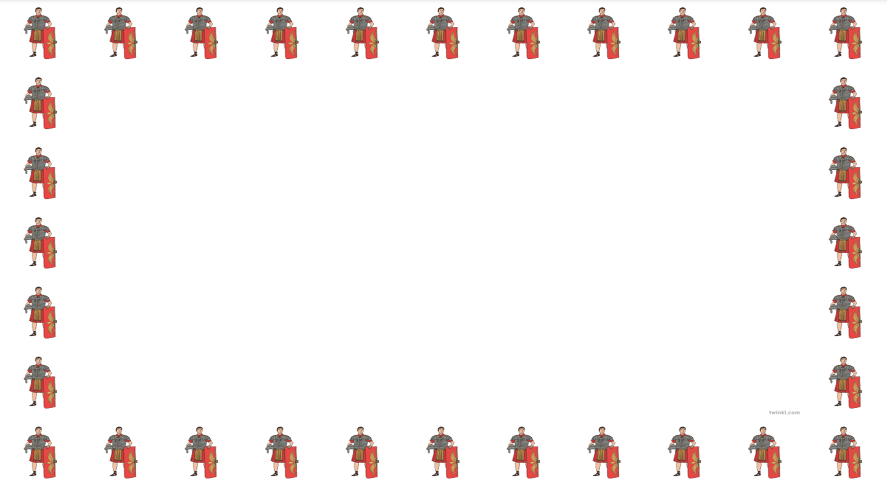
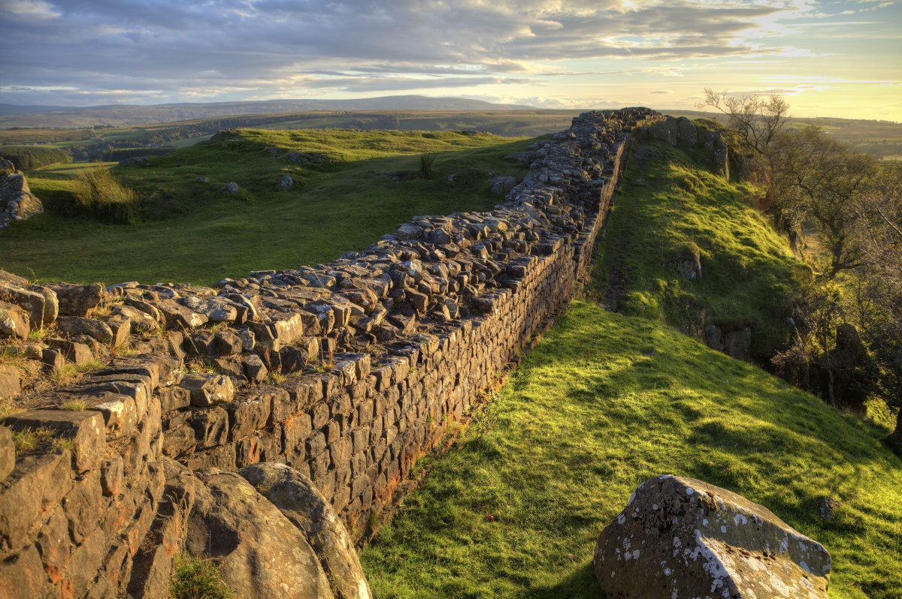
Timeline of the Roman Empire
753 BC – Rome is founded. Romulus becomes the first King.
509 BC – Rome becomes a republic ruled by elected citizens called senators rather than a king.
73-71 BC – A gladiator called Spartacus leads a revolt against the Romans
58-51 BC – The Romans invade France, Belgium, western Germany and northern Italy and control many lands around the Mediterranean sea.
55-54 BC – Julius Caesar tries to invade Britain twice but is beaten back by the Britons.
27 BC – Rome becomes an empire. Augustus Caesar becomes Rome’s first Emperor.
AD 43 – The Romans invade Britain under the orders of Emperor Claudius.
AD 60 – Boudicca leads the Iceni tribe in a revolt against the Romans.
AD 70-71 – The Romans Conquer Wales and northern England.
AD 83 – The Romans defeat the Scottish tribes at the battle of Mons Graupius.
AD 122 – The building of Hadrian's wall to defend the northern limit of the Roman Empire in northern England begins.
AD 211 – Britain is split into two provinces called Britannia Superior and Britannia Inferior.
AD 250 – New enemies, the Angles, Saxons and Jutes, repeatedly attack Britain.
AD 401-410 – Roman soldiers leave Britain to protect other parts of the Roman Empire.
What did the Romans do for us?
The Romans invented or developed many things that are still used today. They designed a system of underfloor heating to keep homes warm. They developed a drainage and sewerage system. The Romans built many roads, some routes that are still used today. They also built stone forts and walls for defence such as Hadrian’s wall and the fort at Vindolanda. Roman baths and aqueducts made o stone are still standing. The Romans brought in coins called denarii to buy things. The calendar we use today is based on the Roman calendar, with July and August being named after Julius Caesar and Emperor Augustus.

