Slide 1
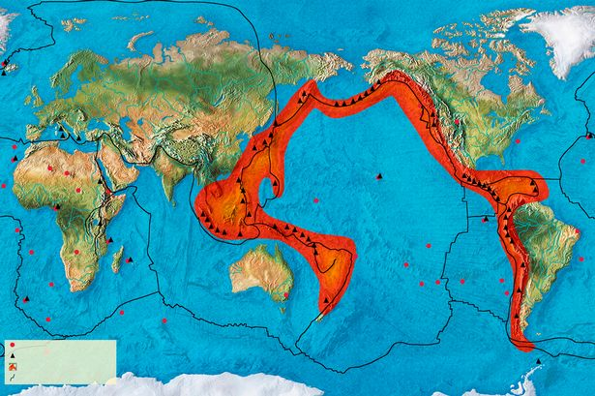
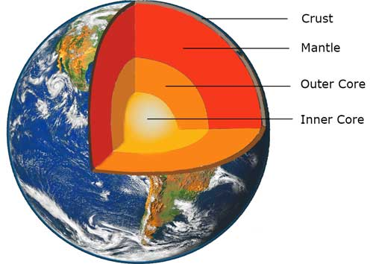
Tremors
Tremors. Overwhelming and mighty, Mother Nature’s awesome energies hiss and roar deep within Earth. Plates collide, spewing lava. Discover the dangerous world of natural disasters, and glimpse their savage and deadly effects. Visit the ancient city of historic Pompeii, frozen in time. Watch out! Volcanologists detect formidable rumblings from an extinct volcano. Red alert!
Earth
The Earth is made of different layers. The inner core is made mostly of solid iron and the outer core is made of liquid iron and nickel. The mantle is made of solid rock and liquid rock called magma. The crust is a thin layer of solid rock that is broken into pieces called tectonic plates. These pieces move very slowly across the mantle.
Volcanoes
When a volcano erupts, liquid magma collects in an underground magma chamber. The magma pushes through a crack called a vent and bursts out onto the Earth’s surface. Lava, hot ash and mudslides from volcanic eruptions can cause severe damage.
Earthquakes
An earthquake happens when two tectonic plates move along a fault line. The earth shakes violently, especially at the centre of an earthquake, which is called the epicentre. Strong earthquakes can cause a lot of damage. Buildings and roads can be destroyed and people can be killed. Scientists use a machine called a seismometer and a numbered scale called the Richter Scale to measure the strength of earthquakes.
Ring of Fire
The Ring of Fire runs around the edge of the Pacific Ocean and is made up of fault lines in the Earth’s crust. Most of the world’s earthquakes and volcanic eruptions happen along the Ring of Fire.

Slide 2
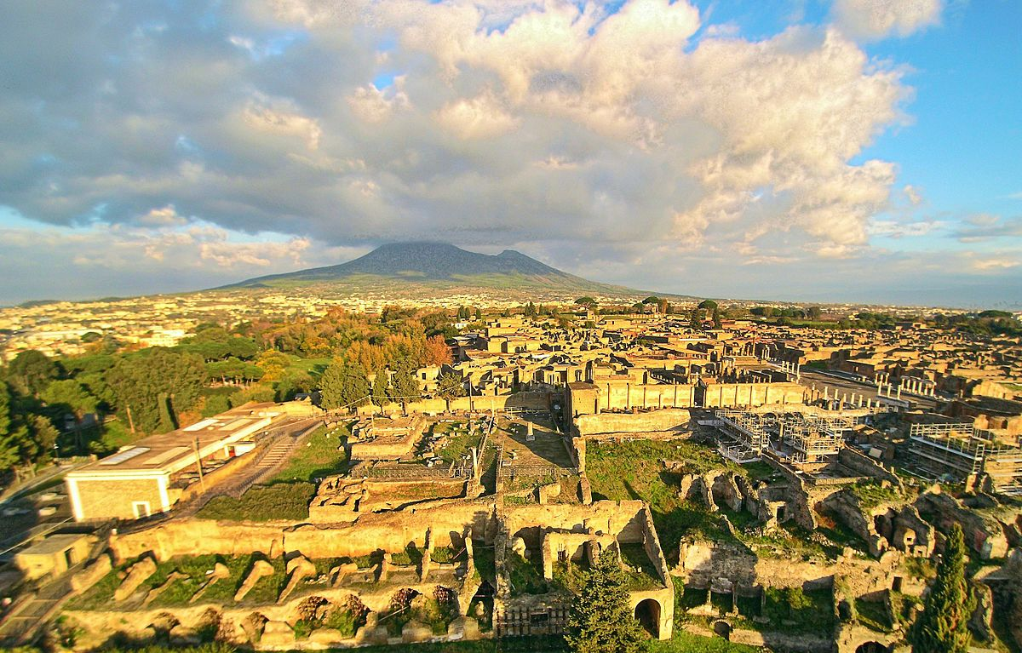
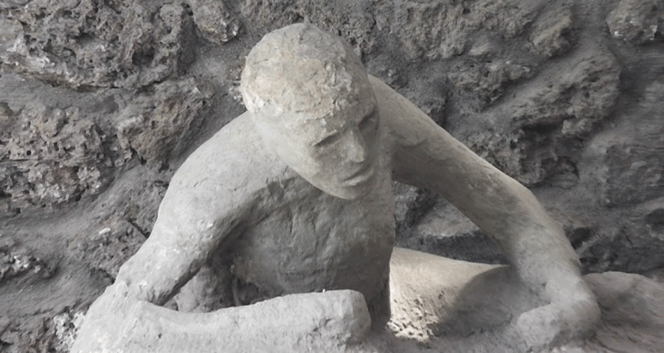
Eruption of Vesuvius
Mount Vesuvius in Italy erupted in AD 79, covering the Roman town of Pompeii with volcanic ash. The town was rediscovered in the 16th century but excavations didn’t begin until 1748 and archaeologists have been excavating ever since.
Glossary
fault line – a break in the Earth’s crust
lava- hot, molten rock that comes out of a volcano
magma – hot, molten rock found in the Earth’s mantle
Richter scale – a mathematical scale (1-10) used by scientists to describe the size of an earthquake.
seismometer – a device used to measure and record the strength and duration of an earthquake
tectonic plate – a large, moving piece of rock that makes up the Earth’s crust
vent – an opening in the Earth’s crust through which lava escapes
Timeline
24th August 79 AD
8am Small puffs of ash are seen from the volcano
1pm Mount Vesuvius erupts
3pm Hard pieces of cooled lava rain down
5-6pm Large pieces of pumice stone rain down
25th August 79 AD
4am The eruption column of ash and gas from the volcano reaches 30 km into the sky
5am Violent earthquakes shake the whole area
7am The eruption column collapses, sending rock, gas, ash and heat into Pompeii. Anyone still in the town dies. The eruption continues for days.
September 79 AD
The whole area is now buried in rock and ash. The crater of Vesuvius has collapsed and the volcano is 200m shorter than before the eruption.
1748
The excavation of Pompeii begins.
Present day
Archaeologists are still excavating the site.

