Slide 1
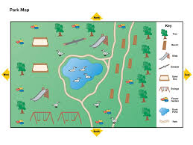
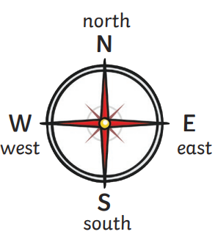
Geography - Street Detectives
Maps
A map is a picture or a drawing that shows the location of human and physical features in your local area or the world.
Maps often include symbols, instead of words, to show important features. These can be pictures or letters.
A key explains what the map symbols mean.
Compass directions help us to follow directions.
Directional language
Directions tell us
which way to go.
We can use this
language to describe
where things are on
a map.
These include:
Left
Right
Forwards
Backwards
Left and Right
The had that makes
the L shape is the
left hand.
We can also use
compass directions.
North
East
South
West

Slide 2
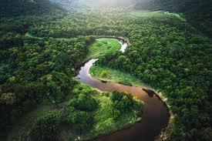
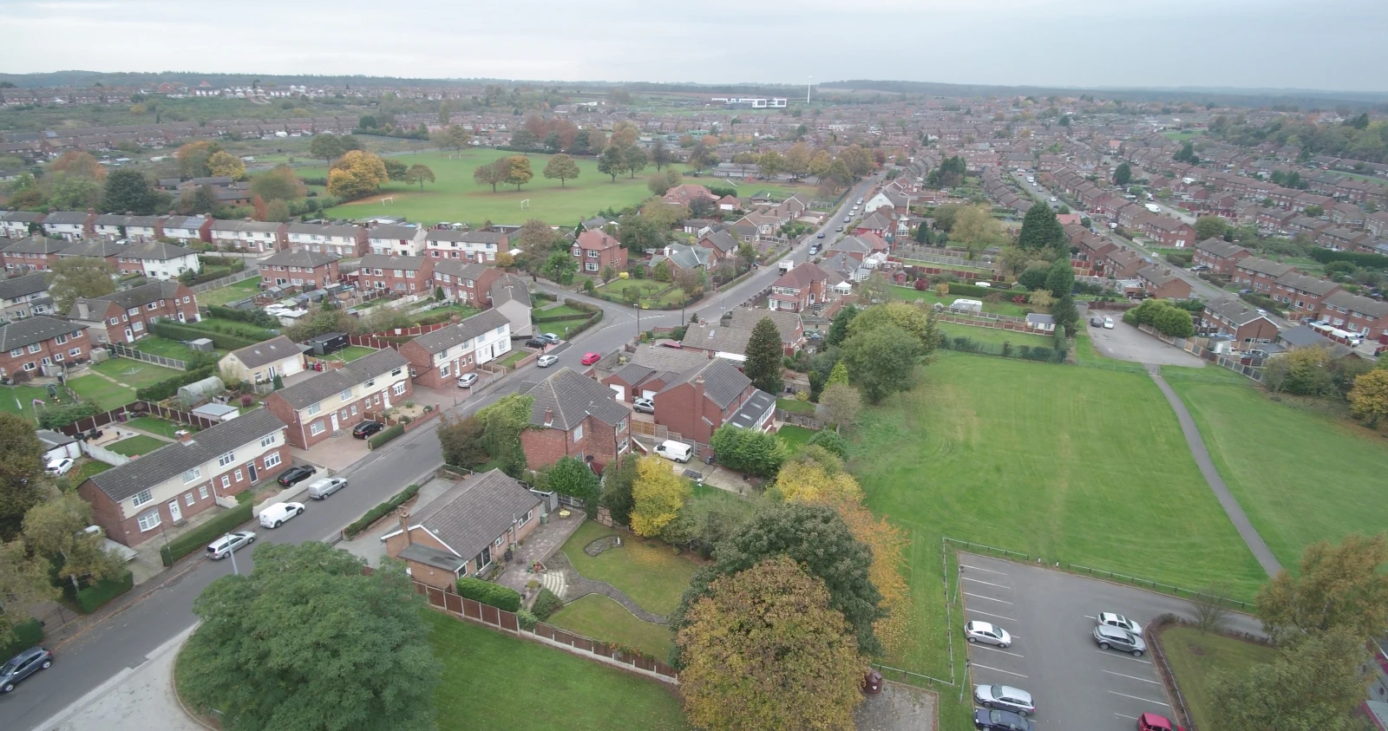
Human and physical features.
Human and physical features are landmarks that we can often recognise a place by. We can also use human and physical features to make simple observational skills.
Glossary
local area
A group of people living in the same area.
feature
An interesting or important part of something.
Physical features form naturally.
Human features are man- made.
key
A key shows what the symbols on a map mean.
aerial
Something that is happening in the air.
river
woodland
house
church
land use
How land is used by humans.
stream
train station
road
hill
cliff
shops
coordinate
Determines the geographical point of a place.
Aerial Photography
We can use aerial photographs to recognise these landmarks in our local area.
An object or feature of a landscape or town that is easily seen and recognized from a distance
landmark

