Slide 1
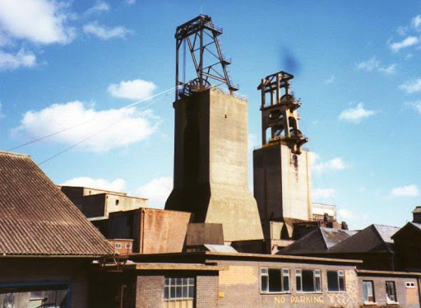
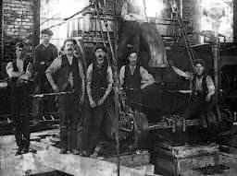
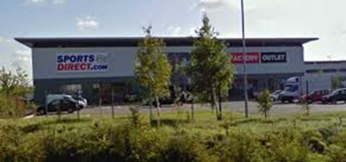
History - Street Detectives
In this topic we will be learning all about our local history and what it was like in the past!
Shirebrook Colliery
Shirebrook Colliery was a coal mine where men and children worked underground collecting coal.
Shirebrook Colliery was a huge part of the community and was one of the reasons why Shirebrook grew in size!
When Shirebrook Colliery opened the population increased and therefore more houses had to be built. Whilst the houses were being built people lived in huts and tents.
After the Colliery closed there were strikes and people had to find new jobs.
Timeline
1897 --
1906 –-
1964 –-
1993 -–
2004 –
2023 –
Shirebrook Colliery opened
Shirebrook train station opened
Our church was built.
Our school was built.
Shirebrook Colliery closed.
Sports Direct opened.
This year

Slide 2
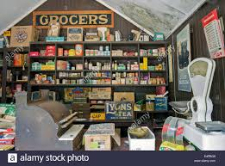
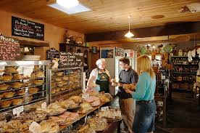
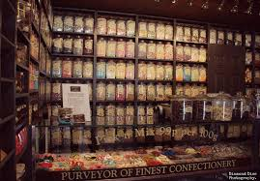
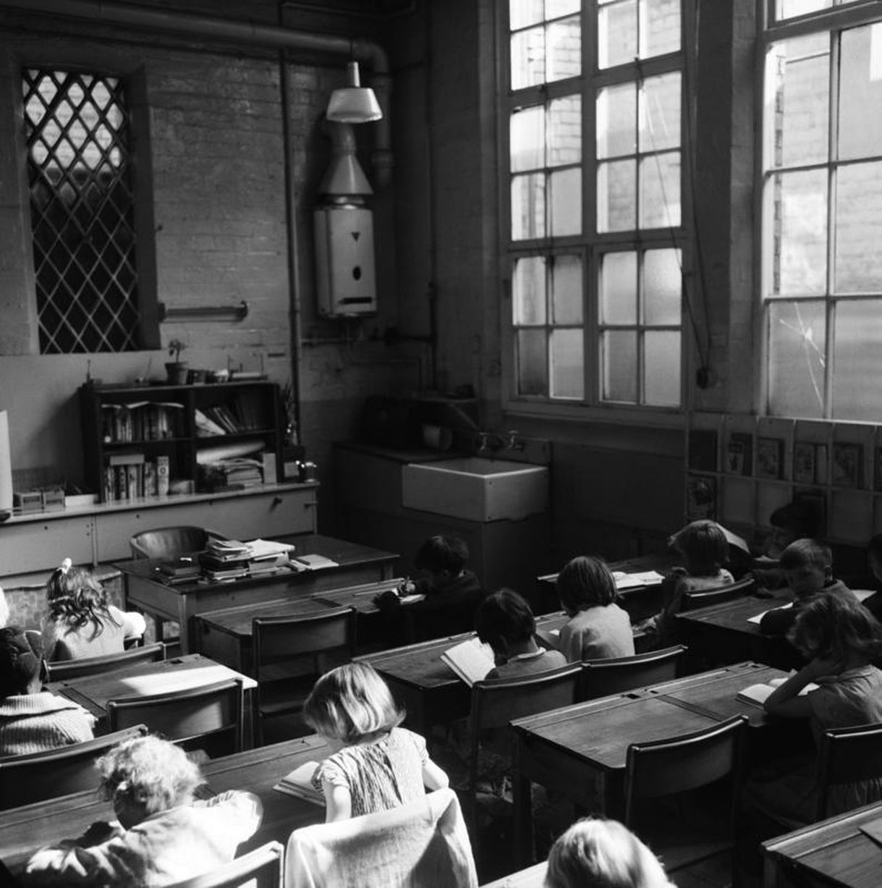
Changing communities
A community can change over time. How people shop is one way a community might have changed. In the past, people shopped in smaller shops like the examples below. Now, most people do their shopping at supermarkets.
Houses have also changed over time through technology and materials.
Glossary
community
A group of people living in the same area.
colliery
A place where you can mine coal.
butchers
A shop that prepares and sells meat.
Fire service
A means or moving people from place to place.
Grocer’s
Food like butter, eggs and cheese were bought from the grocer’s shop.
detached
house
A stand alone house.
semi-detached house
A house that shares a wall with another house.
Bakery
Bread and cake were bought from the bakery.
Terrace house
A house build in a row with other houses.
Sweet shop
Sweets were bought in sweet shops. They were kept in jars.
School
Schools have also changed overtime including class sizes, equipment, teachers and lessons.

