Slide 1
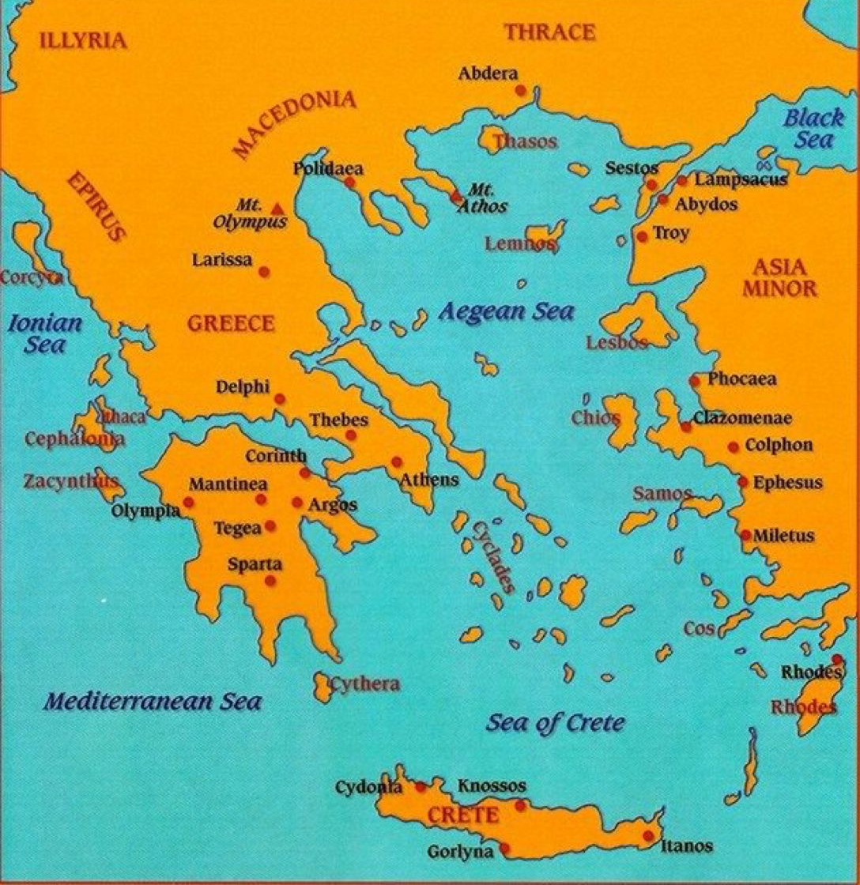
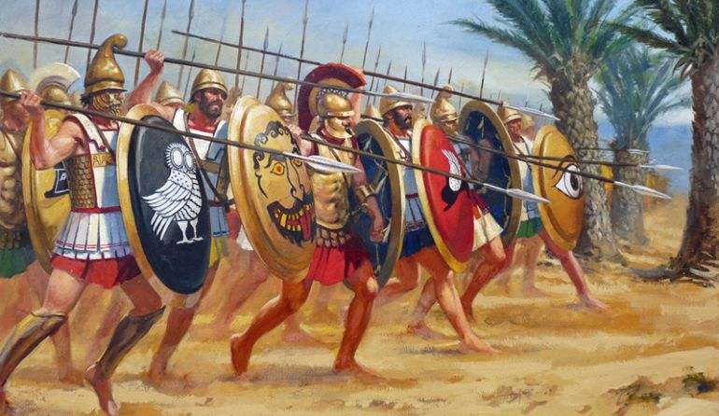
Gods and Mortals
Discover a fantastical world full of mythical creatures and legendary heroes. Poseidon, Apollo, Artemis and Zeus reign almighty from Mount Olympus, watching mere mortals on dusty Athenian streets. Meet Theseus, the hero, and Helen of Troy, the beautiful face that launched a thousand ships. Explore the terrains of Greece, where in pure blue skies, the sun scorches waxen wings and melts the fortunes of Icarus and Daedalus.
Ancient Greece
Life in Ancient Greece
Greek Soldiers
The Ancient Greeks lived about 4,000 years ago. Ancient Greece was made up of many city-states. These city-states were protected by a powerful city. Each city-state had its own laws, customs and rulers. Many city-states were at war with each other.
Ancient Greece was a warm, dry country. Most people worked as farmers, fishermen or traders.
Homes
Ancient Greek homes were usually built around a central courtyard. The walls were built from wood and mud bricks, with small windows. Rich people decorated their walls with paintings and colourful tiles. There were no bathrooms so people washed in public baths or streams. Mattresses were stuffed with wool, feathers or dry grass.
Family
Men made all the important decisions in ancient Greece. Women were mostly expected to look after the home and were taught home-making skills, such as cooking and weaving. However, women and girls in the city-state of Sparta had more freedom and were taught to read and write. Spartan children were sent away from home when they were 6 or 7 years old. Boys were trained as soldiers and girls went to school.
War was a big part of life in ancient Greece. The armies were mainly made up of foot soldiers, known as hoplites. They fought with a long spear and used a large shield for protection. In battle, hoplites fought together as a team. They would line up and interlock their shields to create a shield wall, then point their spears over the top. This formation, known as the phalanx, was very effective.

Slide 2
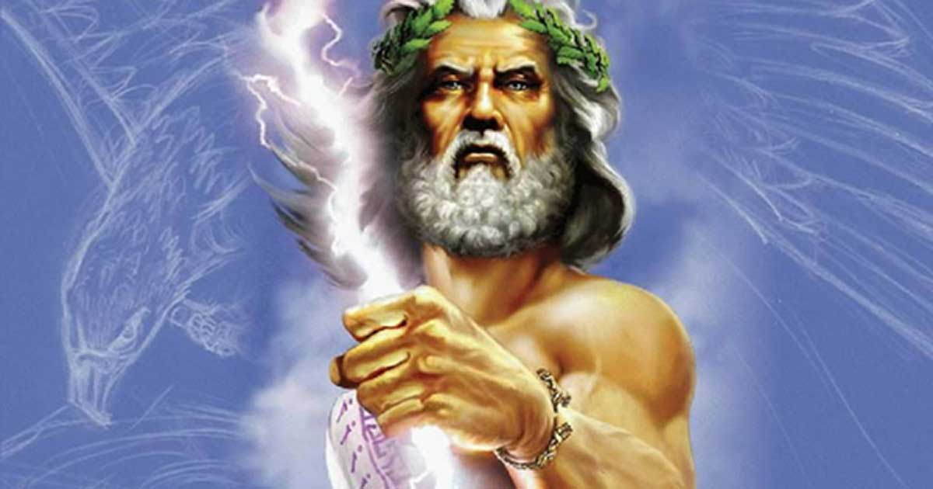
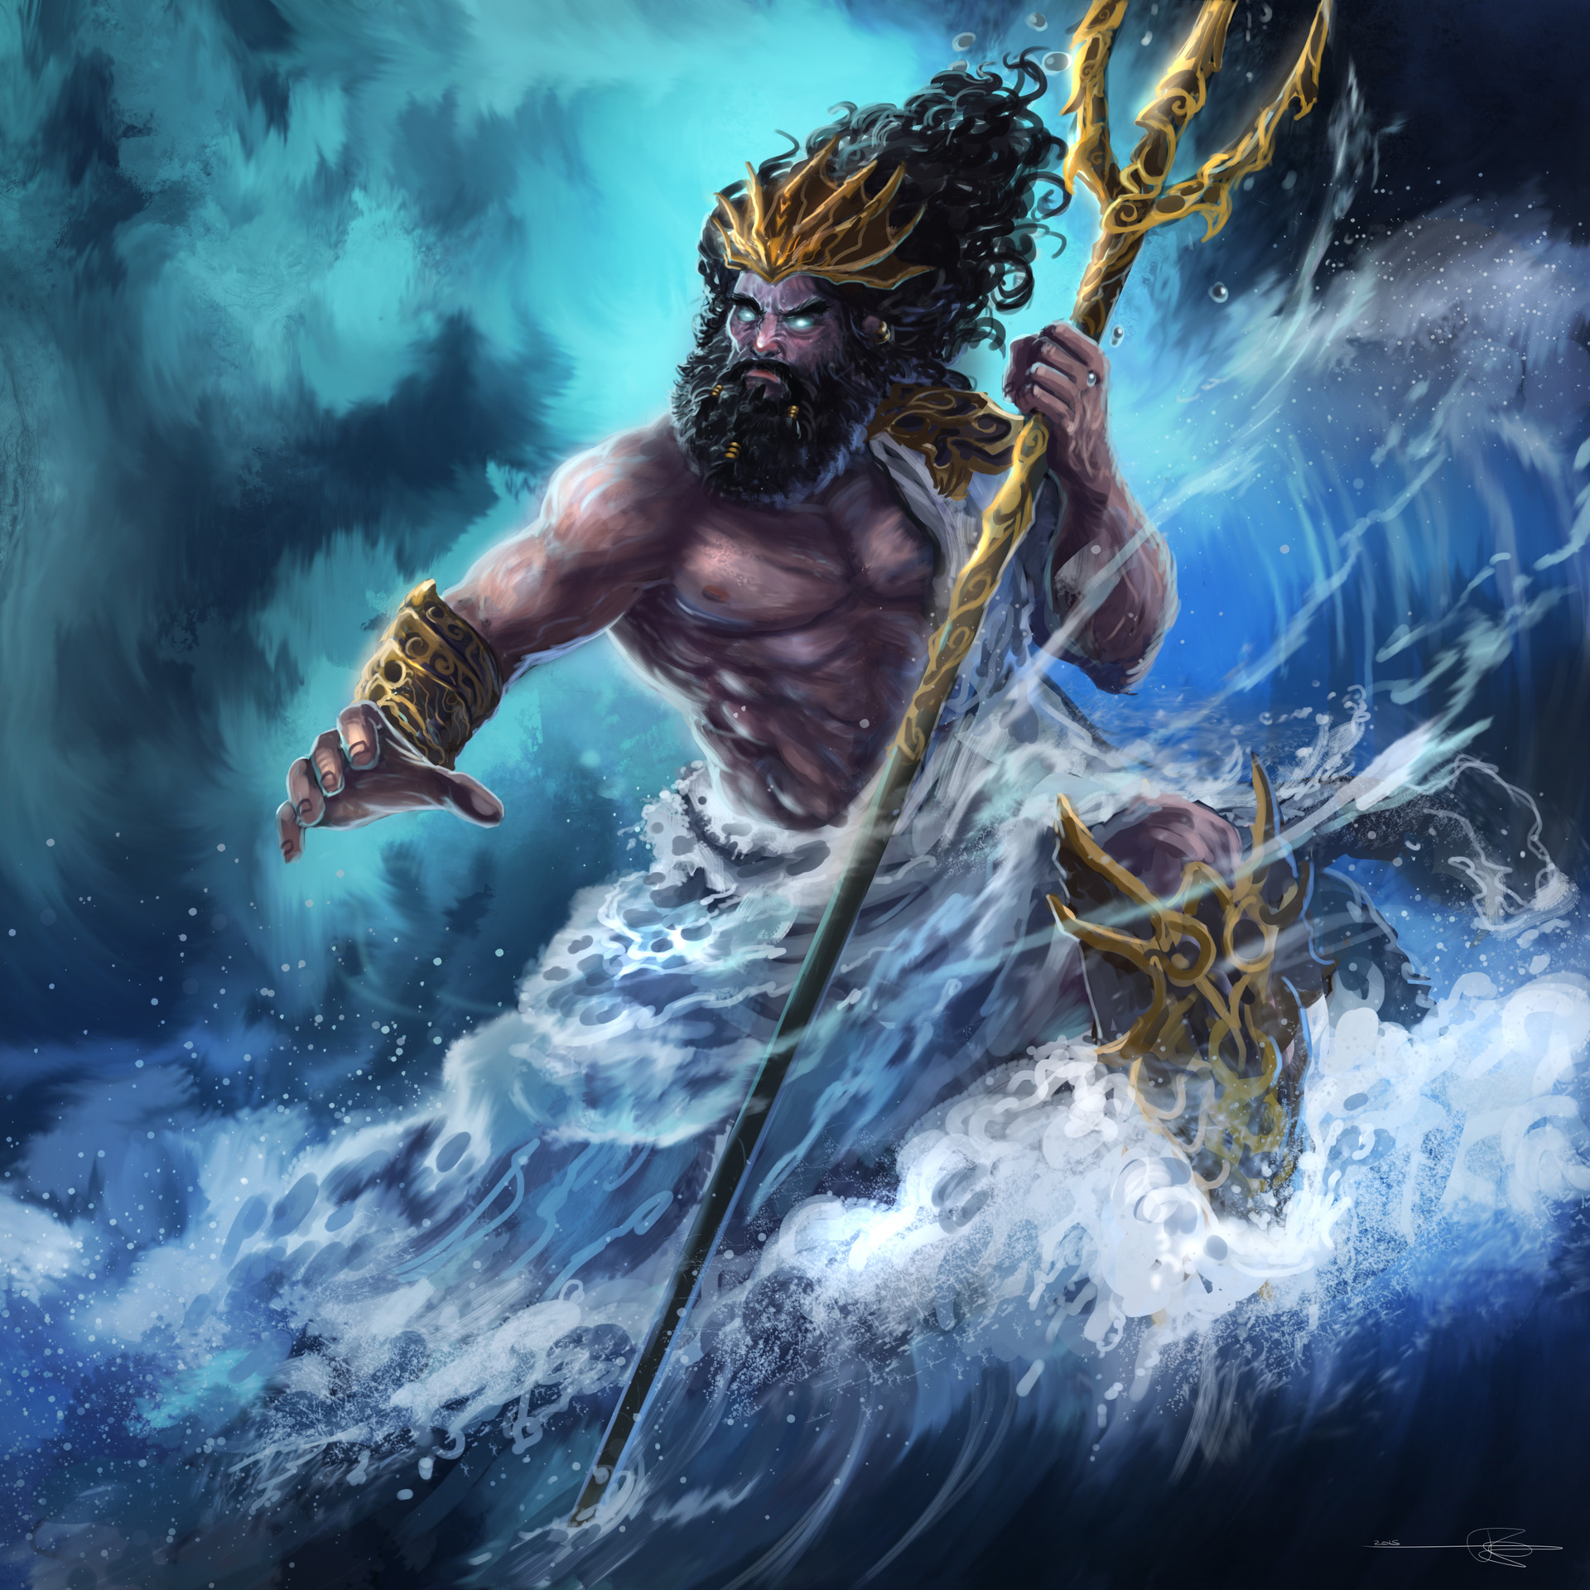
Timeline
Gods and goddesses
Glossary
1600BC Greek civilisation begins. City-states are formed.
1200BC The Trojan War is fought between ancient Greek city-states and the city of Troy.
850-700BC The Greek alphabet is developed.
776BC The first Olympic Games are held in honour of the god Zeus.
600BC Greek coins are introduced.
508BC Democracy is introduced in Athens, where citizens vote for people to be their representatives.
490BC The Greeks win the Battle of Marathon against the Persians.
336BC Alexander the Great, King of Macedonia, invades and conquers Persia and Egypt.
323BC Ancient Greek civilisation begins to decline after the death of Alexander the Great.
146BC The Romans conquer ancient Greece and Greece becomes part of the Roman Empire.
The ancient Greeks believed the gods and goddesses watched over them from the top of Mount Olympus and that each god or goddess had a power over a different part of the world.
Zeus – king of the gods and ruler of the skies
Poseidon – god of the sea
Hades – god of the underworld
Demeter – goddess of the Earth and harvest
city-state An ancient city and the surrounding area with an independent government in ancient Greece.
conquer To take control of another country and its people, usually after a war or battle.
democracy A system where the government is elected by the people.
hoplite A heavily armoured, non-professional foot soldier of ancient Greece.
labyrinth A confusing set of complicated, connecting passages and blind alleys that make it easy to get lost.
minotaur In Greek mythology, a monster that is half man and half bull, who lived in the centre of a labyrinth.
Mount Olympus A mountain peak in Greece where the ancient Greeks believed the gods lived.
myth An ancient story that explains the early history of a group of people.
Greek myths
Greek myths are stories about the gods and magical creatures of ancient Greece. They taught people about values such as bravery, intelligence, right and wrong.
Icarus and Daedalus
Daedalus and his son, Icarus, built a labyrinth for King Minos of Crete. They were locked up but escaped by making wings from feathers and wax.
Theseus and the Minotaur
Theseus from Athens killed the minotaur belonging to King Minos and escaped from Crete with Princess Ariadne.

