Slide 1
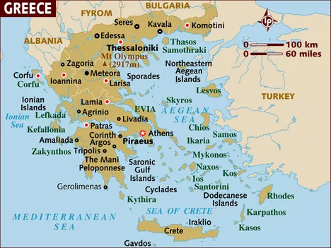
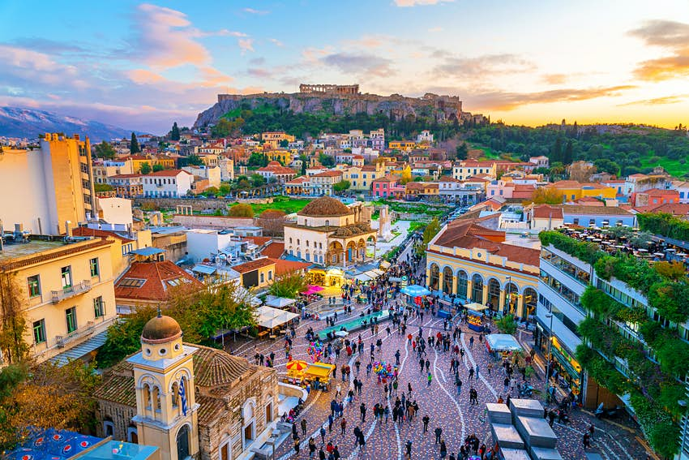
Gods and Mortals - Geography
Greece
The most populous and the capital city of Greece is Athens. It has a population of over 3 million people. Most settlements were founded around the coast, as Greeks historically were seafaring people. Land is used for agriculture, leisure, tourism and fishing.
Greece is a country in Europe. To the north of mainland Greece, there is Albania, FYROM (Macedonia) and Bulgaria. There are also many Greek islands.
Greece has a warm, sunny climate and enjoys more than 250 days of sunshine a year. It has a typically Mediterranean climate with hot, dry summers and mild, rainy winters.

Slide 2
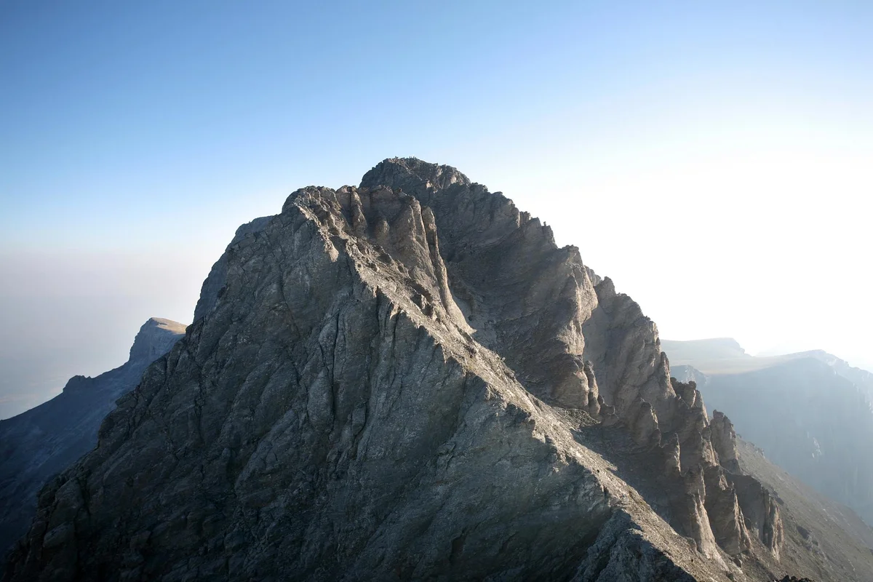
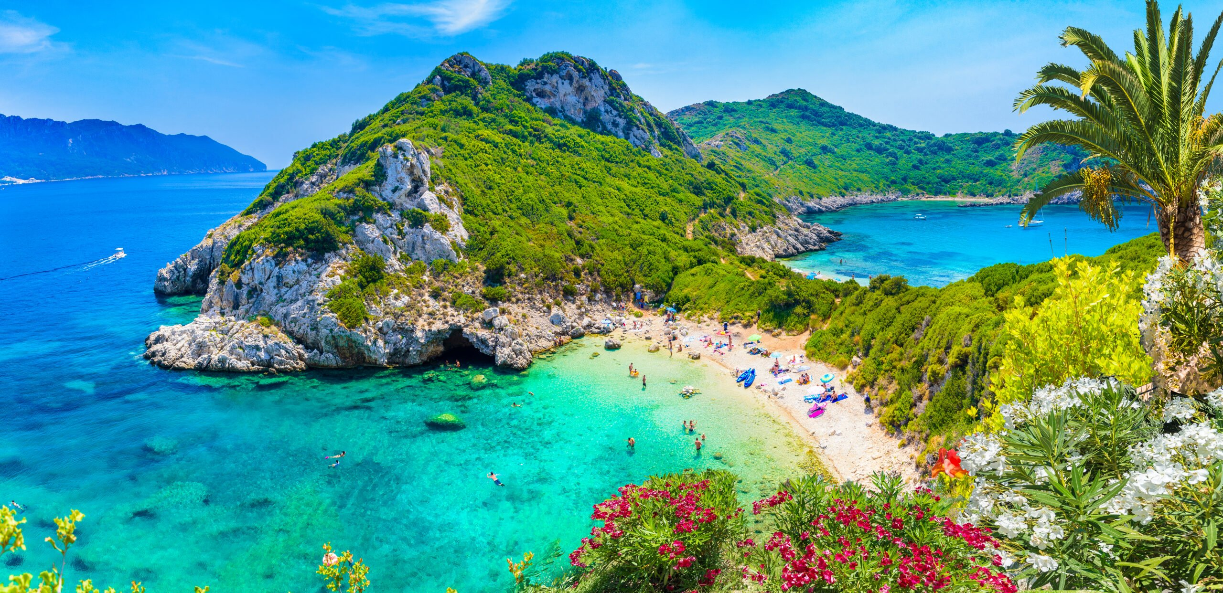
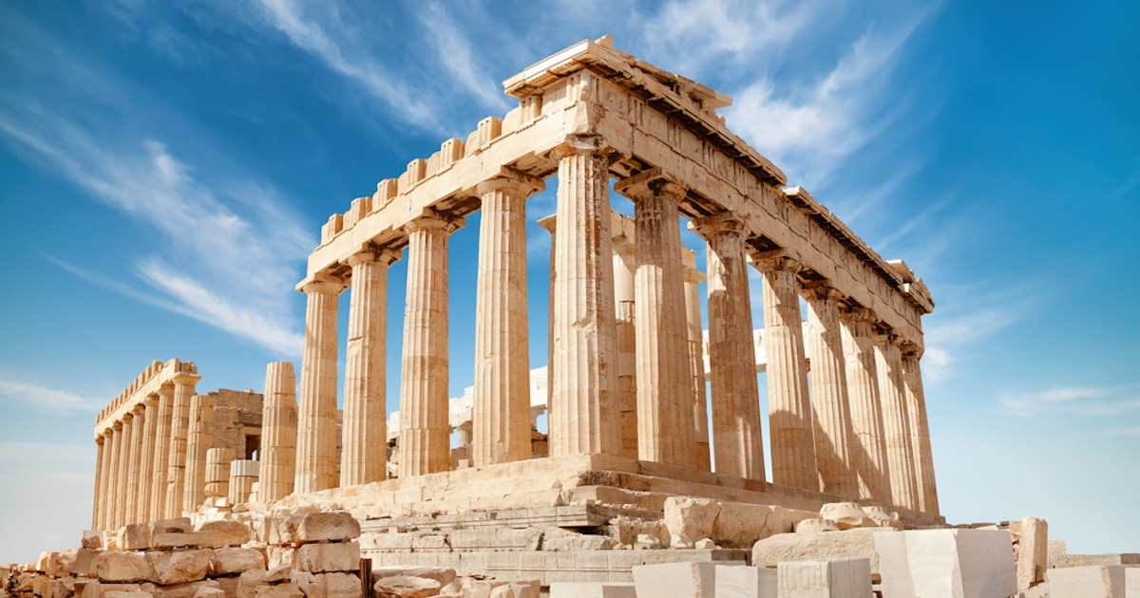
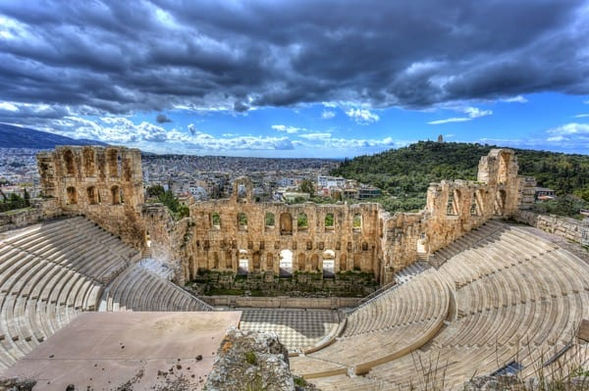
Physical Features/Topographical features
Glossary
A mountain is formed by tectonic plates moving together and pushing up until tall structures are formed.
Acropolis – a part of an ancient Greek city built on high ground and containing important buildings
climate – the weather conditions in an area.
coast – the part of the land next to or near the sea
feature - An interesting or important part of something.
mainland – a large area of land that includes the greater part of a country
populous – lots of people live there
seafaring – regularly travelling by sea
temple – a building devoted to the worship of a god or gods
trade – buying and selling items
An island is formed when land breaks away from a continent or volcanoes form under the sea and rise out of the water.
Human Features
The Parthenon is a former temple, dedicated to the goddess Athena who is said to be the patron of Athens.
The Odeon of Herodes Atticus is a stone theatre structure on the southwest slope of the Acropolis in Athens, Greece.

