Slide 1
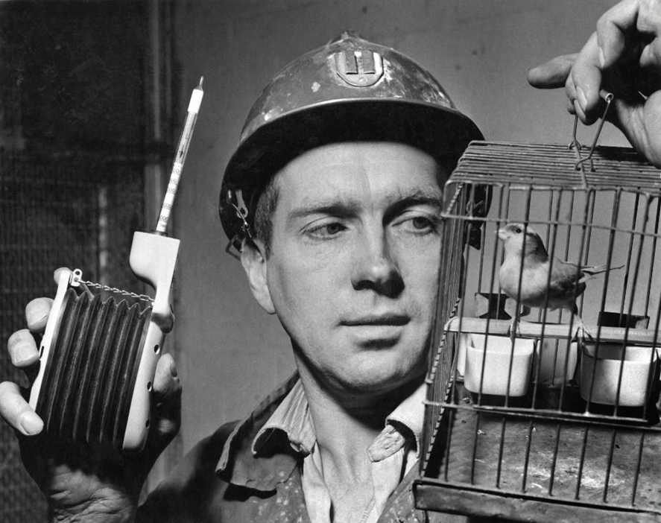
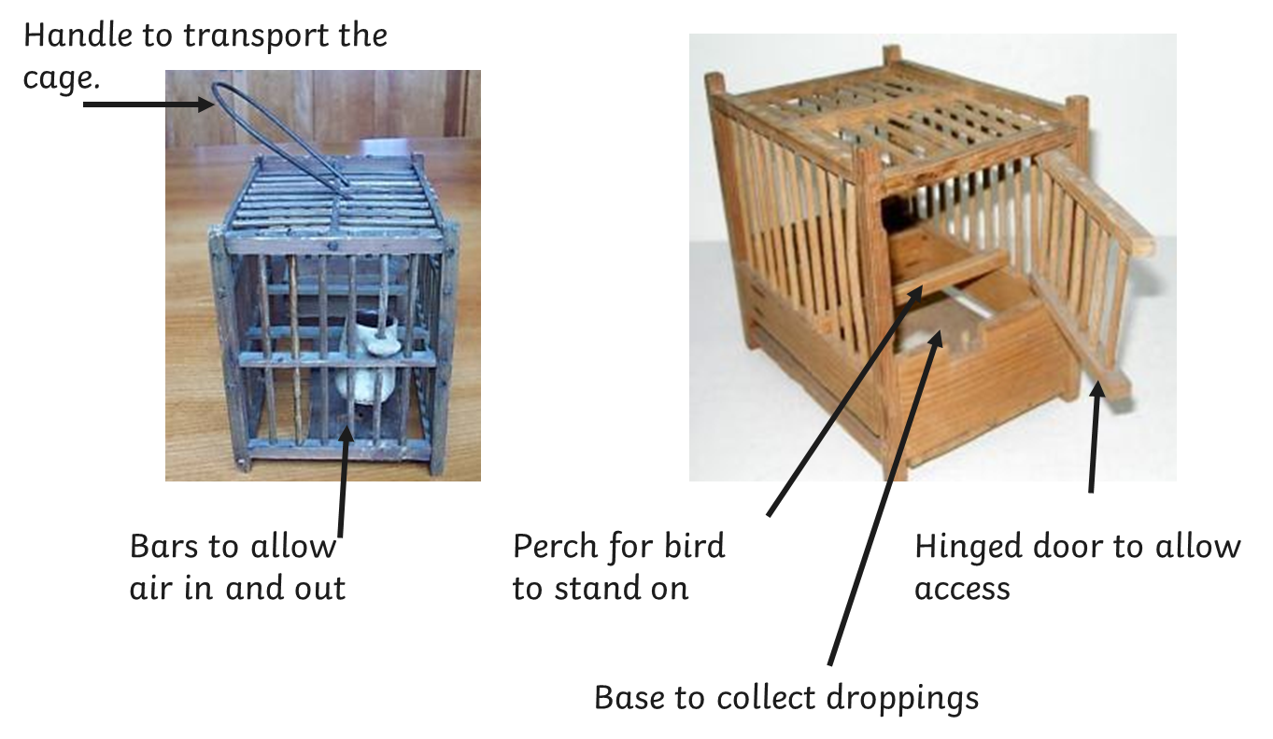
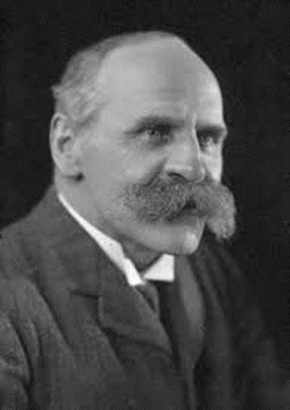
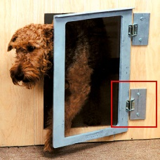
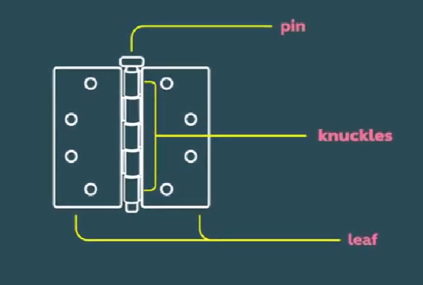
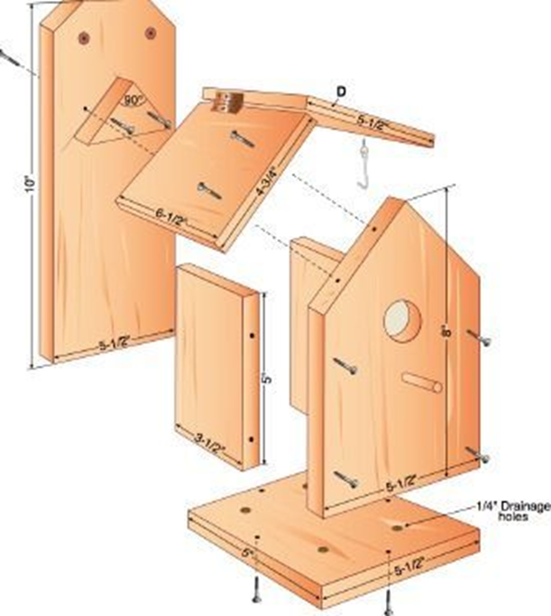
DT Structures
Mechanisms- Hinges
Glossary
Cage- A structure made with bars or wires.
Design Criteria- A list of objectives to be included in the final product e.g size of product, purpose, features to be included etc
Exploded diagram A detailed diagram that shows each component and how it fits together.
Hinge- A product that allows movement between two objects such as a door and a frame.
Miner’s bird cages were often small and cube shaped with a vertical bars. Most were made of wood and included a perch, food dish, door and handle on the top.
Doors, gates, cages and lids all use hinges to allow them to open and close.
A simple hinge consists of two separate leaves, joined in the centre around a pin. The knuckles surround the pin and allow the two leaves to move – making a door or lid open and close.
Designers use exploded diagrams to show users how to make their products.

