Slide 1
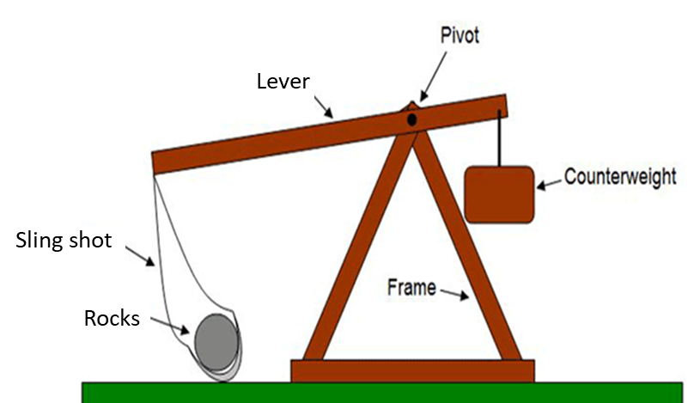
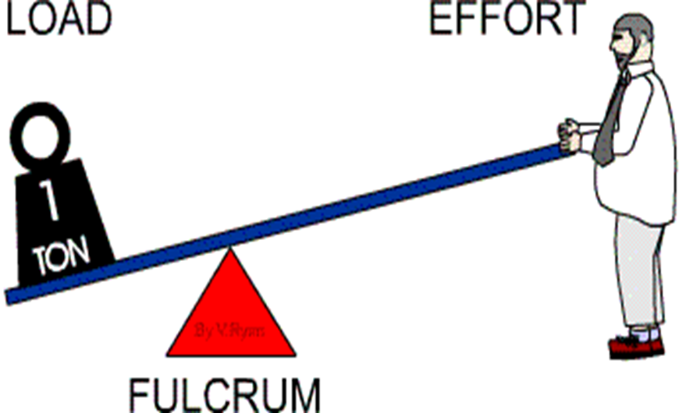
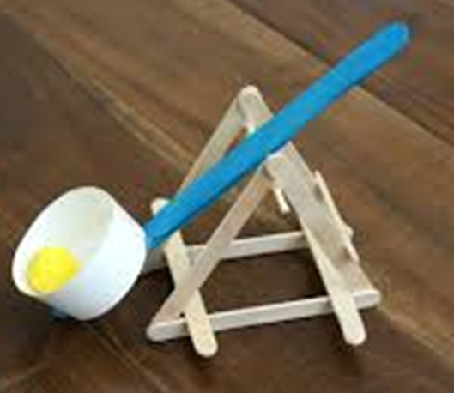
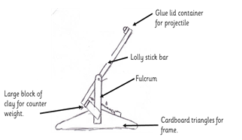
DT Mechanisms- Levers
Glossary
Counter weight-A weight on the opposite end of a load
Design criteria- List of objectives to be met.
Effort- The force applied.
Fulcrum- The part of a mechanism that lets the bar pivot.
Lever- Stiff bar
Load- The force produced
Pivot- Moving up and down or round and round from a central point.
Projectile- An object that is thrown though the air by force.
Sling shot- Used to shoot stones.
Stable- Not likely to fall down.
Trebuchet- A medieval mechanism similar to a catapult.
A lever pivots around a fulcrum. It reduces the amount of force needed to move or lift a load. The force you apply is called the ‘effort ’ and the force you produce is called the ‘load’. There are different classes (types) of lever. When the fulcrum is in the middle, this is a 1st class lever.
The trebuchet was a weapon that had a sling shot filled with stones.
Once the counterweight was released, the lever swung upwards quickly, projecting the rocks far away.
Triangles can help strengthen a structure because they won’t collapse under a lot of weight..
Wide, level bases ensure structures are stable.
Adding weight to the base can help stop it moving.
A detailed plan can show the materials you intend to use for each part of your mechanism and ensure you include the correct design criteria.

