Slide 1
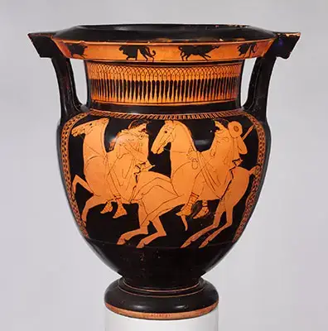
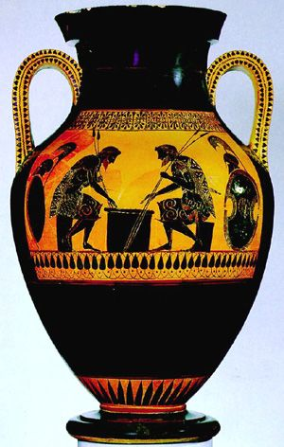
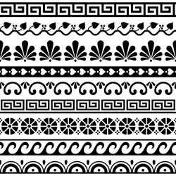
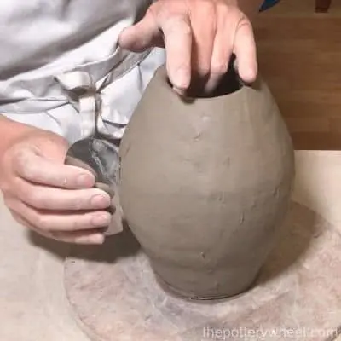
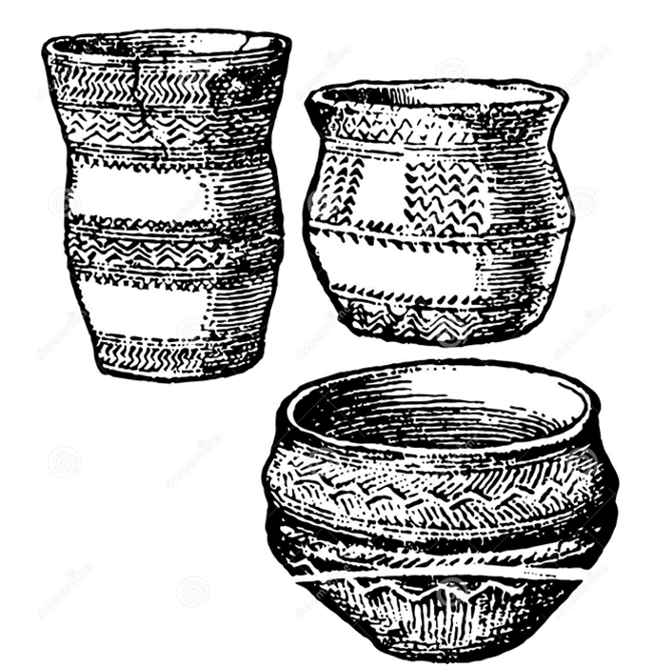
Art knowledge organiser-Clay
Glossary
Amphora- 2 handles jars that stored wine, grain, oil and milk.
Coils- Long sausage shaped pieces of clay.
Ellipse- A flattened circle shape.
Geometric- 2d shapes such as circles, squares and triangles.
Herringbone- A zig zag pattern that resembles the bones of a Herring fish
Score- Scratches on the surface to make the clay rough.
Slip- A mixture of clay and water.
The Ancient Greeks made pots or vases which featured geometric shapes around the neck and base of a pot.
Over time, people started painting pots with scenes of their everyday lives, stories from Greek mythology, the Olympic games or pictures of battles. The clay used had lots of iron in it and would turn red once it had been heated in the kiln. Amphoras were a popular style of jar.
Clay Coil Pot
The pot needs a circular base to attach the coils onto. Coils need to be the same thickness. They need to be joined with slip and score to the base and each other. The outside of the pot should be smoothed with water and fingers or a tool. Handles should be symmetrical
Shading can make the pot look 3 dimensional.
An ellipse can be used to show the beaker pot opening.

