Slide 1
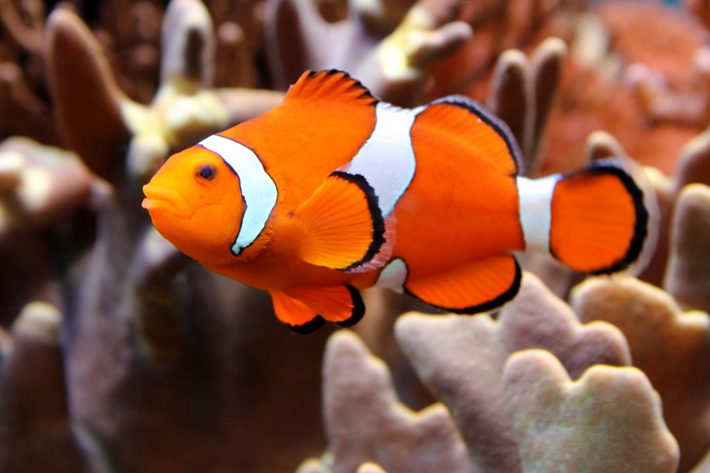
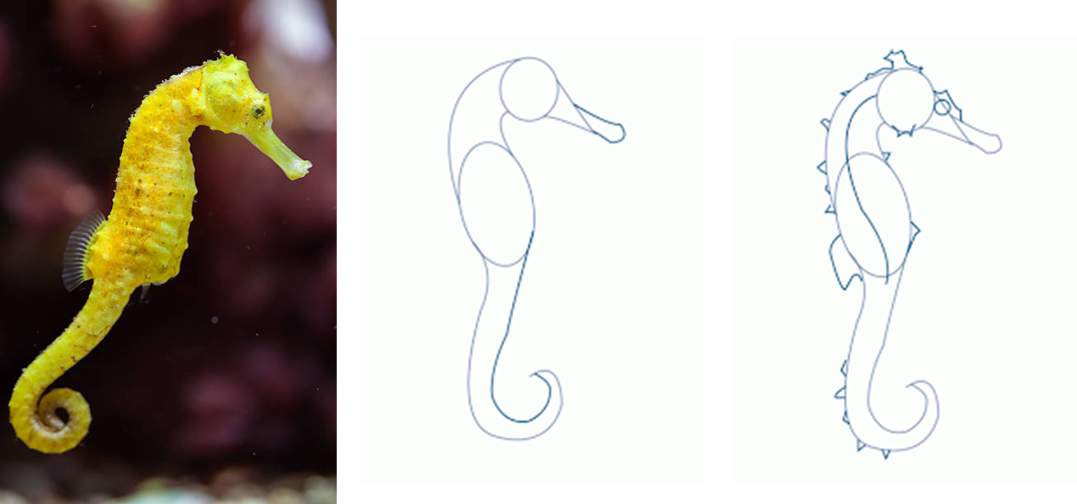
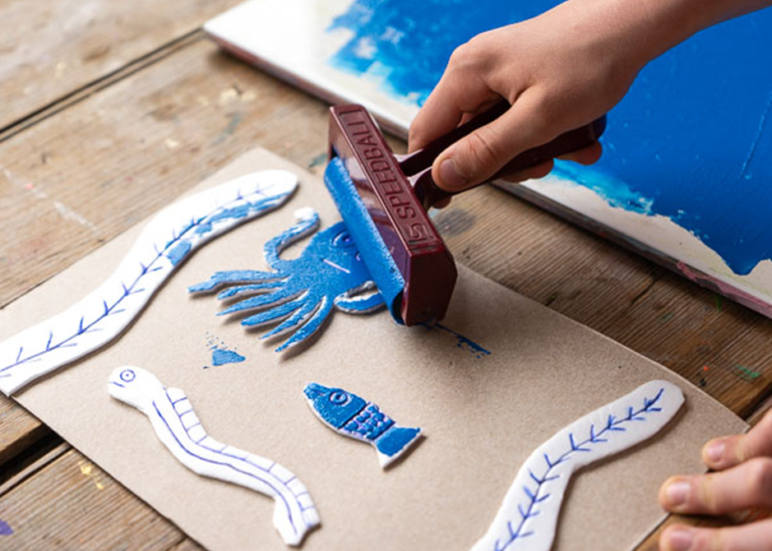
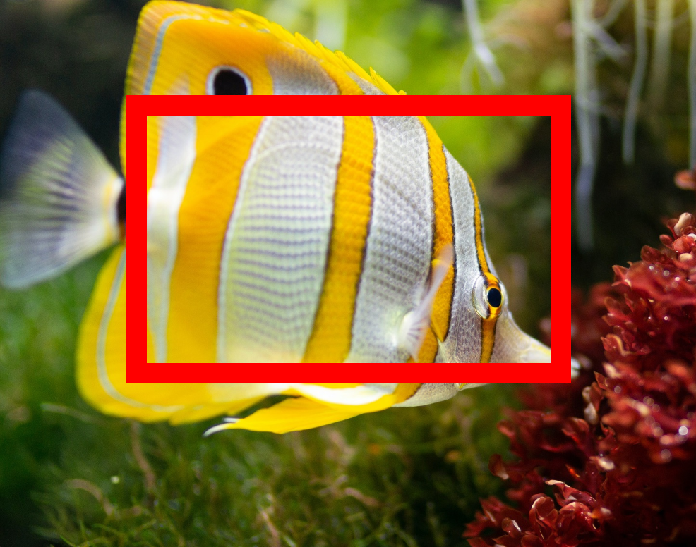
Art Knowledge Organiser
Collograph Printing
Glossary
Collograph- A printing technique where different materials are glued onto the printing plate.
Ink-Similar to paint but takes longer to dry.
Printing plate- You press this onto the paper to print the image.
Texture- How something feels
Viewfinder- A piece of paper with a piece cut out to look through.
You can use simple shapes to draw the parts of a sea creature e.g ovals for the body, triangles for the fins and circles for the eyes.
Suitable materials
Wool
Bubble wrap
Cardboard
Foam
String
Tissue
Cotton wool
Collograph printing
Different materials are glued down onto the printing plate
They need to be glued well so they don’t come off during printing..
A viewfinder can help you to focus on texture such as scales.
You only draw what is inside the viewfinder.

