Slide 1
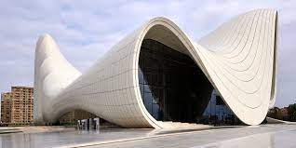
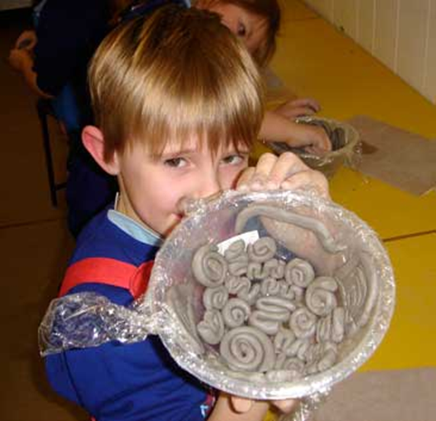
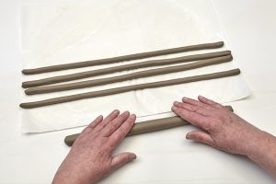
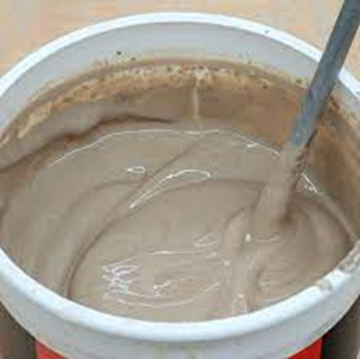
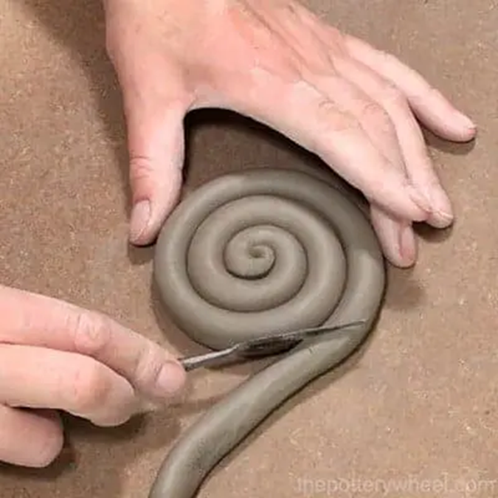
Art Knowledge Organiser
Architecture and Clay
Glossary
Architect- someone who creates drawings and plans for builders.
Coil- Long sausage shaped pieces of clay.
Frame- A support structure.
Plans- Drawings which show the outside and inside of a building.
Score- Scratches on the surface to make the clay rough.
Slip- A mixture of clay and water.
Zaha Hadid was a famous architect. She was born in 1950 in Iraq.
Her designs were modern looking. They had curves and were often based on nature such as waves, boulders and water.
Clay techniques
Clay can be rolled into coils and moulded into shapes.
Slip and score is used to join clay together.
You can mould clay over a frame.

