Slide 1
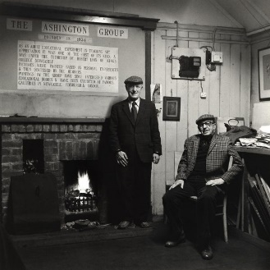
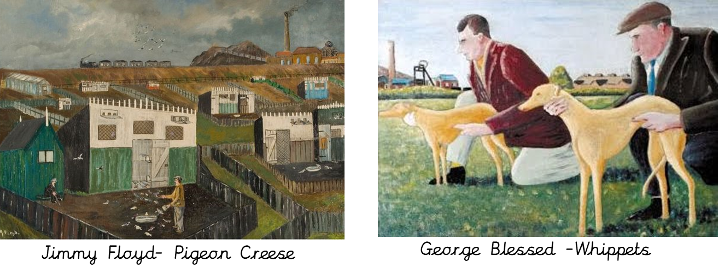
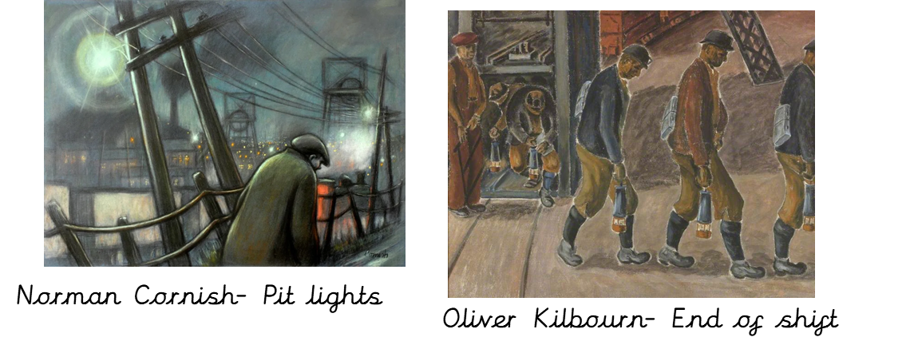
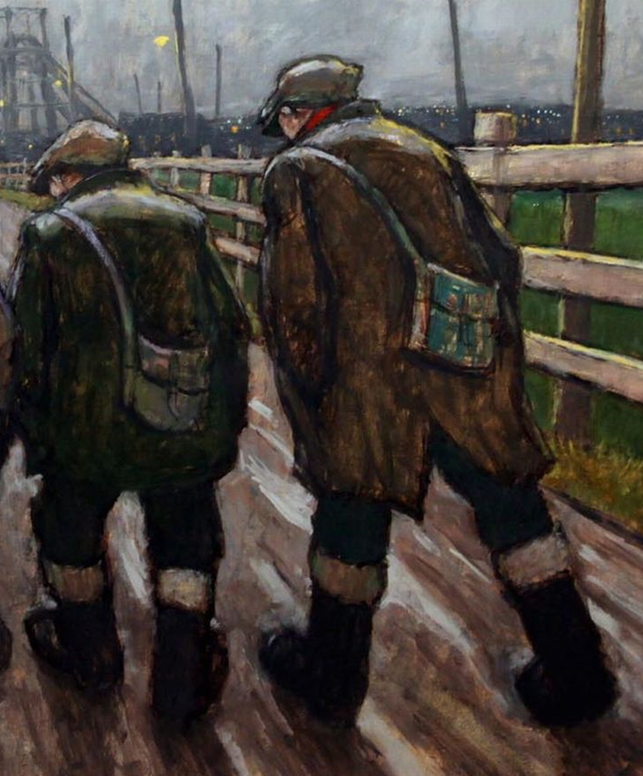
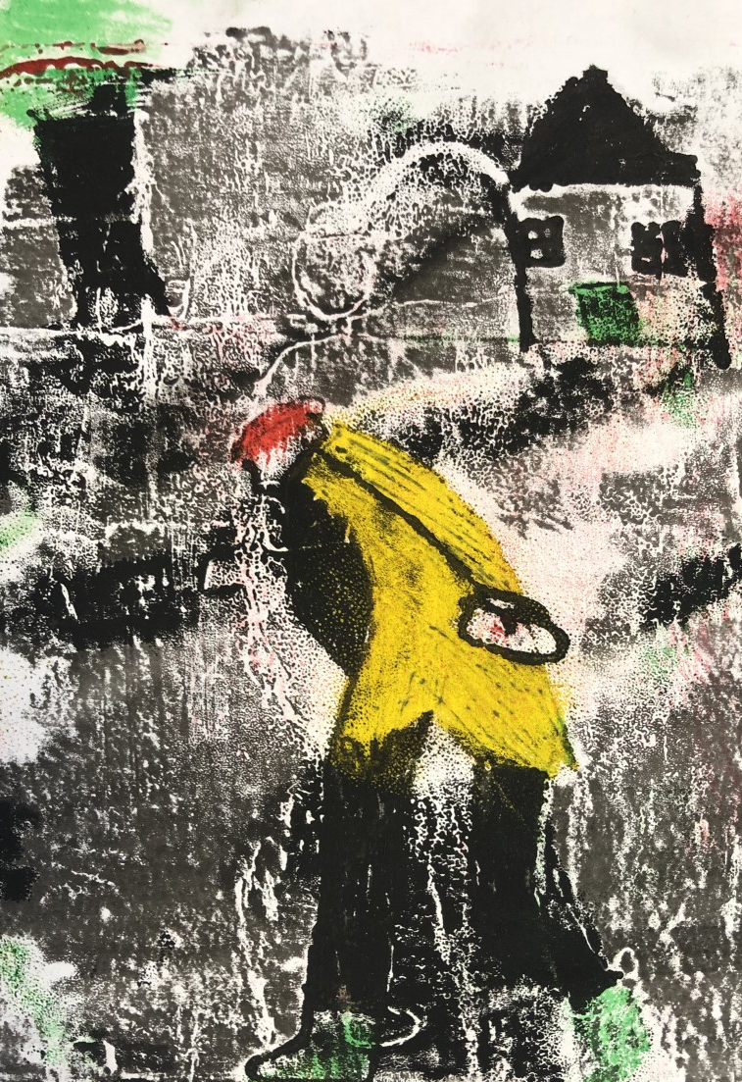
Art Knowledge Organiser Drawing and printing
Glossary
Art movement- A style of art that spans a particular time.
Inking pad- A plastic tray or board where the ink or paint is poured
Mono print -A printing technique where the artist draws or traces an image onto an ink pad and creates an image.
Texture- How something feels.
Tone- Light and dark areas.
Shading- Darker areas.
The Pitmen painters (Ashington Group) were a small group of miners who met regularly between 1934 and 1983. They produced hundreds of paintings showing what life was like both above and below ground for their mining communities in Ashington in Northumberland. They did not really belong to a particular art movement.
Texture can be shown by varying the size, direction, amount of marks and lines and amount of pressure applied by the pencil.
Shading down one side of a figure can show tone and make a figure appear more 3 dimensional.
To draw a figure that looks like it is moving, the body should lean forwards, legs be apart and one foot can be off the ground. Sometimes, arms appear to be swinging.
Mono printing
More than one colour can be mono printed by inking up different inking pads with different colours. You need to print the lightest colours first and then the darkest colours.

