Slide 1
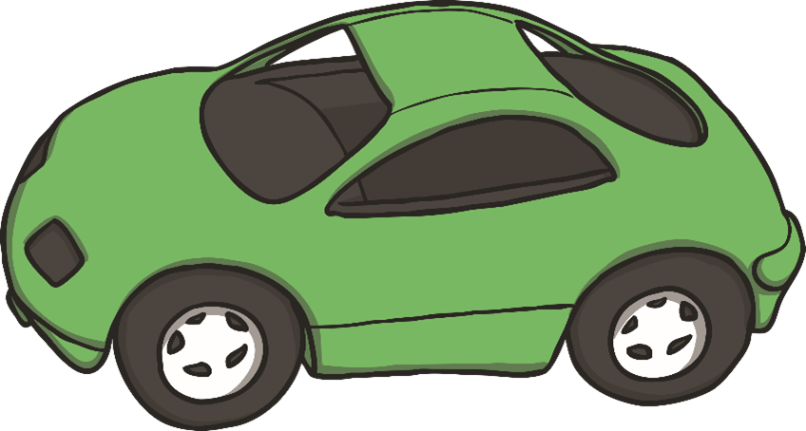
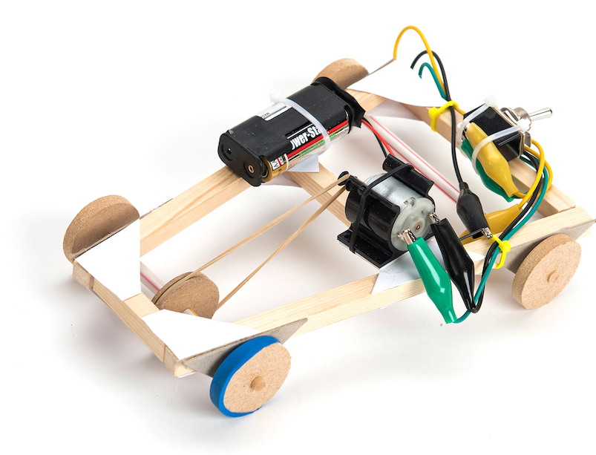
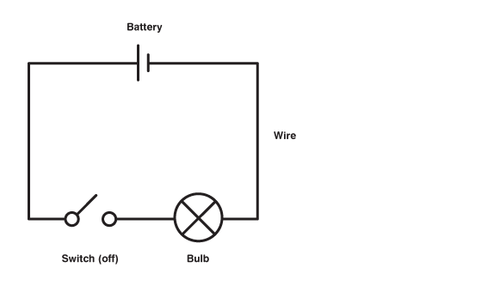
Glossary
Annotate-Adding writing to explain an idea in more detail.
Axle-A pole that passes through the centre of a wheel.
Circuit- A path for electricity to flow around.
Chassis- The frame of a vehicle.
Force- Energy or movement.
Motor- A device that rotates around and can transfer electrical energy into mechanical energy.
Pulley- A wheel with a grooved rim that can transfer a force.
Switch-A part within an electrical circuit which enables the flow of electricity to be turned on and off.
DT Electrical mechanical
Moving vehicles have a chassis, axles and wheels.
.
M
In this simple vehicle, the battery powers a motor. The motor spins round and round. It has a pulley attached to it that transfers the force from the motor to the wheels of the car.
Motor
A circuit with a switch can turn the motor on and off.

