Slide 1
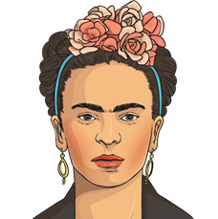
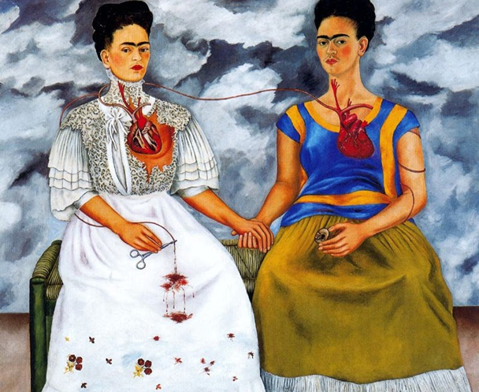
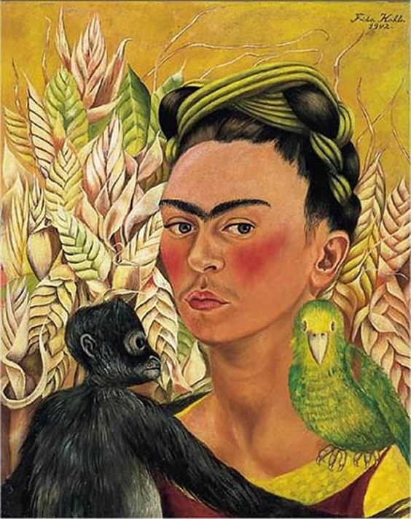
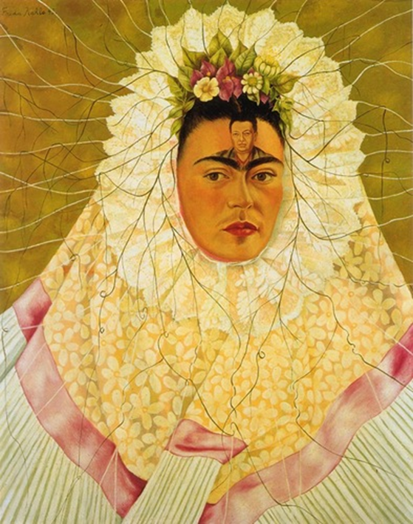
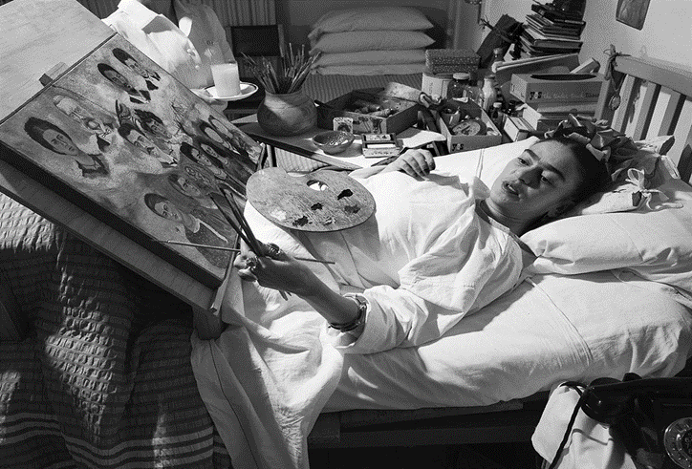
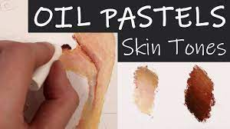
Art Knowledge Organiser
Drawing and Oil pastels
Glossary
Art movement- A particular style of art followed by a group of artists.
Autobiographical- About one’s own experiences.
Body cast- A hard covering, that allows broken bones to heal by holding them in place.
Blend- Mix together colours so they join.
Oil pastel- Oily sticks of colour.
Polio- A virus that can cause paralysis.
Tone- Light and dark areas.
The two Frida’s 1939
Monkey and Parrot 1942
Self Portrait as a
Tehuana 1943
Frida Kahlo was born in Mexico in 1907. She was famous for painting self-portraits She didn’t really follow an art movement although she considered her work autobiographical as she painted her actual experiences that were felt at the time. Frida was married to the famous Mexican artist, Diego Rivera. It was a stormy marriage. They divorced in 1939 but they remarried in 1940!
As a child, Frida suffered from Polio and later on she was involved in a traffic accident which left her in a whole body cast but she overcame her disabilities to paint.
Drawing a sideways pose
The line down the middle of the face shits to the side.
The face will not be symmetrical.
One ear will not be visible.
Skin tones can have a blue, red or yellow undertone,
Oil pastels should be blended smoothly.

