Slide 1
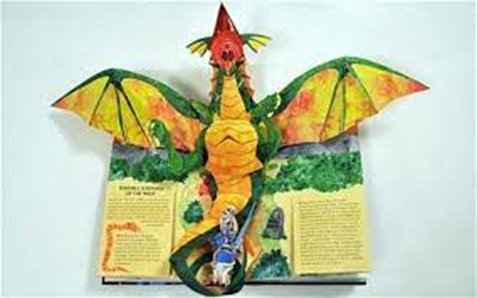
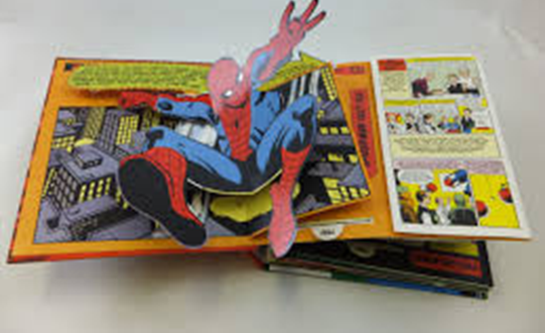
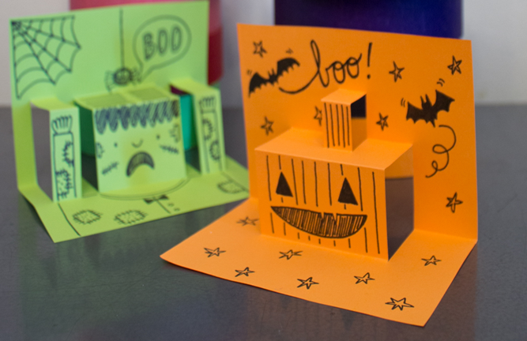
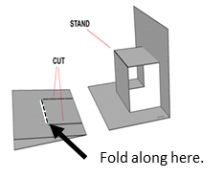
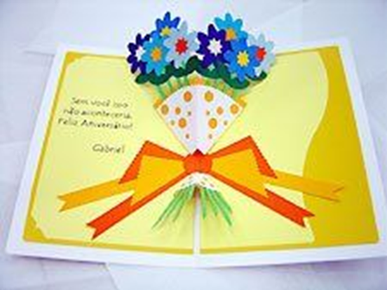
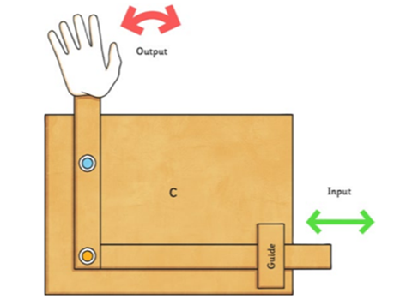
DT Mechanisms- Linkages and folds.
Glossary
Box fold- A type of pop up that creates a step.
Guide strip- Thin strips of card that keep other parts in place.
Lever- A bar which moves around a pivot.
Linkage- Created form connecting levers together.
Mechanism- A product that has parts that move together to create movement.
Pop up- A 3 dimensional feature.
Pivot- A part which allows a mechanism to rotate around.
Valley fold- A type of pop up that creates a V shape..
A pop-up book is 3 dimensional. It contain mechanisms to make pictures or text pop up or move. Box folds, V folds and linkages are common types of mechanism.
Box Fold Valley (V) fold
A linkage is the part of the mechanism used to join one or more levers to produce the type of movement required. They are connected by a pivot. Guide strips keep levers in place.

