Slide 1
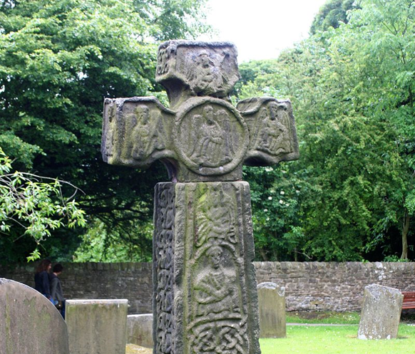
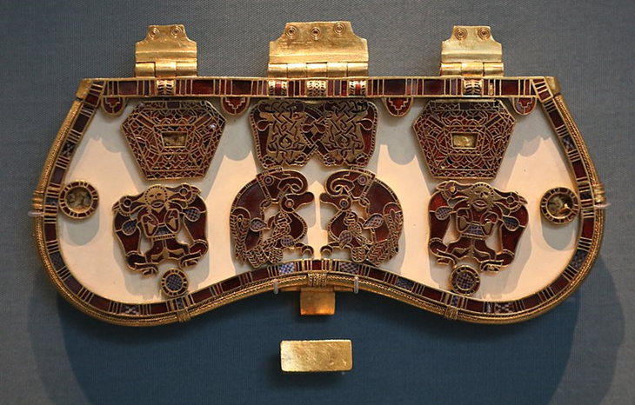
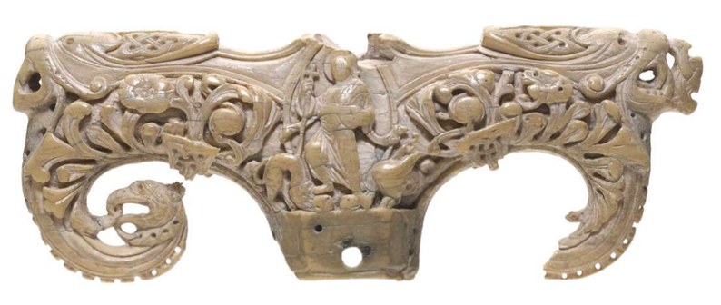
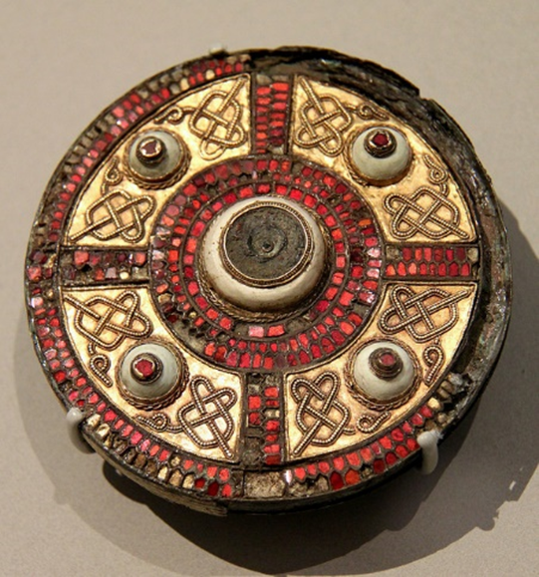
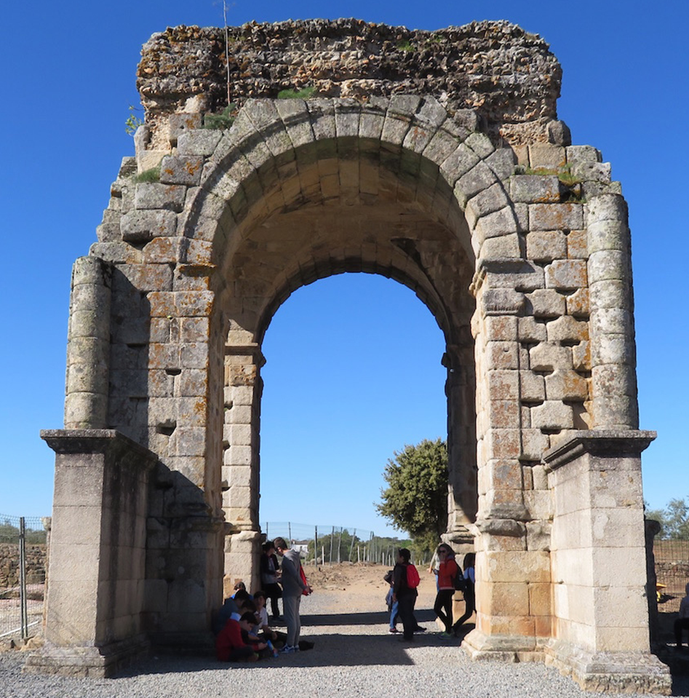
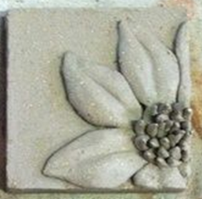
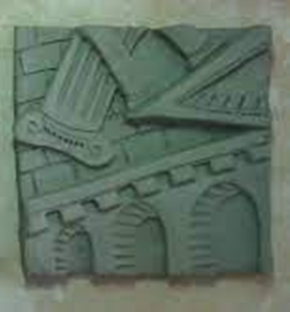
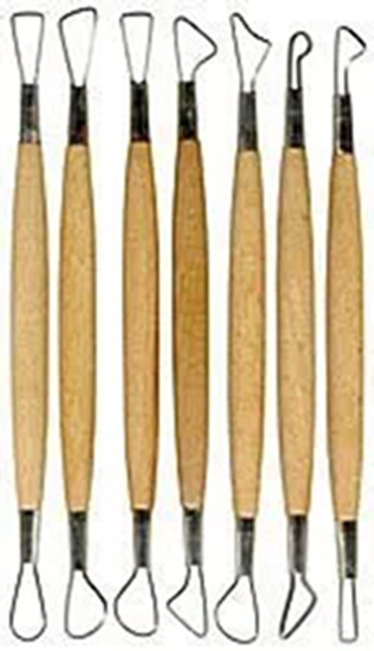
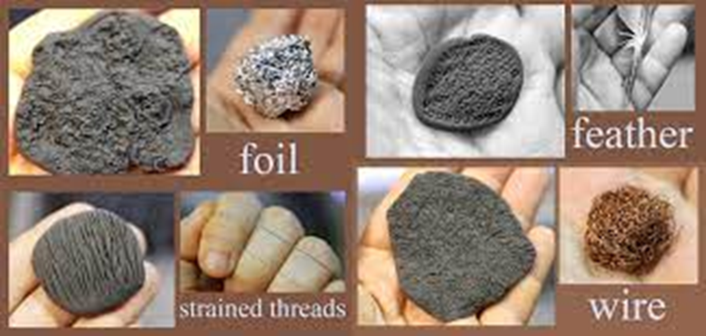
Art Knowledge Organiser- Clay relief
Glossary
Carving- Using a tool to scrape or shape parts of a material away
Gemstones- Precious stones like amethyst, orange amber and red garnets.
Ivory- hard, white material from the tusks and teeth of animals,
Loop tool- A wooden tool with a metal loop on the end.
Relief- A clay technique where the image is raised up from the base.
Slab- A piece of clay rolled out to an even thickness.
Texture- How something feels
The Anglo-Saxons made brooches, beads and gold ornaments. Broaches often featured gemstones for decoration. They created carvings of huge stone crosses with ornate patterns. They also carved ivory and bone using ivory from the tusks of walruses and bones from whales.
Pencil marks and lines of different thickness can show different textures such as cracks, chips and rough areas. Sketch the outline first then add different marks to show details:
Dots
Dashes
Scribbles
Relief is a technique where the images look like they have been raised up off the background tile. The term ‘relief’ is from the Latin verb relevo, to raise. You should sketch out your design onto a clay slab then scrape away the background with a loop tool.
A range of everyday objects can pressed into clay and be used to create brick textures, e,g foil, steel wire, sponge, fabric, finger tips etc.

