Slide 1
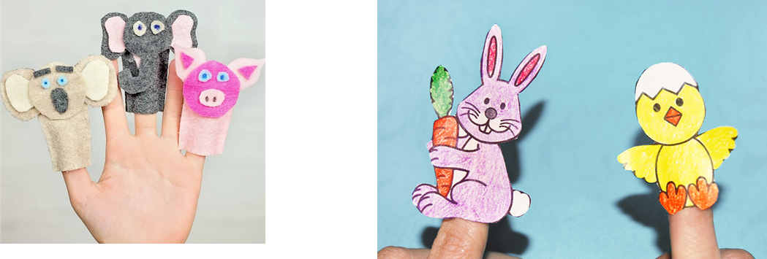
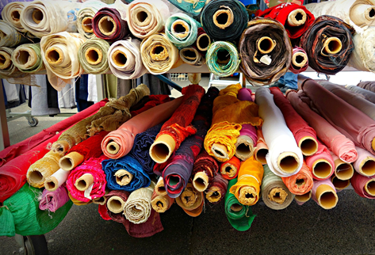
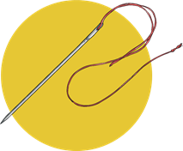
DT Product design-Finger puppets
Glossary
Designer- Someone who comes up with ideas for how something will be made.
Felt- A type of matted material.
Needle- A tool to with a hole at one end and a sharp point at the other
Product design – Planning and creating something that is going to be used.
Property –A quality such as shiny or waterproof.
Sketch- A drawing to show how a product will look.
Stitch- Using thread to join material.
Finger puppets are designed to be placed over individual fingers. They can only really bend up or down.
They have to be small enough to fit on your fingers and are made of felt or paper
.
Different materials have different properties. For example, they can be smooth, warm or waterproof.
There are different ways to join materials.
Running stitch uses small stitches in a straight line.
This part of a needle is called the eye. It’s where the thread goes through.

