Slide 1
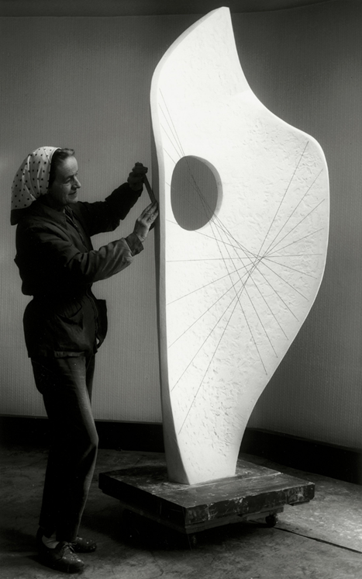
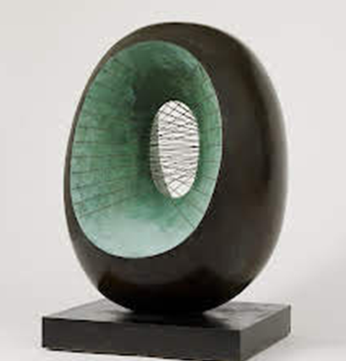
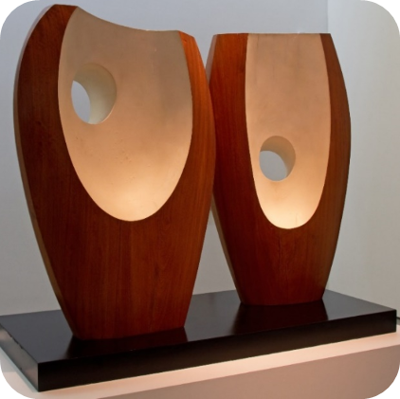
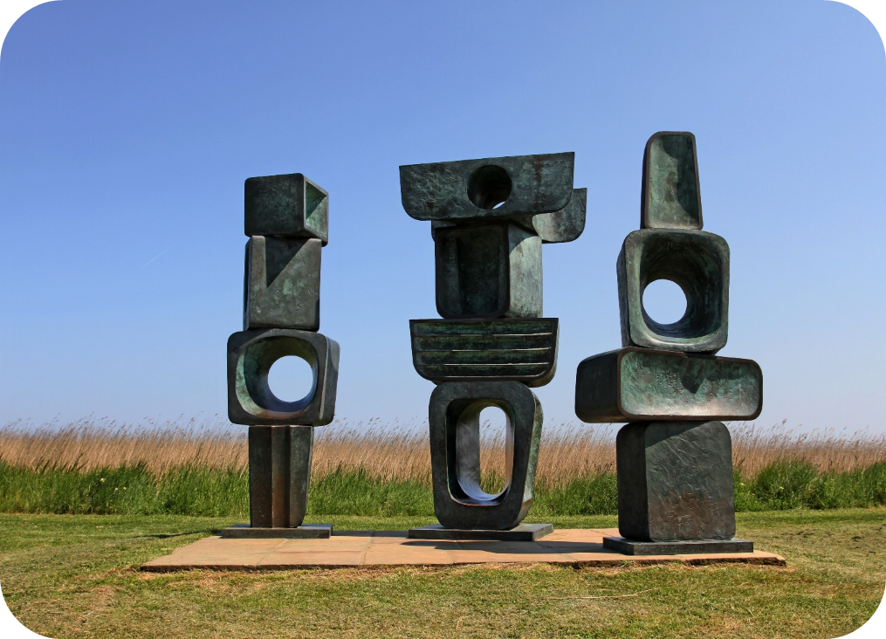
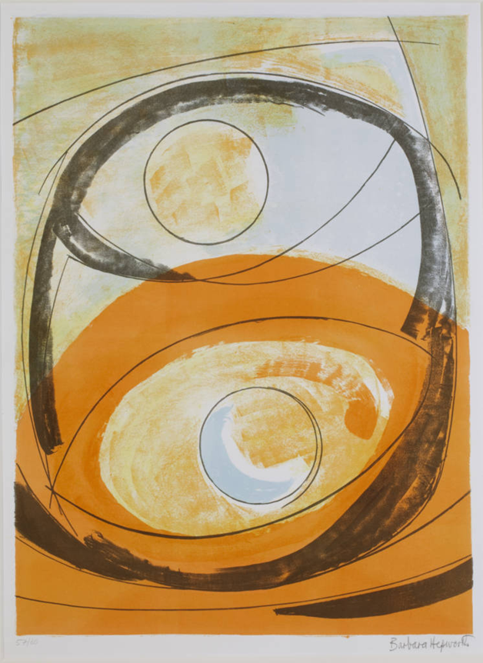
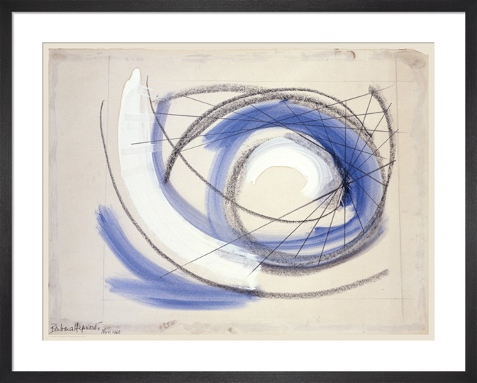
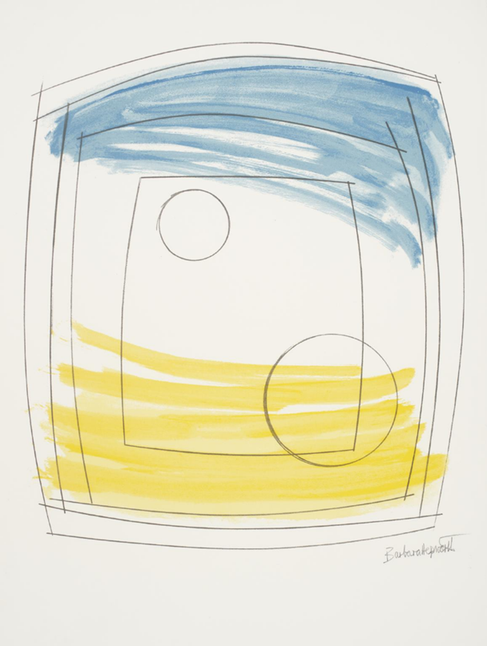
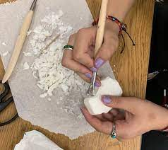
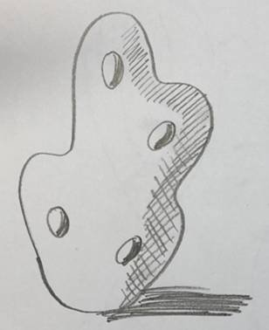
Glossary
Cross hatching- Closely drawn crossed lines.
Directional shading- Shading that uses marks or lines all following the same direction.
Form- 3 Dimensional
Layout- Where images are placed on the page.
Mould- To form an object out of a material.
Sculpt- To shape an object.
Sculpture- A 3 dimensional piece of art.
Smudging- A technique where you rub the pencil or pastel to soften the edges.
Art Knowledge Organiser-Barbara Hepworth
Painting and sculpture
Barbara Hepworth is one of the most famous female artists and is known all over the world. She was from England and was most famous for her abstract sculptures.
At the outbreak of the Second World War, Hepworth and her family moved to St Ives in Cornwall Here she wanted her sculptures to look like they had been formed by the landscape, like pebbles found on a beach. Many of her sculptures were carved from stone or wood
Scrapers, knives and other simple tools can be used to sculpt and mould soap. Sculptures need a flat base to stand up.
Smudging, hatching, cross hatching and directional shading techniques can show form.
Hepworth wanted to create art that was calm, that people could enjoy looking at and wouldn’t make them feel uncomfortable so she used simple shapes and layouts with few colours.

