Slide 1
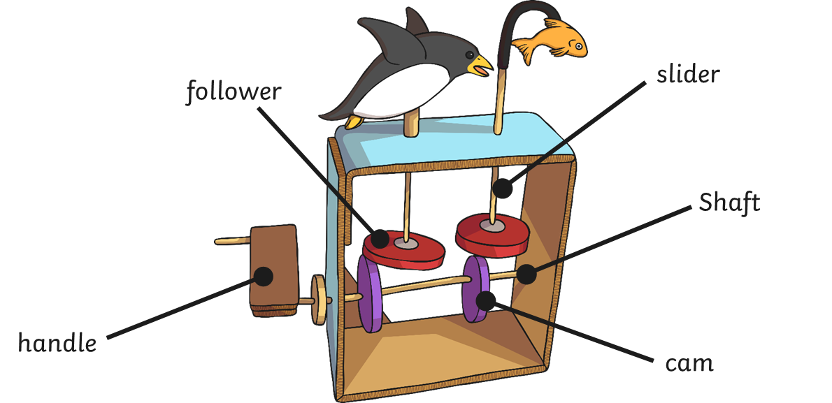
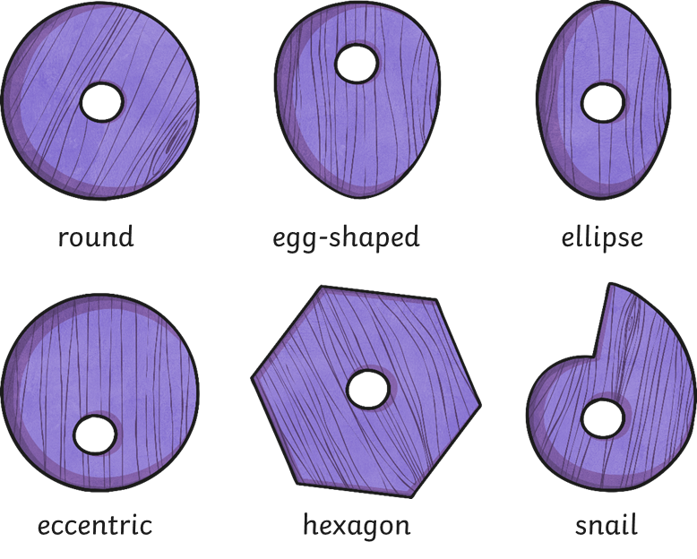
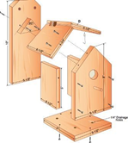
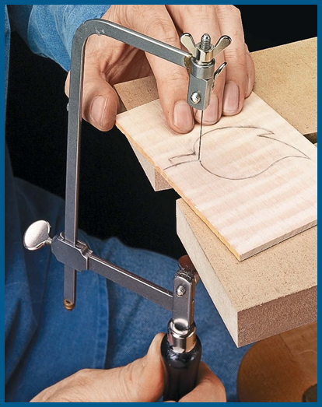
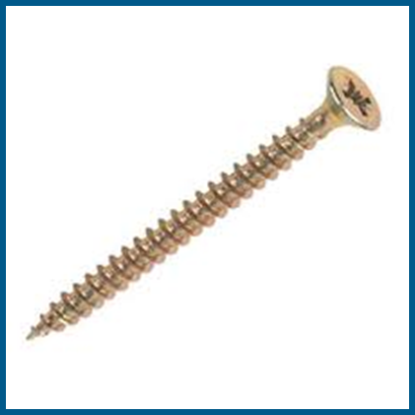
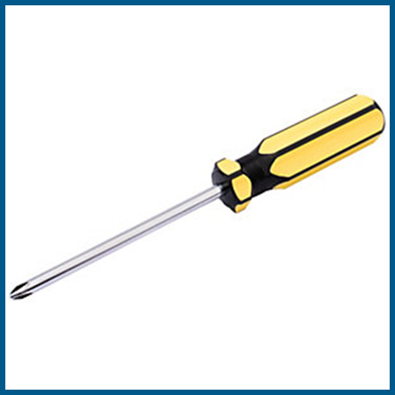
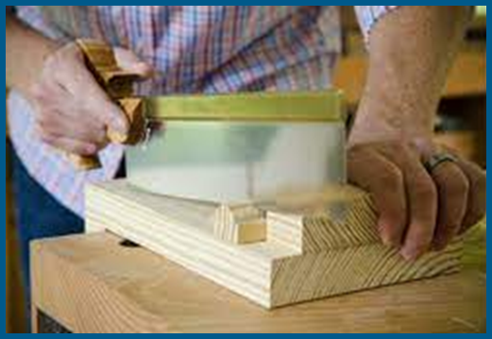
DT Mechanisms- Cam toy
Glossary
Cam- A rotating part in machinery.
Exploded diagram A detailed diagram that shows each component and how it fits together.
Follower- Part of a mechanism that touches the cam
Mechanism- A system of moving parts.
Slider-This attaches to the follower and rises and falls..
Shaft- A pole that the cam fits on to.
Cam toys are hand powered mechanical toys. Rotary (circular) motion turns the handle and the shaft turns the cam round. This hits the follower and moves it in a linear (up and down) motion. The slider that is attached to the follower therefore moves in an up and down motion causing the toy to move in the same motion.
Different shaped cams create different types of movement.
Smooth
Bumpy
Jerky
Fast
Slow
Even
Designers use exploded diagrams to show users how to make their products
Screws have a spiral pattern called a thread which runs around the screw making sure it fastens securely into wood.
Screwdrivers drive the screw into the wood. There are different ‘head’ shapes to fit different screws.
A bench hook enables a piece of wood to be held firmly in position on a workbench while it is cut.
Coping saws have
thin and narrow blades which are used for cutting curved shapes.

