Slide 1
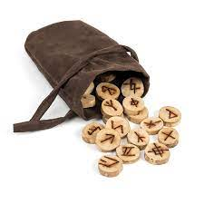
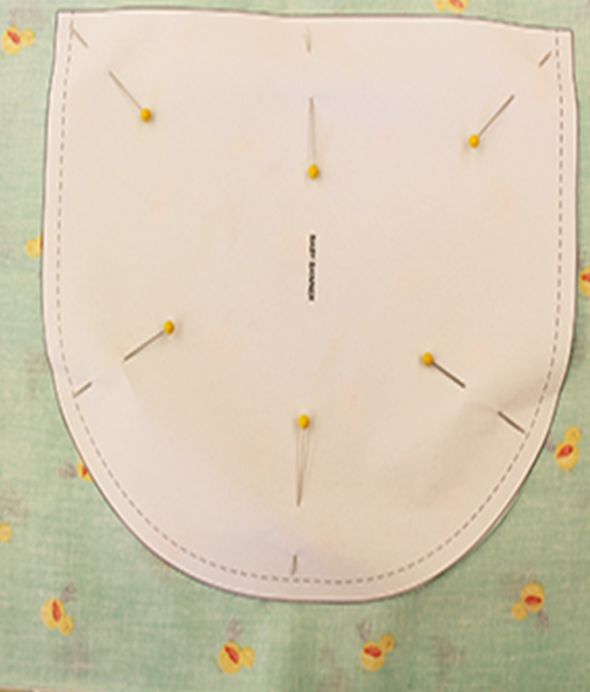
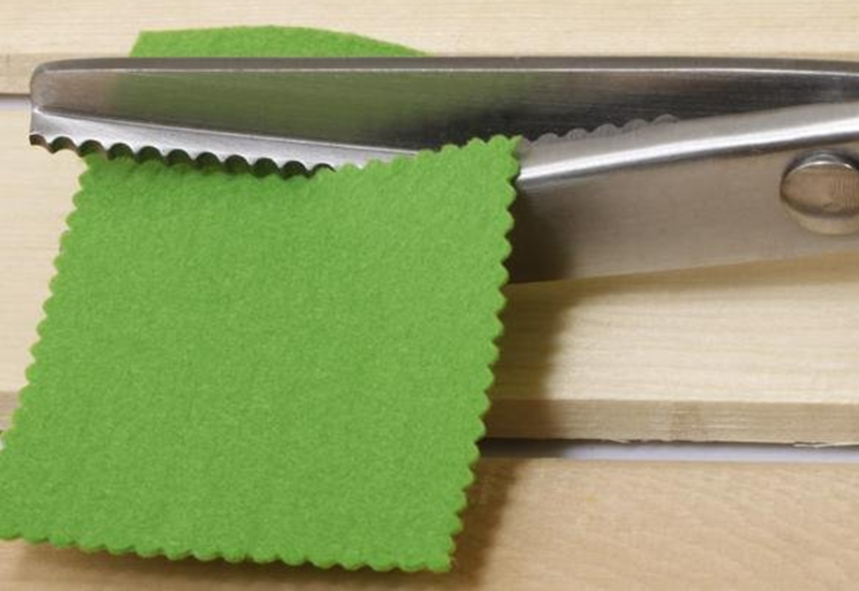
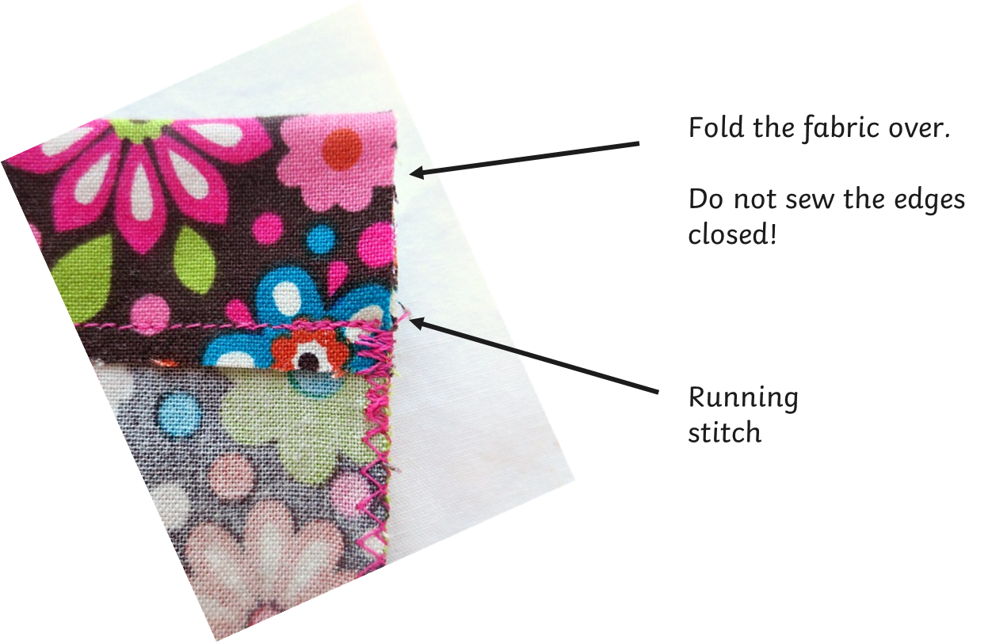
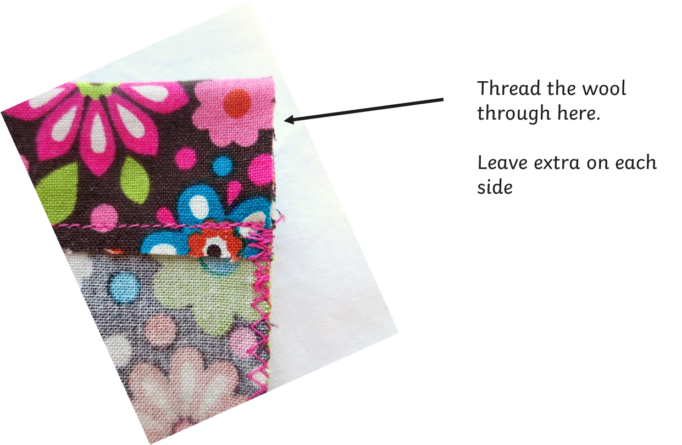
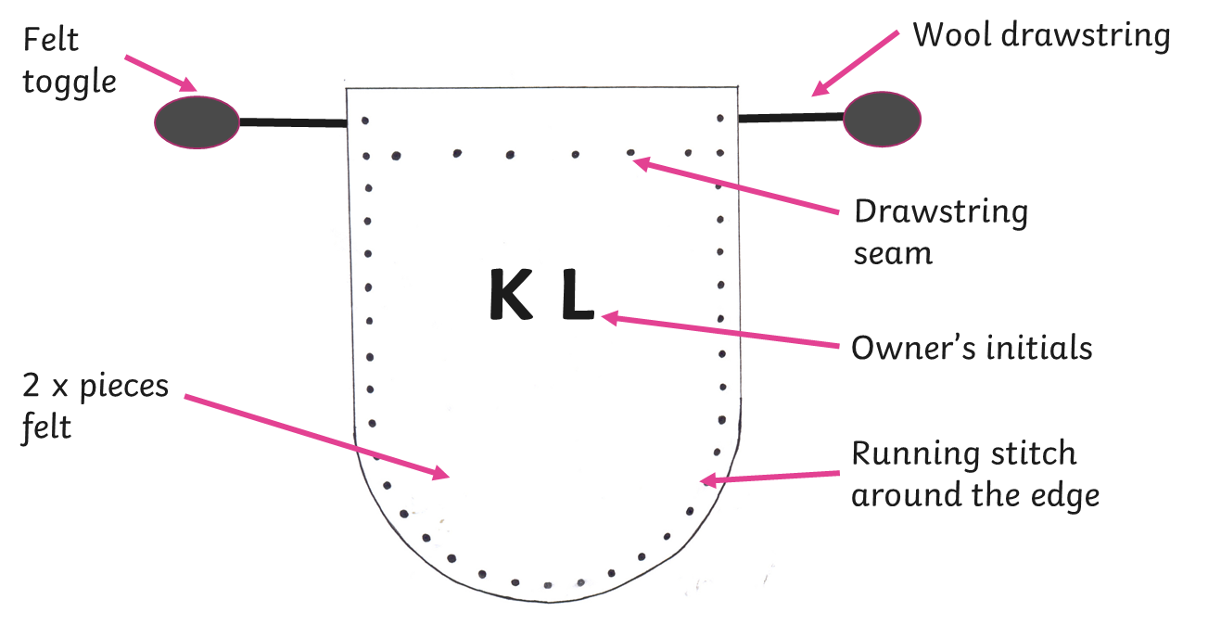
Glossary
Drawstring- Thick thread inside a seam. You pull them together to close the pouch/bag
Fraying- Unravelling
Pinking shears -special zig zag scissors which stop the fabric fraying.
Seam- a line where two pieces of fabric are sewn together.
Template- A paper guide which helps you cut out a piece of fabric the correct size and shape.
DT Product design
A template or pattern piece is a paper guide which helps you cut out a piece of fabric the correct size and shape. They are pinned to the fabric so they do not move as you trace and cut around them.
Pinking shears help to reduce fraying on the edge of fabrics.
Anglo Saxon Rune Pouches had a drawstring sometimes with toggle and were made of soft leather or suede.
Sketches can be labelled to show which materials and joining techniques will be used to make each part of a product.
Creating a seam for a drawstring.

