Slide 1
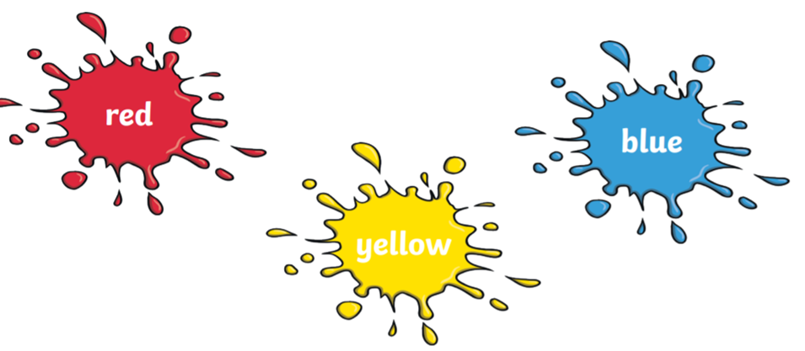
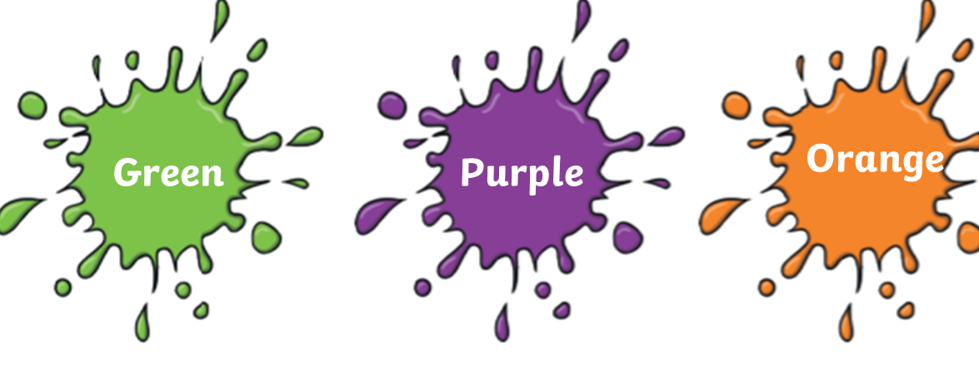
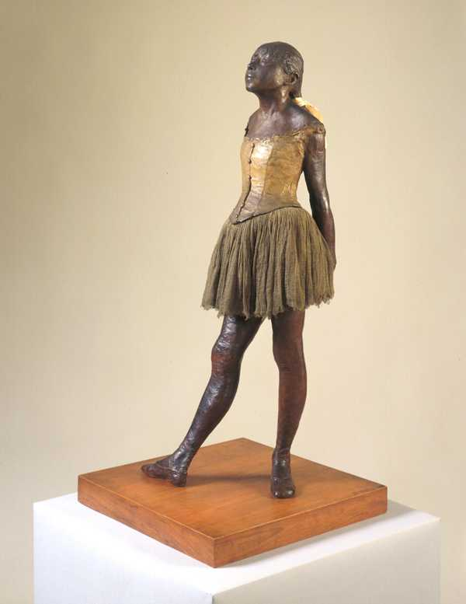
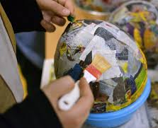
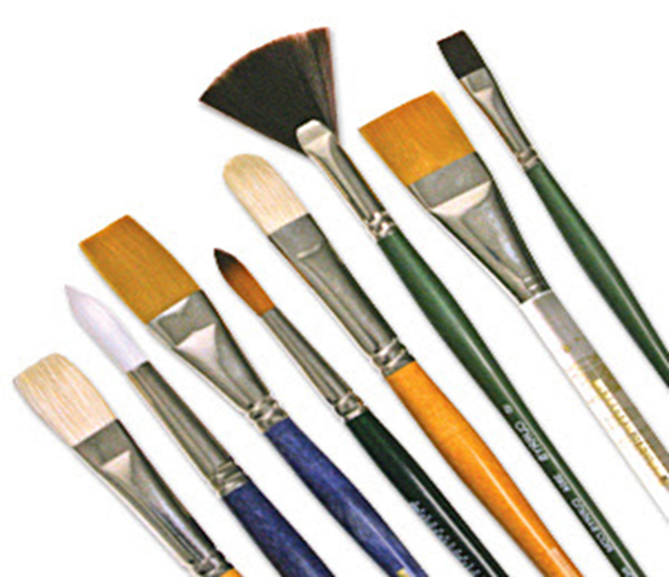
Art Knowledge organiser
Painting and Sculpture
Glossary
3 Dimensional - Not flat.
Dab- To lightly press
Papier mache- a sculpture made from paper and glue.
Primary colours- These colours cannot be made by mixing any other colours.
Secondary colours- Made by mixing other colours together.
Sculpture- A type of art that is not flat.
Sweep- Move from side to side.
Primary colours cannot be made by mixing any other colours.
They are red, yellow and blue.
Secondary colours are made by mixing other colours.
Blue + Yellow = Green
Red + Blue = Purple
Red + Yellow = Orange
You can sweep or dab the paint brush
Sculpture is a type of art that is 3 dimensional. Papier mache is a sculpture technique that uses layers of paper and glue.

