Slide 1
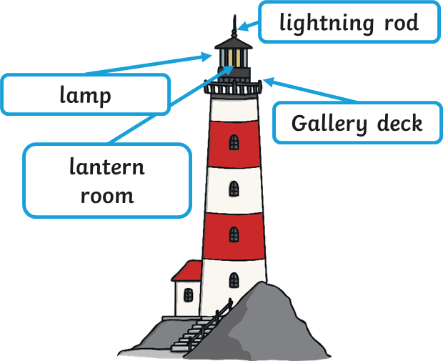
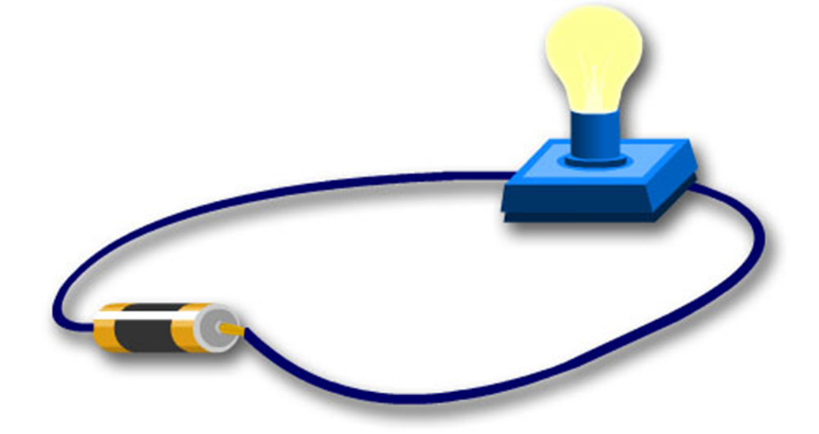
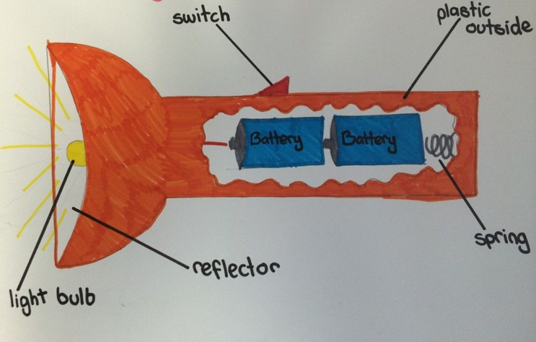
DT Structures- electrical systems
A lighthouse structure is a cylinder shape that is wider at the bottom.
This makes it more stable when waves are crashing against it.
It needs a lamp to help sailors spot dangerous rocks.
Glossary
Circuit- A complete path for electricity to flow along.
Cross sectional drawing- This shows the inside of a product or structure.
Cylinder –A tube shape
Stable –If a structure is stable it wont fall over or collapse.
Strengthen – To make something stronger.
Structure – Something that is built and made of several parts
An electrical circuit should have no gaps.
The power travels from the battery along the wires to the bulb.
A cross sectional drawing will show the inside of a structure or product.

