Slide 1
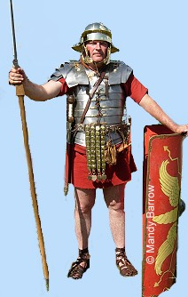
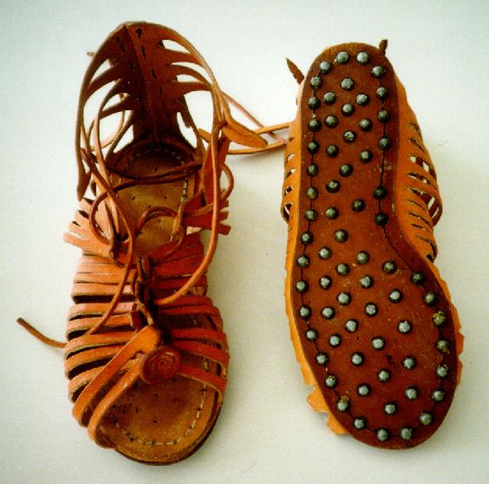
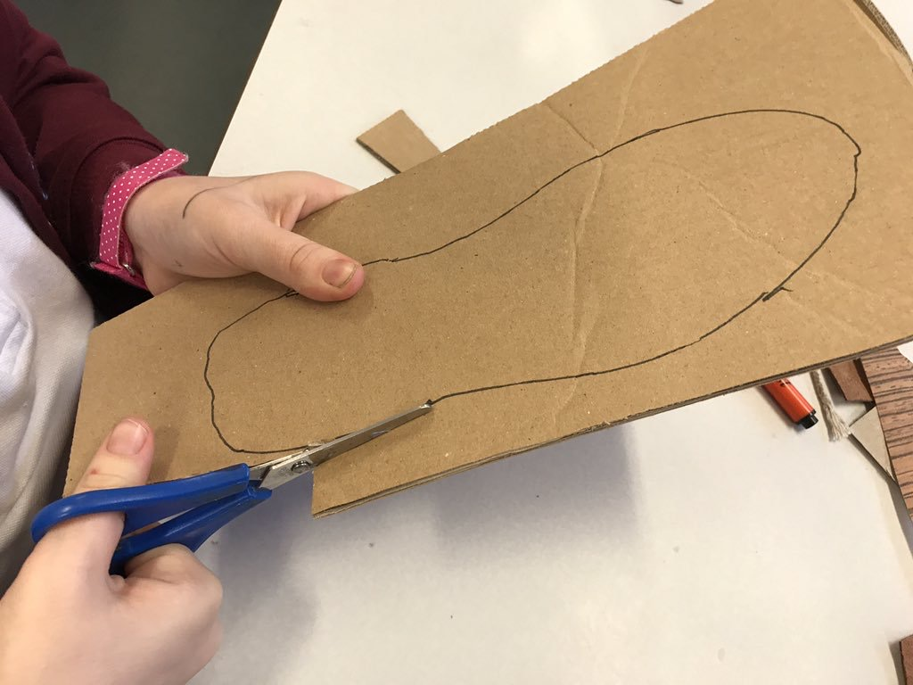
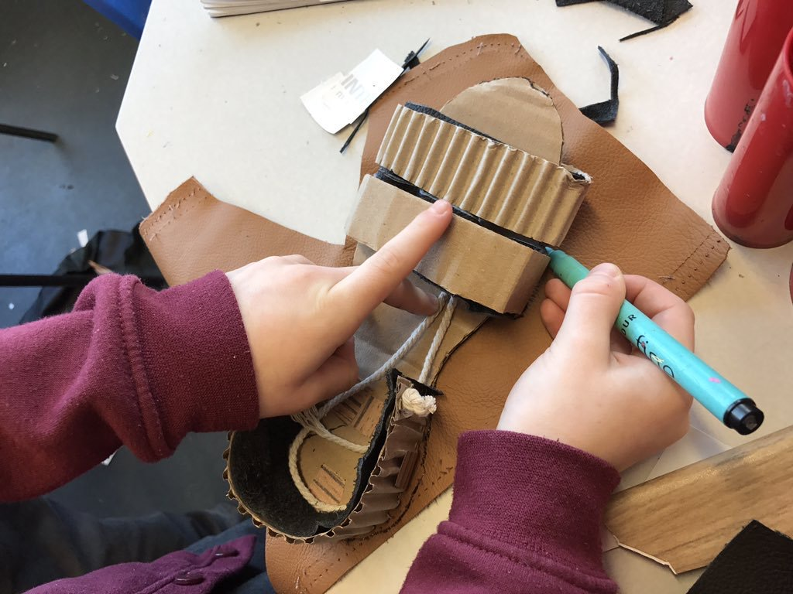
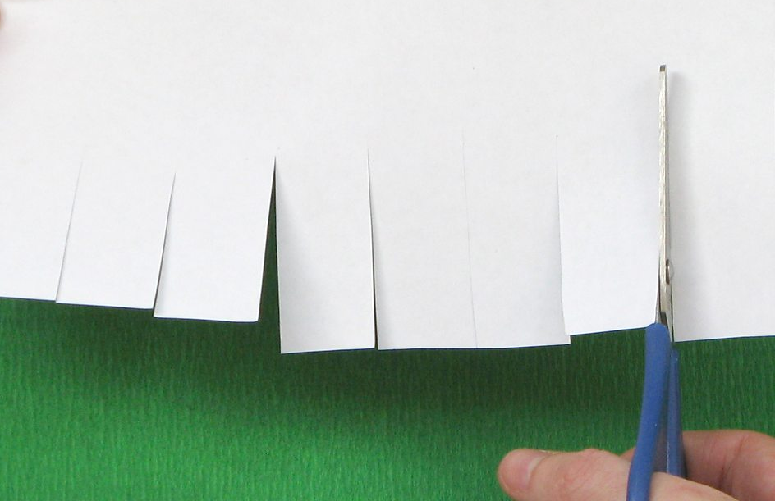
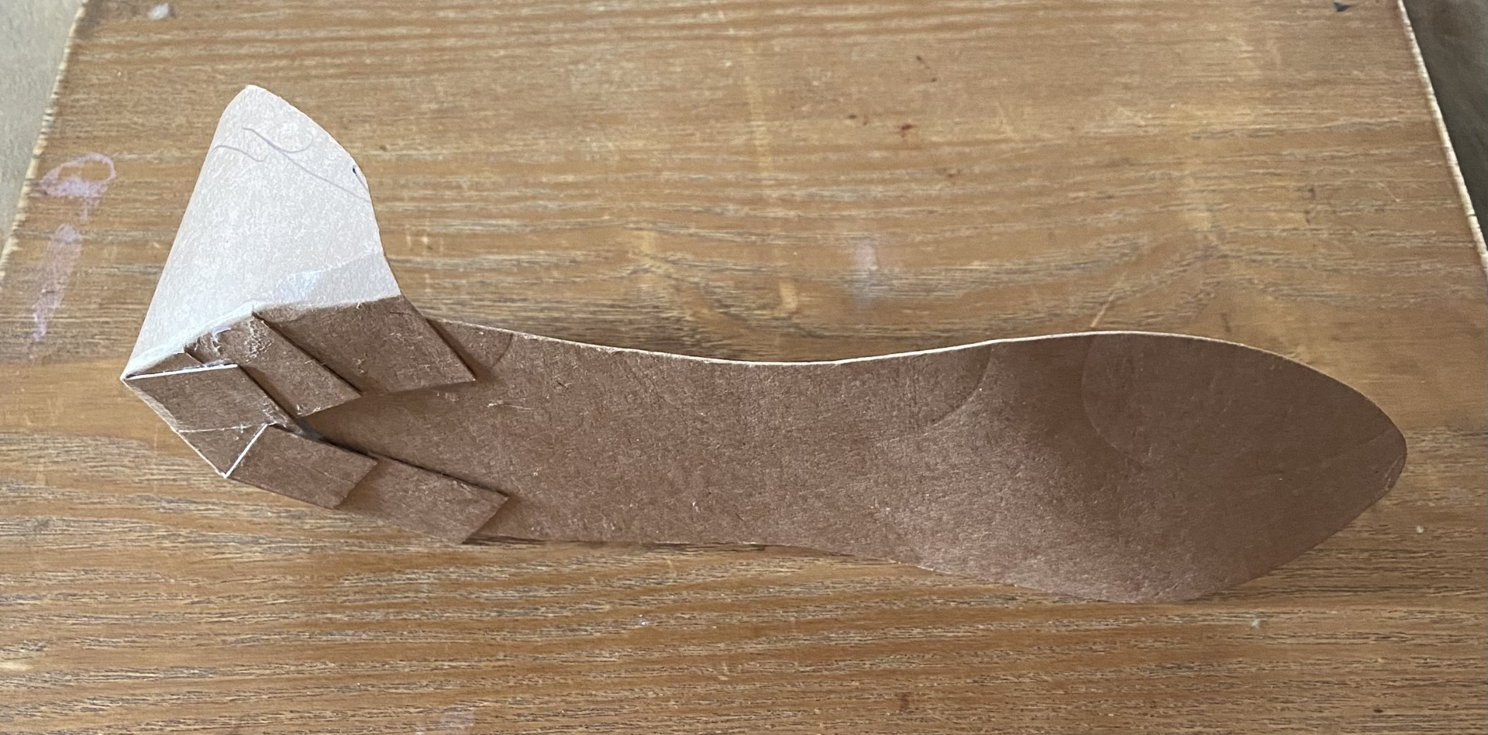
Glossary
Annotate-Adding writing to a drawing to explain an idea in more detail.
Fringe- Equally sized cuts in paper that allow you to bend paper and card
Hobnails- Short heavy-headed nails used to reinforce the soles of boots.
Leather- Material made form an animal’s skin.
Prototype-A small model to show your initial ideas.
Sole- Bottom of the sandal where the straps and heel guard attach to.
DT- Product Design
Roman military sandals were strong and had a thick sole with soft leather straps.
They laced up the front and had brass hobnails on the sole to help them last longer, provide grip and protect soldier’s feet.
The sole should be cut slightly bigger than your foot. Then the straps, heel, laces and hobnails can be added to it.
A fringe can be used to attach the heel to the sole.

