Slide 1
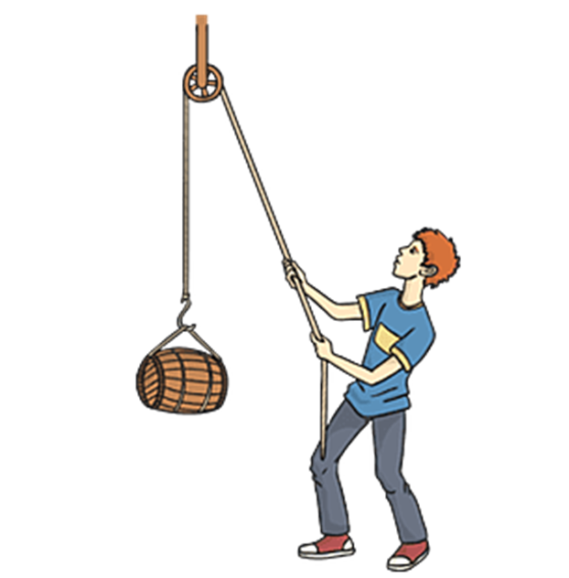
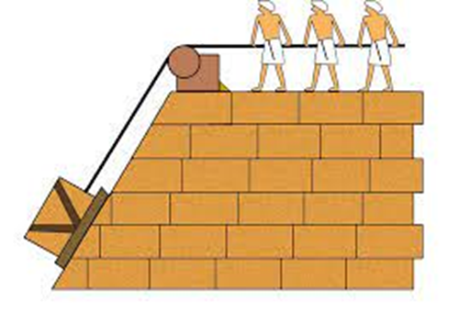
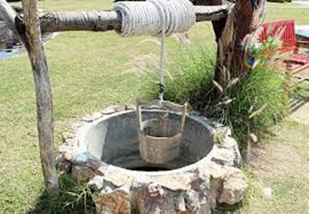
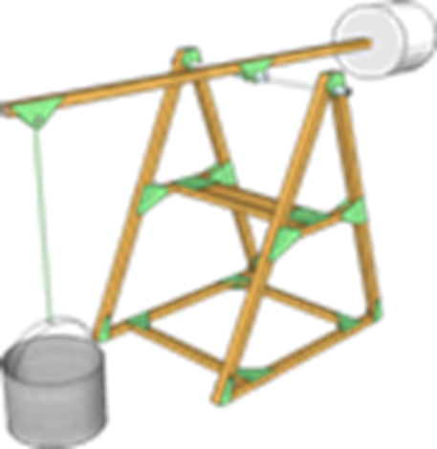
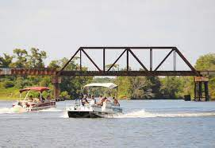
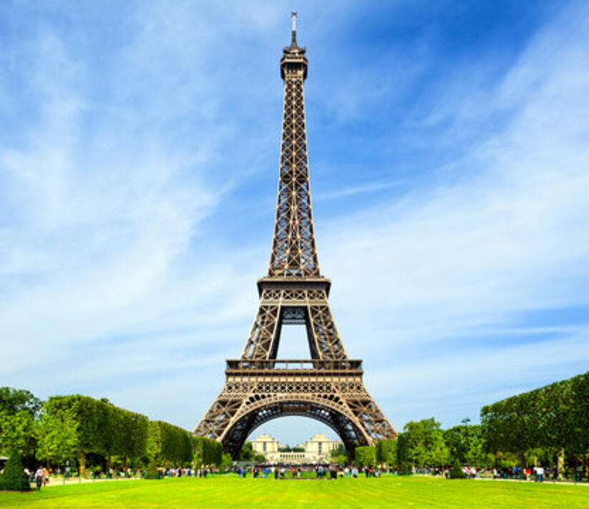
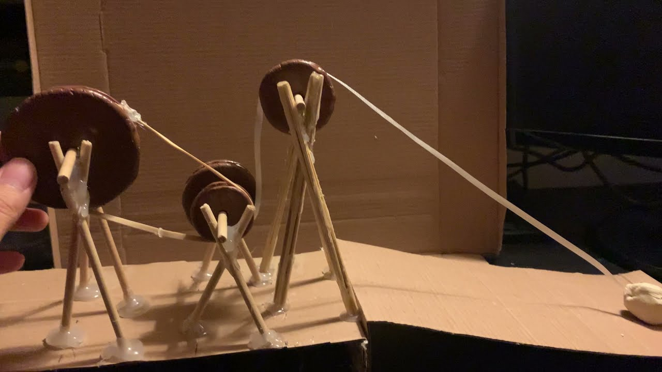
DT Structures- Pulleys
Glossary
Force- A push or pull
Groove- A narrow cut in a surface.
Load- The object being moved.
Mechanism-A product that has parts that move together to create movement.
Prototype- A small model to show your initial ideas.
Pulley- A mechanism that uses a rope placed over a wheel.
Stabilise- Stop something from falling over.
A pulley is a simple mechanism that allows a small amount of force to lift a larger load. The wheel has a groove around the edge that can hold a rope. To lift the load, you pull the rope downwards. A simple pulley just changes the direction of a force. For example, a pulley that pulls up a bucket of water from a well, or the pulley that helps you raise the flag on a flag pole
Triangles can help to stabilise a frame. Bridges and towers are good examples of triangles being used to stabilise frames. Attaching a base also makes them stronger.
A prototype is an initial idea used to test a product’s design.
Sometimes products are made out of cardboard first to see what they would look like.

