Slide 1
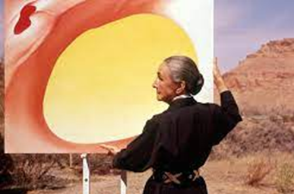
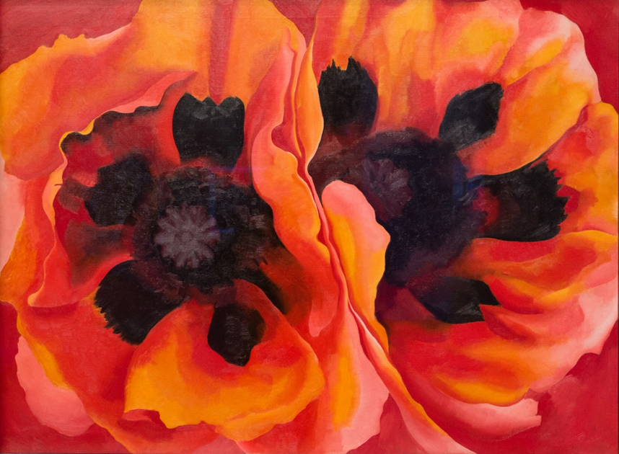
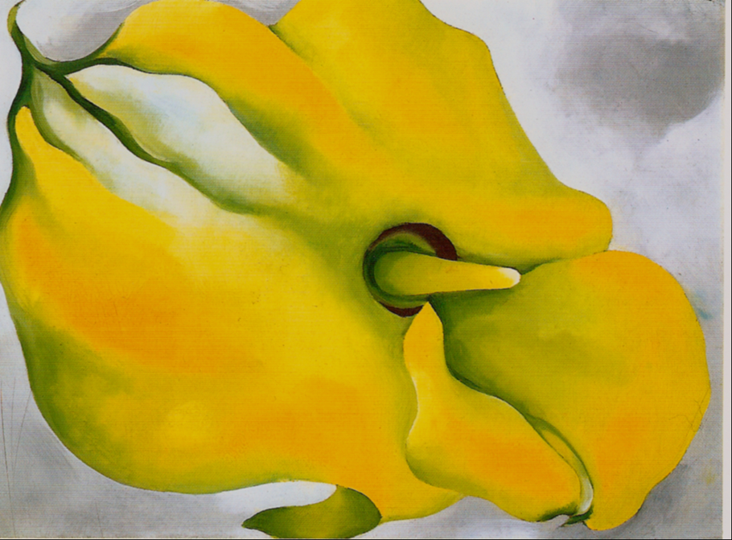
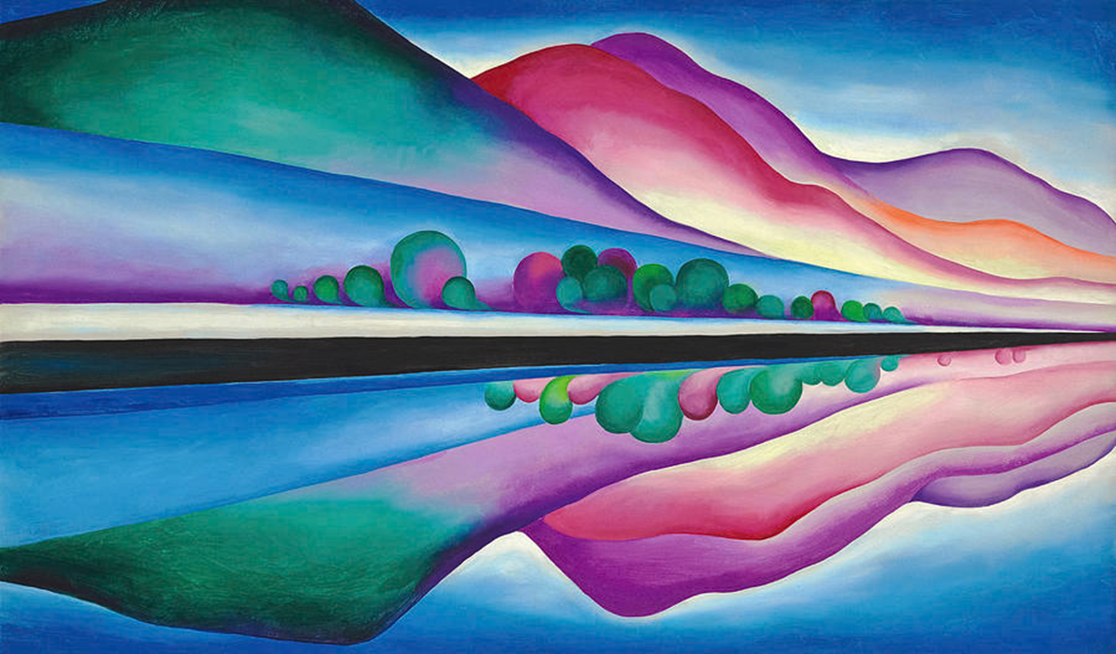
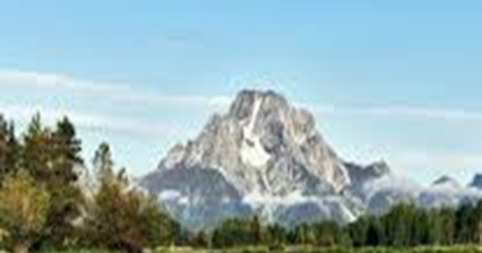
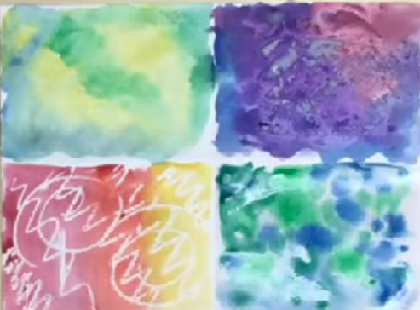
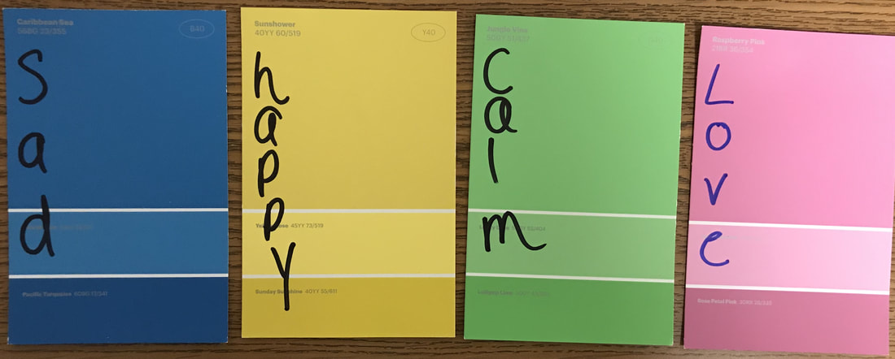
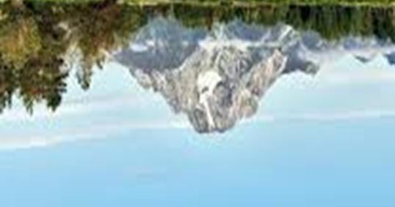
Art Knowledge Organiser Drawing and Painting
Glossary
Abstract- An art movement where paintings are not realistic.
Graduated- A technique that moves from a vivid colour to a paler colour gradually.
Mirror line- A line that shows both sides are symmetrical.
Modernism- art that rejects traditional techniques
Resist- A technique that repels (withstands) paint.
Georgia O’Keeffe was born in 1887 in Wisconsin, USA. In the 1920’s art was exciting. Artists were using colours, shapes and brush marks to express meanings, ideas and feelings. This encouraged Georgia to experiment with her own style- a mixture of abstract and realistic art. Georgia is recognised as being a pioneer of American modernism.
Georgia began experimenting with painting large scale, close up views of flowers. She used paints in vibrant, bold colours and created over 200 paintings.
Georgia based many of her paintings on the areas around Lake George Village in New York. She also enjoyed painting mountains.
Watercolour techniques
-Wet on wet
-Dry brush -Adding salt -Graduated wash -Tissue texture -Plastic bag texture -Wax resist
To draw a reflection in water, you draw a symmetrical copy under the mirror line.
Different colours can evoke different feelings.

