Slide 1
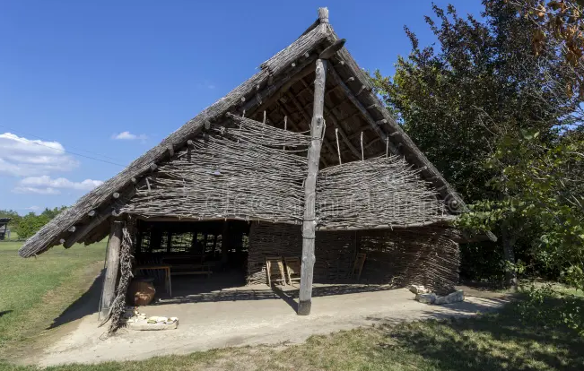
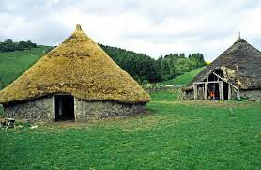
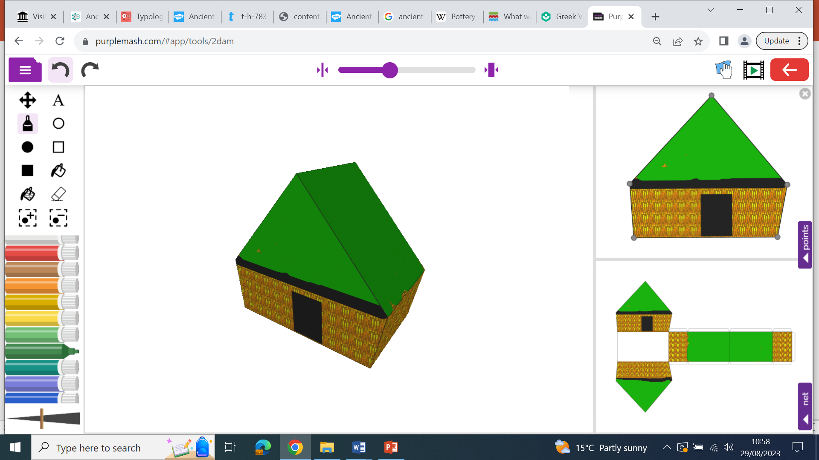
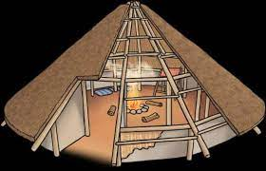
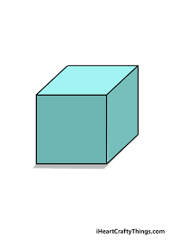
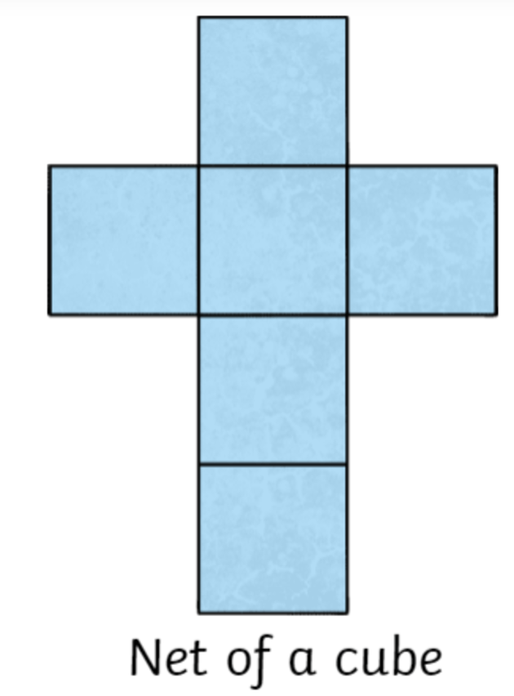
DT Knowledge Organiser-Structures
Glossary
Architecture- Buildings and physical structures.
Computer aided design (CAD) -Shows how a product will look when it is made.
Cross sectional drawing- Shows the inside of a product or building.
Daub- A mixture of: manure, clay, mud and hay.
Design criteria- A list of objectives to be met.
Net- The 'net' of a shape is used to describe what a 3D shape would like if it was opened out and laid flat.
Wattle- Sticks and branches woven together
Stone Age houses were a lot like the ones we live in today compared to other periods from this time.
Stone Age houses were built out of wood, wattle and daub. Some houses were made out of stone too and roofs were commonly made out of straw. Doorways were usually low to the ground. Often, there weren't any windows.
Cross sectional drawings add inside details.
The 'net’ is what a 3D shape would like if it was opened out and laid flat.
Computer aided design (CAD) can show how a product will look when it is made.

