Slide 1
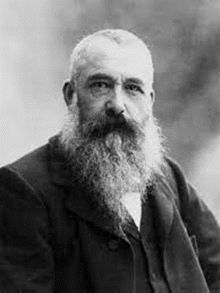
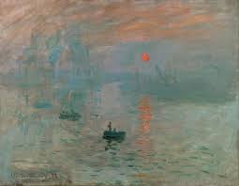
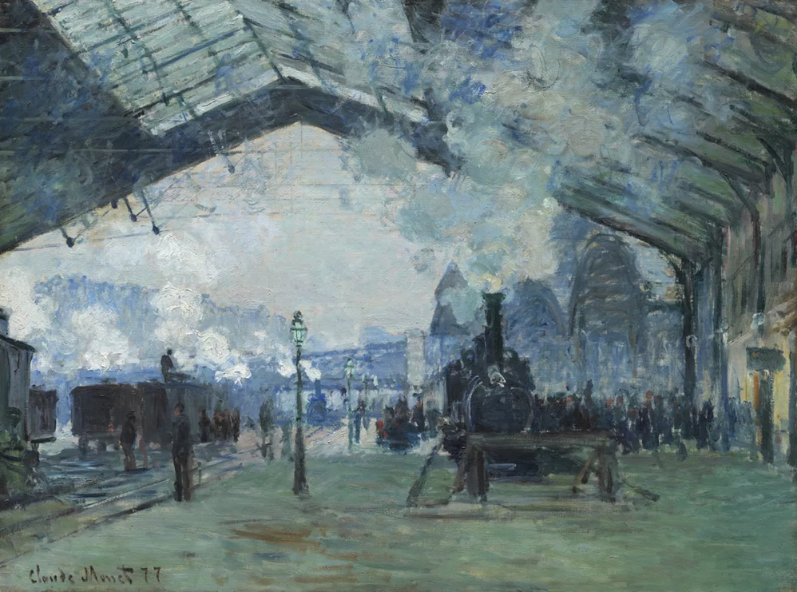
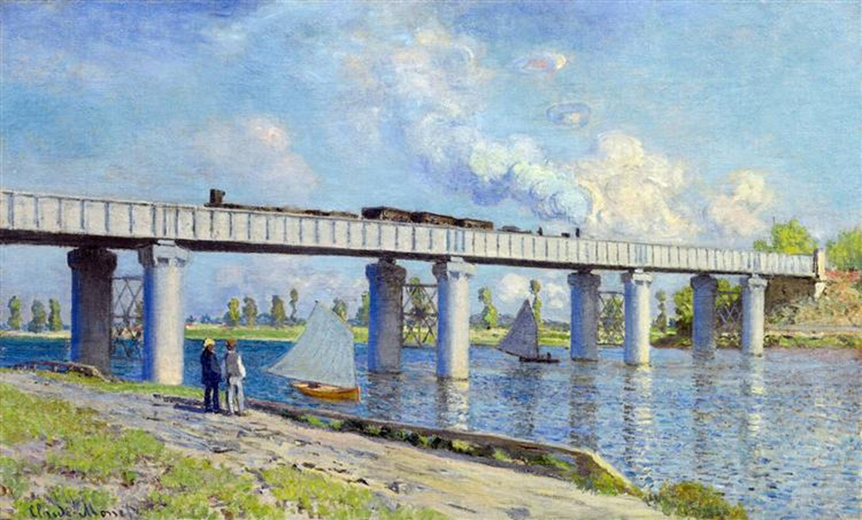
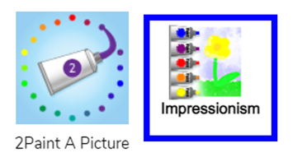
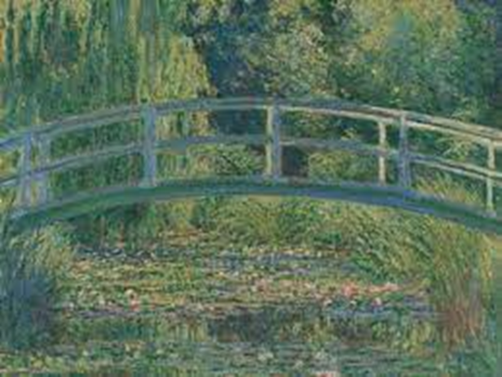
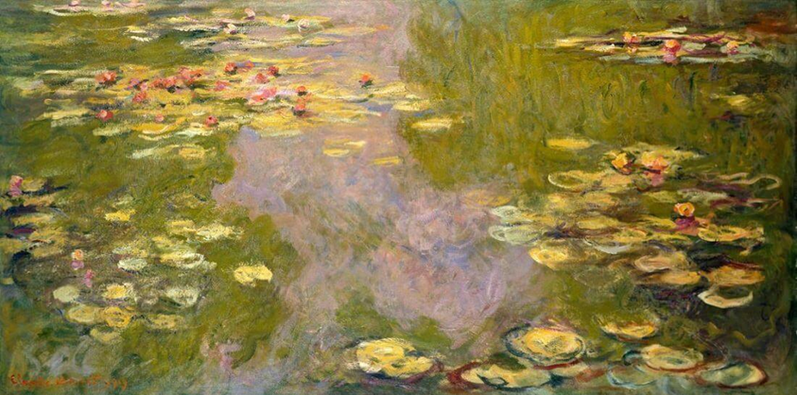
Art Knowledge Organiser- Painting
Glossary
Dab- To lightly press.
Edit- To change something.
Impasto- A painting technique where thick dabs of paint are built up on the page.
Impressionism- An art movement made popular in France.
Plein air- The act of painting outdoors.
Software- A computer program
Impression Sunrise 1872
Arrival of the Normandy Train,
Gare Saint-Lazare, 1877
Railway Bridge at Argenteuil 1873
Monet was an impressionist painter born in Paris in 1840. Impressionism started in the 1860’s in France after a group of artists did not want to paint realistic pictures anymore. They preferred plein air to painting in a studio indoors. Mary Cassatt, August Renoir and Edgar Degas are some famous impressionist painters. During the industrial revolution, paintings started to feature bridges, trains, workers and factories. The impressionists used thick layers of paint with dabs of colour which they did not bother to mix colours in a palette but instead mixed on the canvas. Brush marks were left visible. This technique is often referred to as impasto.
.
As an artist, Monet was really interested in showing the effect of changing light on a scene. This meant that he often painted the same scene at different times of day. Among the best known examples are his series of haystacks 1890–1891.
Photos can be uploaded onto editing software and used as a template to draw onto.
The colour, size of brush and level of water can be changed to create a digital impressionist image.
Monet’s paintings of water lilies in his garden in Giverny occupied him continuously for the last 20 years of his life.

