Slide 1
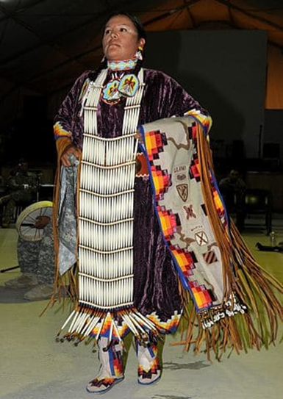
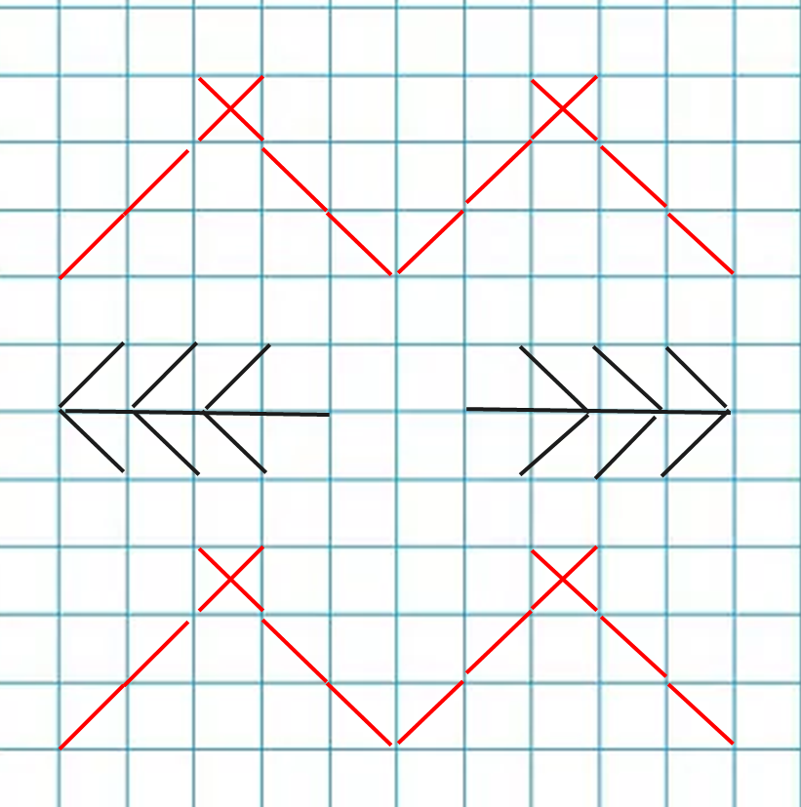
Art Knowledge organiser
Native American art and Cross stitch.
Glossary
Binca- A stiff fabric with large holes used for cross stitch.
Craft- A skill that requires knowledge of how to make something by hand.
Cross stitch- A type of craft that uses stitches to create a pattern
Geometric- A 2 dimensional shape
Stitch- Loops of thread that join fabric or create a pattern.
Thread- Strands of fibre used for sewing.
Traditional Native American crafts include woven baskets, cross stitched blankets, slippers, clothing and bowls.
Black, red, yellow, orange and blue are popular colours as are geometric shapes and animals.
Types of stitch
Running
Half cross
Cross
Arrowhead
Herringbone
Patterns can be marked out on squared paper.

