Slide 1
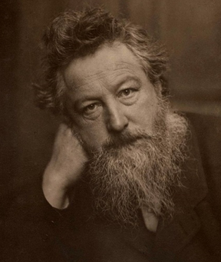
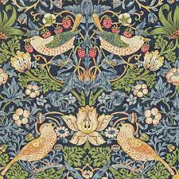
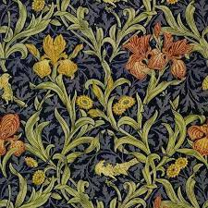
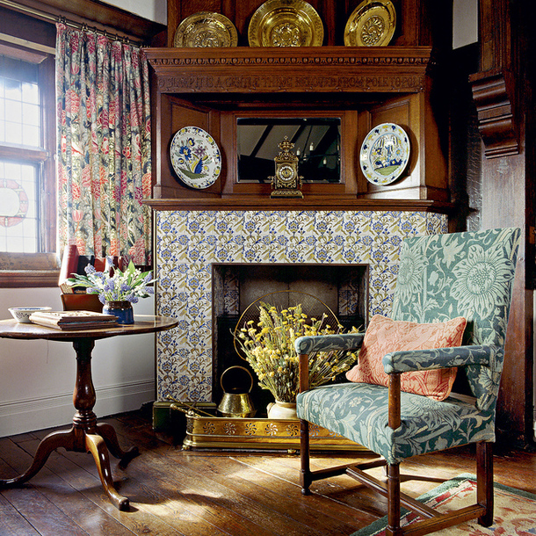
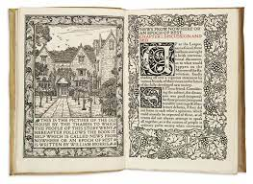
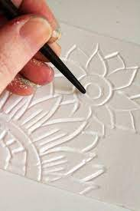
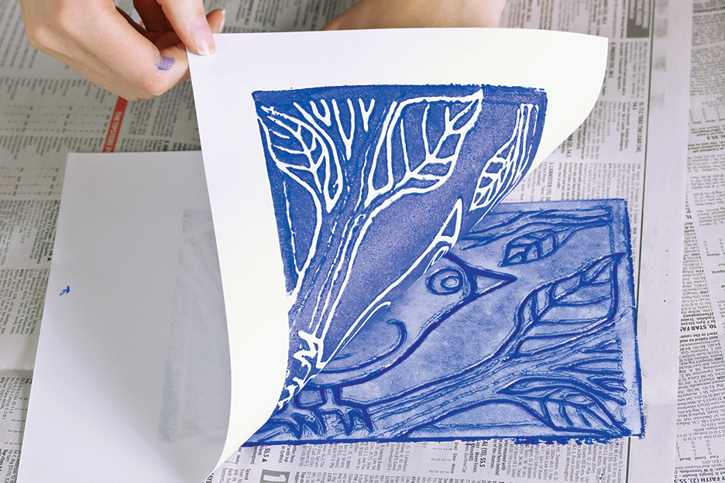
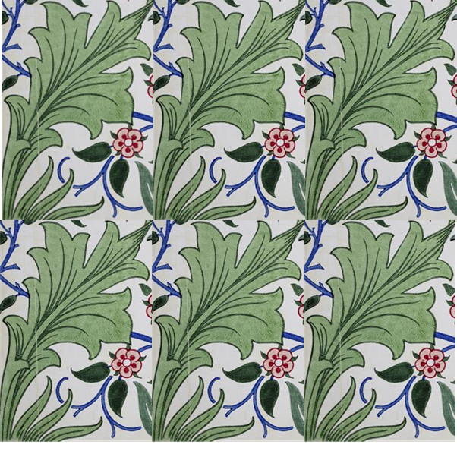
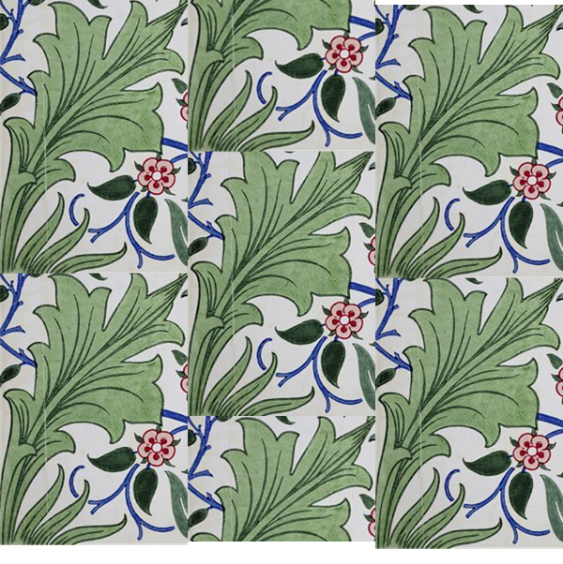
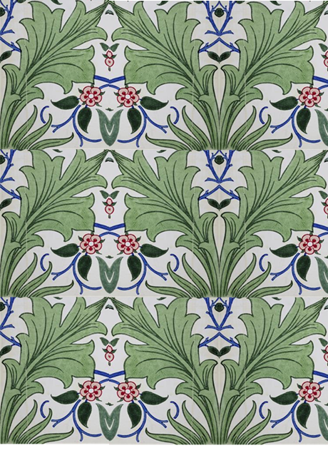
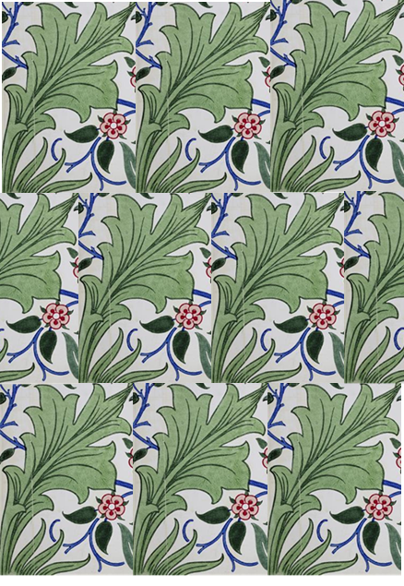
Art Knowledge Organiser
William Morris-Printing
Glossary
Designer- Someone who creates ideas for a final product.
Illustrations- Pictures for books
Floral- A pattern consisting of mainly flowers
Printing plate- You apply paint or ink and press this onto the paper. Repeat
Scale- How big or small the pattern is.
William Morris was born in 1834 and was an influential designer during the Victorian/Industrial era. He designed many products such as wallpapers, fabrics, furniture and stained glass windows. He is particularly remembered for his floral patterns.
.
William Morris wrote many poems during his lifetime. He set up a company called the Kelmscott Press in the early 1890’s. This company published books which contained beautiful illustrations.
Morris was a founding member of the Art & Crafts Movement. This group of designers went back to making traditional hand made items rather than machine made goods which had become popular during the industrial revolution.
Relief prints use a foam board as a printing plate. You press down where you don’t want the colour to print.
Patternator is an app that can digitally create a range of repeated patterns.
Types of repeat pattern
Block Half Drop Mirror Half Brick

